Slide 1

Toward the Open Future We Make
ALT-OER 25
24 June 2025 London, England
Dr. Connie Blomgren
Paola Corti
Jonathan Poritz
Except where otherwise indicated, this slide deck is by Connie Blomgren, Paola Corti, and Jonathan Poritz, is released under CC BY-SA 4.0, and can be found at https://poritz.net/j/share/ALTOER25panel/.

Slide 2
Panel Overview
How it came together
Podcast style:
  5 areas from 2024 keynote Catherine Cronin & Laura Czerniewicz Open Education at a Crossroads
3 Panelists = interdisciplinary/transdisciplinary
Panelists opening comments
Rotation through the 5 areas with 2 commenting & 1 moderating
Panelist’s takeaways
Audience contributions
Notes:
Connie Each gives 2-3 minute orientation; 5 points ( 7-8 minutes)
35 minutes total
one slide for each person = 3-4 min each
Audience participation = open up to broader comments (10 minutes)

Slide 3
Polycrisis
Wikipedia: Polycrisis - https://en.wikipedia.org/wiki/Polycrisis
Polycrisis.org explanation - https://polycrisis.org/lessons/what-does-the-term-polycrisis-mean/
Cambridge Dictionary definition - https://dictionary.cambridge.org/dictionary/english/polycrisis
Notes:
Paola - Polycrisis (from the French polycrise) describes a complex situation where multiple, interconnected crises converge and amplify each other, resulting in a predicament that is difficult to manage or resolve. Unlike single crises that may have clearer causes and solutions, a polycrisis involves overlapping and interdependent issues, making it a more pervasive and enduring state of instability. This concept reflects growing concerns about the sustainability and viability of contemporary socio-economic, political, and ecological systems.
The term was originally coined by French philosopher and sociologist Edgar Morin in 1993. It gained increasing popularity in the early 2020s as a way to refer to the overlapping effects of the COVID-19 pandemic, war, surging debt levels, inflation, climate change, resource depletion, growing inequality, artificial intelligence and synthetic biology, and democratic backsliding.
(Wikipedia, https://en.wikipedia.org/wiki/Polycrisis, CC BY SA)

Slide 4
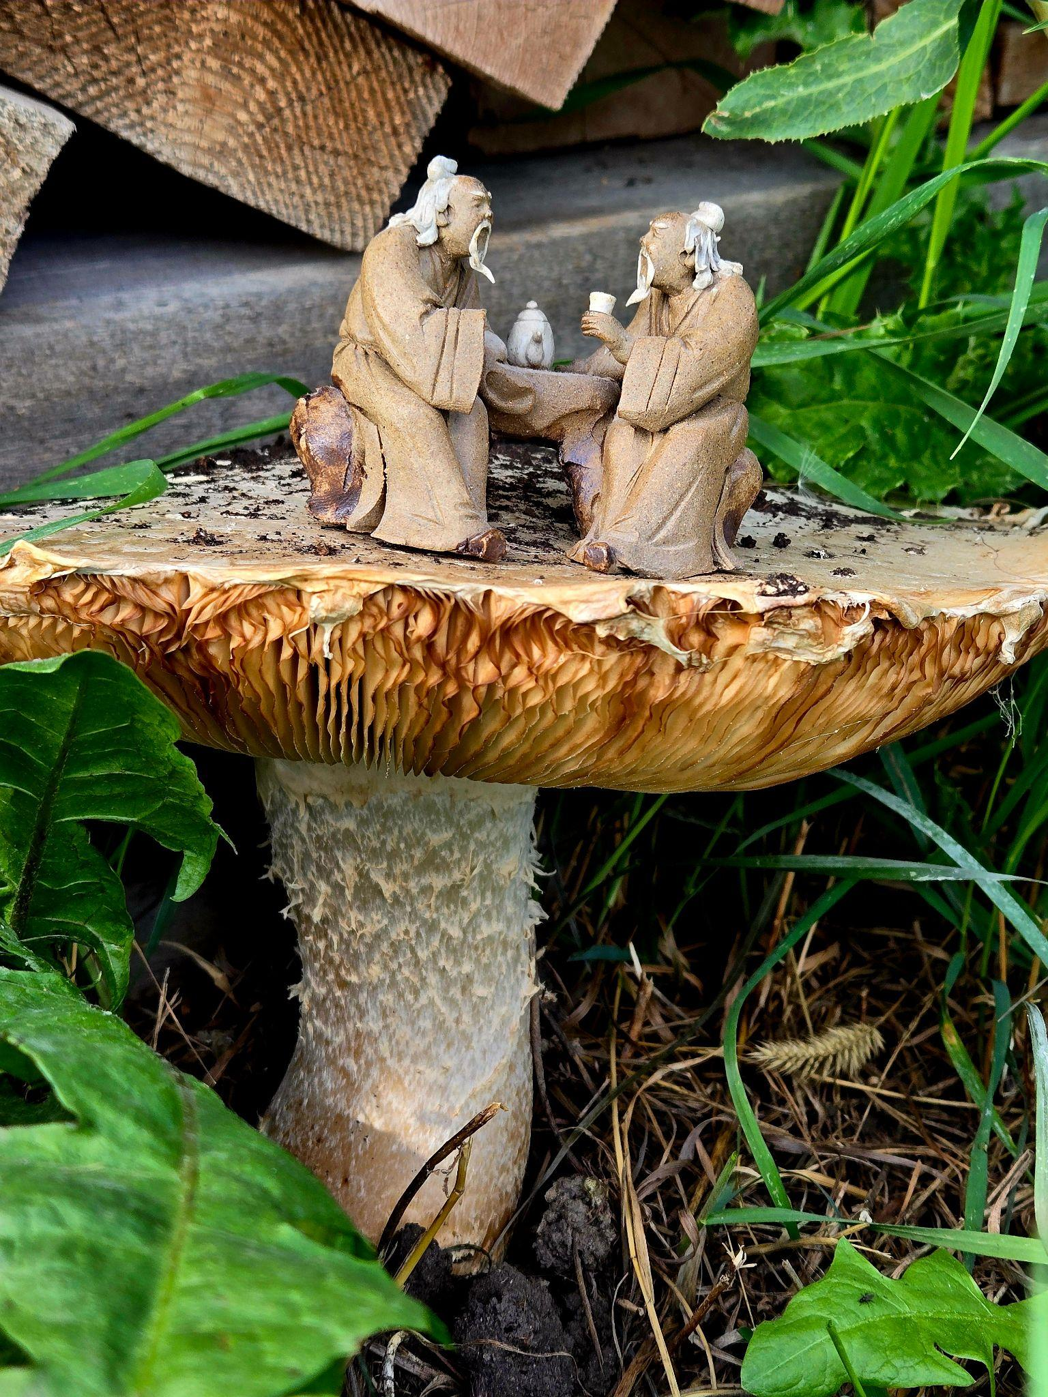
Connie’s Overall Perspective
Indigenous wisdom - Athabasca University Institutional Learning Outcome 6 “... a learner adapts to a changing world with self-reflection, tapahtêyimisowin (i.e., humility, belonging to the category of respect, generosity, and kindness), curiosity, and confidence” Learning to be and to become
ICDE 2025 New Zealand conference theme is Ako: the Māori concept of ‘ako’ (or reciprocity in learning and teaching, the exchange of ideas) as our touchstone. The design of inclusive, scalable, and sustainable education is central to the futures of global higher education, a priority for practice around the globe.
"Two Scholars Talking" by Constance Blomgren is licensed under CC BY-SA 4.0

Slide 5
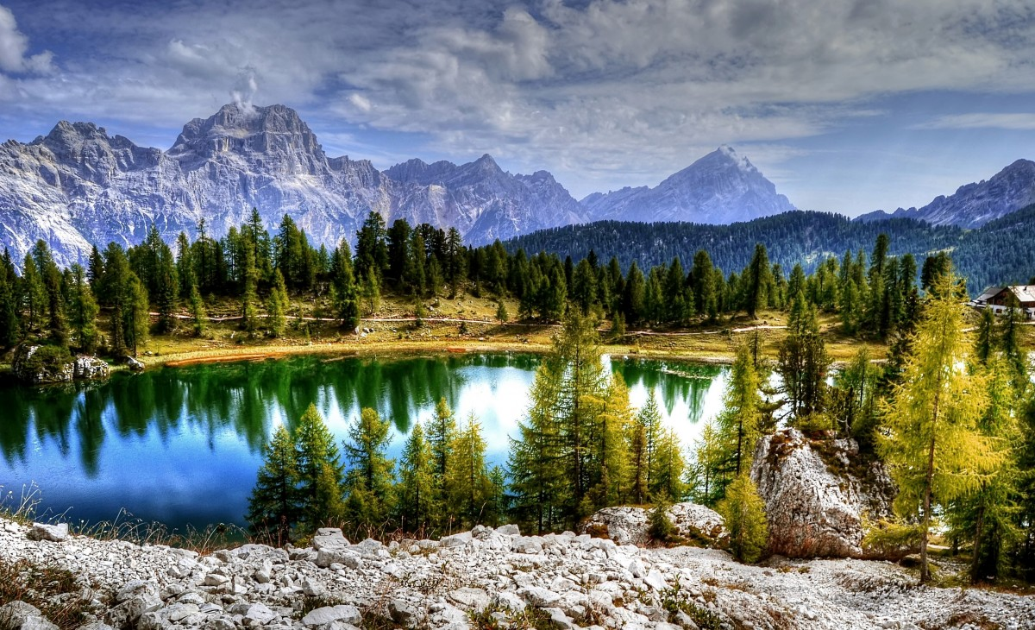
Paola’s Overall Perspective
https://pxhere.com/en/photo/1390517 , CC0
Notes:
Learning to be and to become. In a polycrisis.
What is happening in my context, what am I learning, what am I becoming in relation to all that.
Healthcare systems
Education systems
Investments in weapons
Silenced focus on climate change
Number and scale of war conflicts
Increasing censorship on relevant social topics
Lack of Investment (not only financial) in the new generations

Slide 6
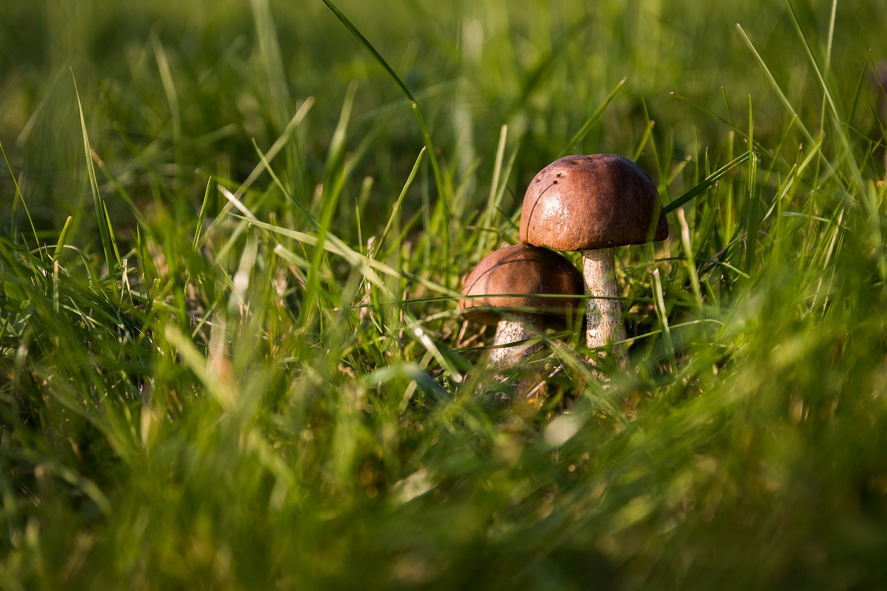
Image by Andreas from Pixabay
Notes:
I am learning and re-learning to start small to regain power and feel like I can still make a contribution, and hopefully, make a small difference.
In a positive way.
Practitioners like fungi.
Fungi are smart, and they transform.
They accompany change.

Slide 7
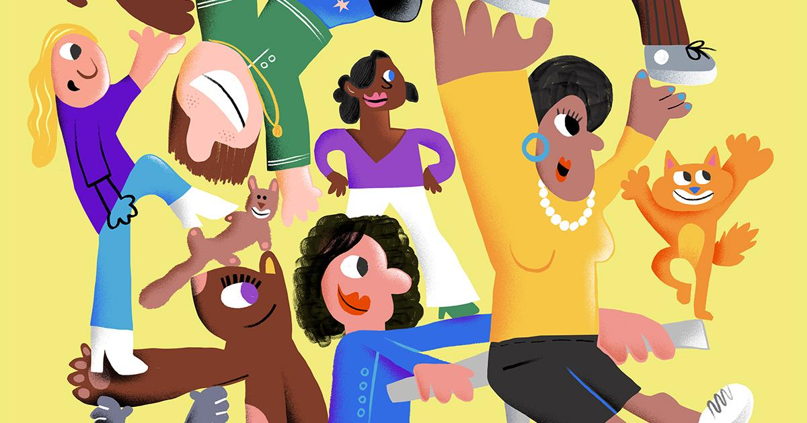
We Can Only Move Forward Together, by @jonhanlan for Fine Acts, CC-BY-NC-SA
Notes:
I look at art as a powerful inspiration in many ways: artists foresee what is to come.Creativity has the power not only to give voice to new ideas, but also to provide the energy to look back and look forward. Back to learn from what happened, forward to have purpose or sometimes to be frightened enough from what COULD come to think about ways to change the path.
Then, I can come back to the present moment to make change happen.
Inviting artists to share, respectfully of their right to make a living out of their work, is one of the ways to enlarge the opportunities to be inspired, or at least to reflect.
Look at this picture created by Jon Hanlan, an artist who chose to share CC BY NC SA through THE GREATS, by Fine Acts

Slide 8

Jonathan’s Overall Perspective
I used to have a binary heart, I measured everything in bits, in 0s and 1s
“Binary Heart” by Randall Munroe is licensed CC BY-NC 2.5.

Slide 9
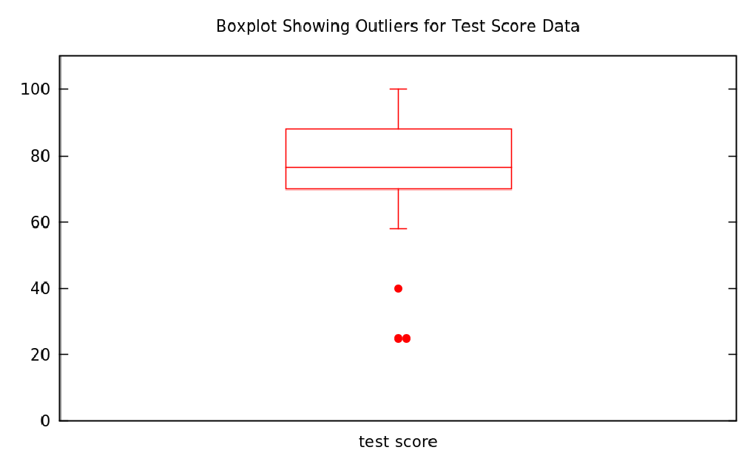
Aside:
The word “bit” was coined by mathematician John Tukey as a shortening of “binary digit.”
He invented the “box-and-whisker plot” [AKA “boxplot”] beloved of statisticians everywhere:
Tukey also seems to be the first person to have used the word “software” in a publication.
Example boxplot of test score data from Lies, Damned Lies, or Statistics by Jonathan Poritz, released under CC BY-SA 4.0.

Slide 10
A good place to start?
Institutions of higher education are conducted for the common good and not to further the interest of either the individual teacher or the institution as a whole. The common good depends upon the free search for truth and its free exposition.
Academic freedom is essential to these purposes and applies to both teaching and research. Freedom in research is fundamental to the advancement of truth. Academic freedom in its teaching aspect is fundamental for the protection of the rights of the teacher in teaching and of the student to freedom in learning.
emphasis added
American Association of University Professors
1940 Statement of Principles on Academic Freedom and Tenure

Slide 11
A beautiful idea for the how of education:
Si tu veux construire un bateau, ne rassemble pas tes hommes et femmes pour leur donner des ordres, pour expliquer chaque détail, pour leur dire où trouver chaque chose... Si tu veux construire un bateau, fais naître dans le coeur de tes hommes et femmes le désir de la mer.
Antoine de Saint Exupéry
…but, alas, this is a false attribution! This closest to a quote in his actual work, from Citadelle, is:
Créer le navire ce n’est point tisser les toiles, forger les clous, lire les astres, mais bien donner le goût de la mer qui est un, et a la lumière duquel il n’est plus rien qui soit contradictoire mais communauté dans l’amour.
Which is, more or less:
To create the ship is not to weave the sails, forge the nails, read the stars, but to give the taste of the sea which is one, and in the light of which there is no longer anything contradictory but community in love.

Slide 12
Speaking of love:
And this is what Jesus means, I think, in this very passage when he says, “Love your enemy.” And it’s significant that he does not say, “Like your enemy.” Like is a sentimental something, an affectionate something. There are a lot of people that I find it difficult to like. I don’t like what they do to me. I don’t like what they say about me and other people. I don’t like their attitudes. I don’t like some of the things they’re doing. I don’t like them. But … love is greater than like. Love is understanding, redemptive goodwill for all men, so that you love everybody…. This is the way to do it. When the opportunity presents itself when you can defeat your enemy, you must not do it.
Rev Dr Martin Luther King, Jr.
"Loving Your Enemies," Sermon Delivered at Dexter Avenue Baptist Church in Montgomery, Alabama, on 17 November 1957
The arc of the moral universe is long, but it bends toward justice.
also MLK, conclusion of a sermon during commencement at Wesleyan University in 1964

Slide 13
Some more dichotomies
Idealism
Love
Revolution
Speak the truth, don’t gaslight your listeners
Return to, and build off, some earlier, better days for ed
Optimism of the will
Practicality
Like
Evolution
Say what your listeners are able to hear, in this moment
Innovate: the world is changing, adapt or become irrelevant
Pessimism of the intellect

Slide 14
a manifesto for Higher Education for Good
MAKE CLAIMS
for just, humane & globally sustainable HE
Courageously IMAGINE
& share fresh possibilities
MAKE POSITIVE CHANGES
here and now
NAME & ANALYSE troubles of HE
CHALLENGE
& RESIST
hegemonies
OER24 keynote - Cronin & Czerniewicz 28-Mar-2024, CC BY NC
Notes:
Paola - OER24 keynote - Cronin & Czerniewicz 28-Mar-2024 - Google Slides
Feel free to jump in if you have a comment on the specific step of the manifesto. Otherwise, consider at the end we will make time for Q&A

Slide 15
Naming and analysing the troubles of open ed in this moment of accelerating polycrisis
Connie & Jonathan
Paola - Moderator
MAKE CLAIMS
for just, humane & globally sustainable OE
Courageously IMAGINE
& share fresh possibilities
MAKE POSITIVE CHANGES
here and now
NAME & ANALYSE troubles of HE
CHALLENGE
& RESIST
hegemonies
OER24 keynote - Cronin & Czerniewicz 28-Mar-2024, CC BY NC
Notes:
How can we…
Develop a process to map issues in open education? Understand the ways that wider global crises impact open education? Develop and continue cross-sectoral research underpinned by equity concerns? As a broader open community, make the necessary projects happen, and urgently?

Slide 16
Jonathan, Naming:
Disruptive impact of new technologies such as genAInt.
The problem of “sustainability.”
Fundamental OE values such as DEI, anti-racism, anti- colonialism, the value of the liberal arts, etc., under attack by a newly emboldened right.
Declining open ed interest and knowledge, at least in some places.
Jonathan, Analysing:
GenAInt – and, one suspects, automated HW systems, VLEs, other “edtech” is largely about deskilling, distorting labor markets, training faculty and students in obedience rather than critical thinking, and concentrating power and money.
“Sustainability” is largely an issue because we in OE have internalized an image of what OER should look like, and academic labor should be.
There’s no point to doing the work of (open) education without values.
So many fires to fight, feelings of betrayal by so many colleagues.

Slide 17
Pointing to the assumptions and hegemonies most in need of challenge now
Paola & Jonathan
Connie - Moderator
MAKE CLAIMS
for just, humane & globally sustainable OE
Courageously IMAGINE
& share fresh possibilities
MAKE POSITIVE CHANGES
here and now
NAME & ANALYSE troubles of OE
CHALLENGE
& RESIST
hegemonies
OER24 keynote - Cronin & Czerniewicz 28-Mar-2024, CC BY NC
Notes:
How can we…Challenge dominant and harmful discourses, models and practices? Resist dominant extractive systems? Counter extractive free labour? Build requisite critical digital and data literacies?
Ensure inclusive governance arrangements?

Slide 18
Jonathan, pointing to questionable assumptions/hegemonies that
education should be primarily workforce preparation, not liberal arts;
it makes sense to teach students skills that machines can do (better);
fundamental structures like HW at home and grades can survive rethinking the above;
reward/organizational structures of higher ed can remain unchanged;
there are no bad actors in education, only misguided ones;
the Turing test made sense;
neoliberalism makes sense in the context of education (or any other!).

Slide 19
Paola on how we can challenge/resist:
“Education should be primarily workforce preparation, not liberal arts.” What about modern literature, arts and music? What about theatre? We learn from artists even when we don’t like what they create.
Examine who benefits from GenAI tools massive use, and whose voices or knowledge systems are marginalised or misrepresented, especially given AI’s tendency to reproduce dominant group perspectives and systemic biases.
Use GenAI to reclaim time and intellectual space from bureaucratic and performative academic tasks, redirecting energy toward critical, relational, creative and transformative educational practices
Foster communities of practice that co-create, adapt, and remix AI tools and outputs, prioritising collaboration and local relevance
Support, develop, train and use of open-source AI models and datasets.

Slide 20
Laying claim to a just, humane, and sustainable open ed that can thrive under today's pressure
Connie & Jonathan
Paola - Moderator
MAKE CLAIMS
for just, humane & globally sustainable HE
Courageously IMAGINE
& share fresh possibilities
MAKE POSITIVE CHANGES
here and now
NAME & ANALYSE troubles of OE
CHALLENGE
& RESIST
hegemonies
OER24 keynote - Cronin & Czerniewicz 28-Mar-2024, CC BY NC
Notes:
What is our responsibility to open digital infrastructure? How can open educators work to change the dominant values and models of AI? Do open educators have a particular responsibility to ensure data justice? What is the role of open educators in raising the ecological issues of open-related work?

Slide 21
Connie’s thoughts
Learn more about GenAI - it’s history and how it has been shaped (e.g. Harari, 2024, Christian 2020)
Technologies are not additive - they are ecological (Postman, 1998)
Consider the intentional use of GenAI and AIED
Know your values about:
open education
ecological footprint
uncertain times/polycrisis

Slide 22
Jonathan, laying claim:
We must retain our commitments to DEI, anti-racism, anti-colonialism: see the keynotes at Open Ed by Jasmine Roberts-Crews, James Glapa-Grossklag and Joy Shoemate; our commitments to accessibility; our commitments to supporting migrants who seek an education; … if not, what are we doing?
Aside from growing evidence it does not support real learning, genAInt devalues human connections, further concentrates wealth and power, explicitly deskills human workers of all kinds, and is built on explicitly colonialist and eugenicist ideologies (see works of Hao, Gebru, and Torres).
We can employ open, innovative, humane, critical pedagogies like ungrading, authentic (even if not “renewable”) assessment, course designs which center students’ lived experiences (e.g., Ribadeneira’s courses, and entire degree program at CSUPueblo).
We can appreciate “the beauty of ugly OER”, which are more sustainable, humane, and often more pedagogically effective.

Slide 23
Sharing imaginations of new possibilities of open ed
Paola & Connie
Jonathan - Moderator
MAKE CLAIMS
for just, humane & globally sustainable OE
Courageously IMAGINE
& share fresh possibilities
MAKE POSITIVE CHANGES
here and now
NAME & ANALYSE troubles of OE
CHALLENGE
& RESIST
hegemonies
OER24 keynote - Cronin & Czerniewicz 28-Mar-2024, CC BY NC
Notes:
How can we…Use more imaginative, alternative, border-crossing approaches to communicate and inspire change? Encourage, develop and support a new generation of open educators and open policy makers? Create spaces, freedom and support for imagining alternatives?

Slide 24
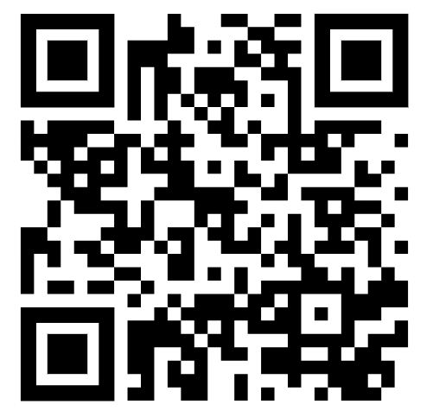
Paola, relating:
“Can’t help myself”, by Sun Yuan & Peng Yu, Biennale di Venezia 2019 → renamed as “Couldn’t help myself” (https://www.youtube.com/watch?v=czHS8p2EtJM)
Involve artists and creative thinkers, they open doors and windows we often see as closed
Look at how nature as already been solving complex problems for just a few millennia
Intentional exercise (also in every small projects!) to see what is doable, what is desirable, what is possible, what is preferable. Then point to preferable! (Nohr et al. 2023; Nørgård et al. 2024)

Slide 25
Connie
The power of the imagination - “what if”?
Speculative education - futures we create (Ross, J. (2018). Speculative Method as an Approach to Researching Emerging Educational Issues and Technologies. In Building Research Design in Education: Theoretically Informed Advanced Methods. Bloomsbury)
Practicescapes “are offered as a speculative learning design climbing frame that could take us from dreams of possibility to enlivened and embodied presents” para 1 (Costello, E., McDonald, J., Macgilchrist, F. et al. Speculative Practicescapes of Learning Design and Dreaming. Postdigit Sci Educ (2024). https://doi.org/10.1007/s42438-024-00465-5)

Slide 26
Relating where we are able to act, here and now, to make positive change
Jonathan & Paola
Connie - Moderator
MAKE CLAIMS
for just, humane & globally sustainable OE
Courageously IMAGINE
& share fresh possibilities
MAKE POSITIVE CHANGES
here and now
NAME & ANALYSE troubles of OE
CHALLENGE
& RESIST
hegemonies
OER24 keynote - Cronin & Czerniewicz 28-Mar-2024, CC BY NC
Notes:
How do we create space and time for collective work and building power? Which initiatives can we as a community join and contribute to, within our existing constraints? How can openness in education at this moment be rearticulated? How can governance and structural forms be reconsidered?

Slide 27
Jonathan, relating:
Maybe there are some basic principles which always apply, such as
Support students, colleagues, and all others: show kindness and humanity.
Be open minded; believe in, respect, listen to expertise, and learn from it.
To the extent that it is possible to do so safely, speak truth and avoid gaslighting.
Choose your battles based on your beliefs and capacities. Maybe you can follow Dr Martin Luther King in “Loving Your Enemies” or maybe Noor Hindi's "Fuck Your Lecture on Craft, My People Are Dying" is where you are.

Slide 28
Paola, relating:
Can we intentionally continue pushing beyond our current and future boundaries, involving all people? People might surprise us
Call to action to notice more all the local nuances of the word “important”
build futures (plural, because there might be different contextual needs and priorities)
How can WE help? How would WE support the practitioners, whichever their level is, in our context, with our role, with our decisions? Here and now. All acts are political.
Bridge global, regional, national, and local scales with the support of trusted intermediaries (libraries, academic institutions, universities of applied sciences, orgs…) to help translate high-level policies into contextual change and ensure alignment with different communities’ priorities.

Slide 29
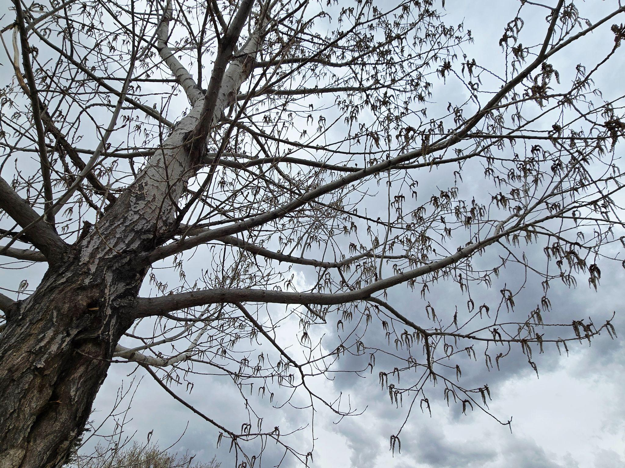
Connie’s Take-aways

Slide 30
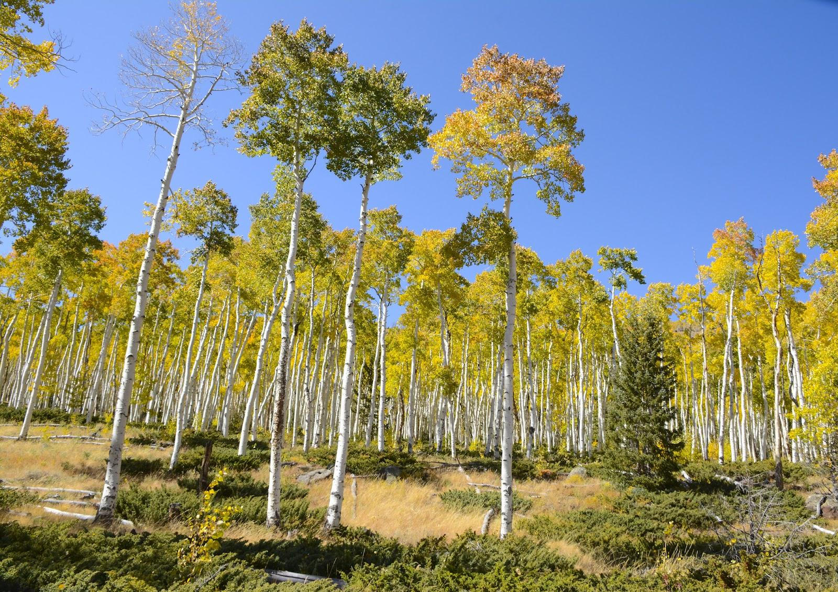
Paola’s Take-aways
Pando in fall colors, by John Zapell, CC0
Notes:
Being multiple/being one. Individual and collective identities.
Like PANDO: Estimated 47,000 stems Root system spans 0,42 km². Known as Trembling Giant. Single male genet of American Quaking Poplar (Utah, US).
Branches of Pando are part of the same living organism with a massive root system, about 80.000 years old.
Where does one individual or collective mind end, and where does it flow into another through communication and reciprocal learning

Slide 31
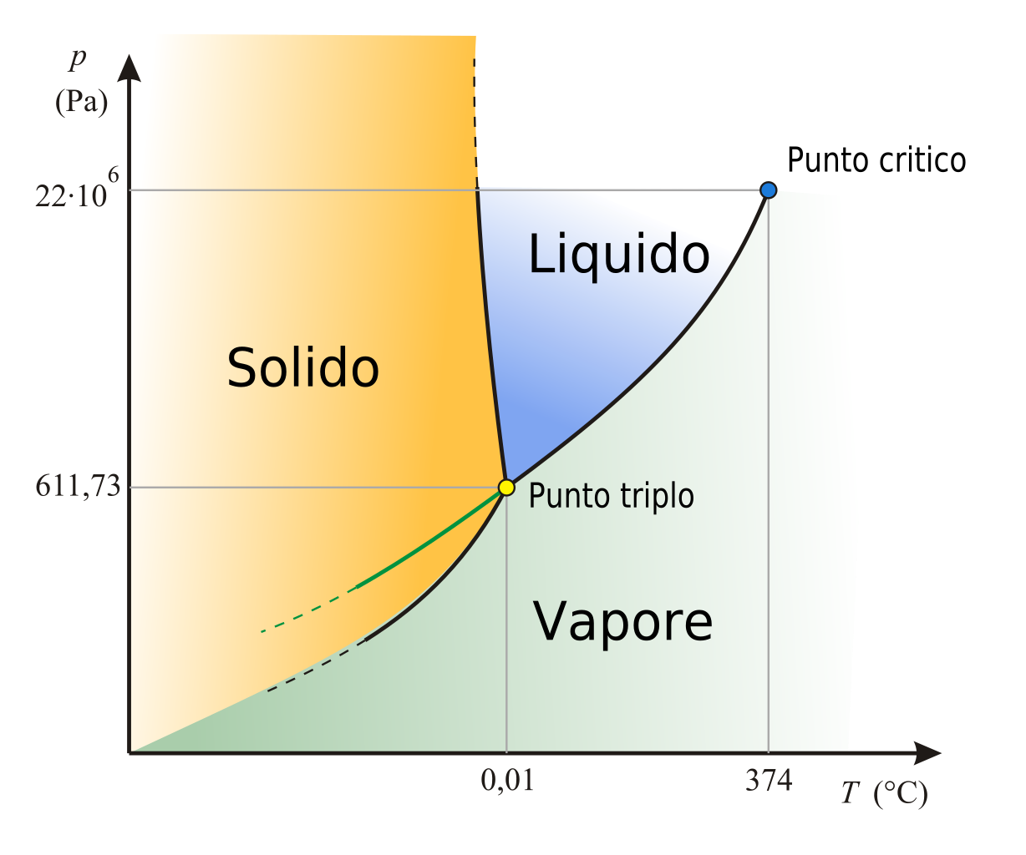
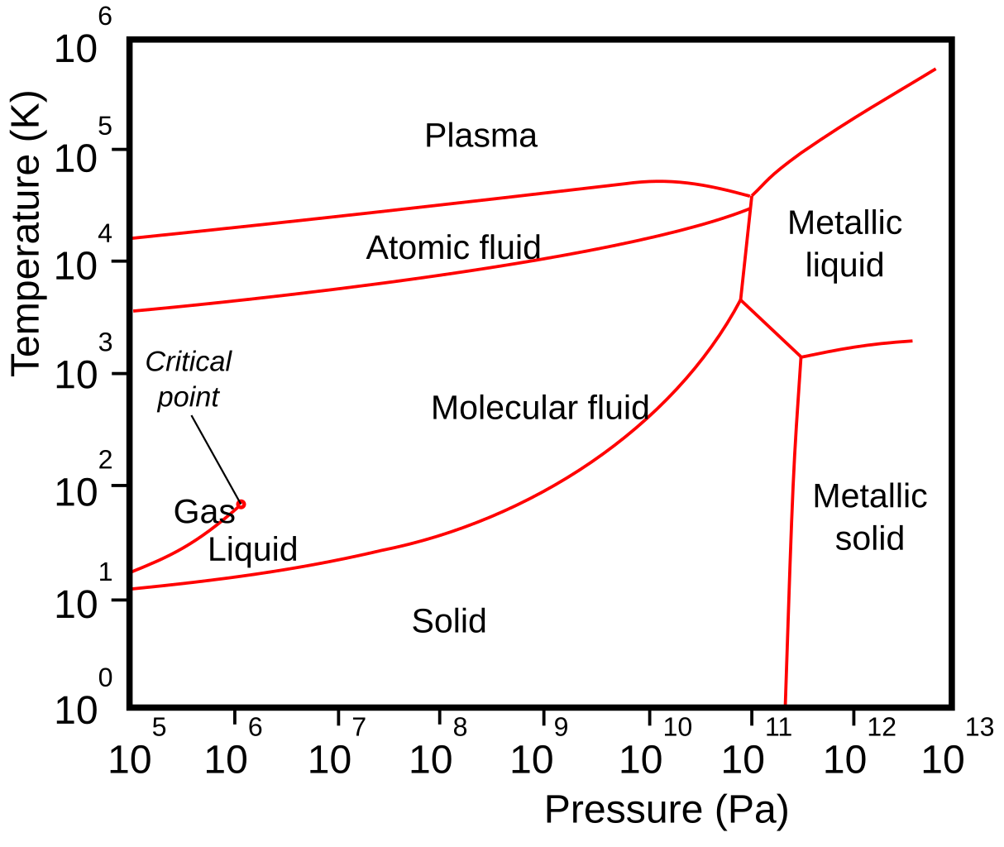
Jonathan’s Take-aways
In physical chemistry one makes phase diagrams which show the different phases of a material depending upon the temperature and pressure. They can be simple or complex:
WaterPhaseDiagram it by Daniele Pugliesi via Wikimedia Commons is licensed CC BY 3.0 Unported
Phase diagram of hydrogen by Tretyak via Wikimedia Commons is licensed CC BY-SA 4.0 International

Slide 32
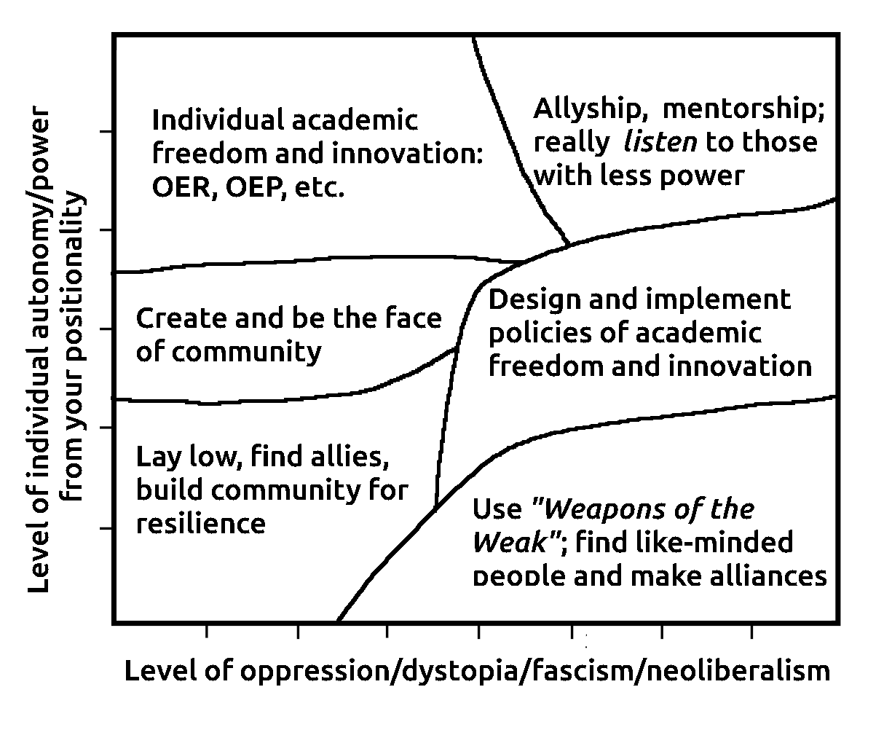
Perhaps we must place ourselves on this autonomy/dystopia phase diagram, where there are presumably regions labelled
Allyship, mentorship, listening
Meaningful academic freedom: OER/OEP/ ungrading/flipping classes/resisting AI individually
“Weapons of the Weak”
Direct departmental or institutional policies for OER/ OEP/ungrading/flipped classes/
Lay low, build community

Slide 33
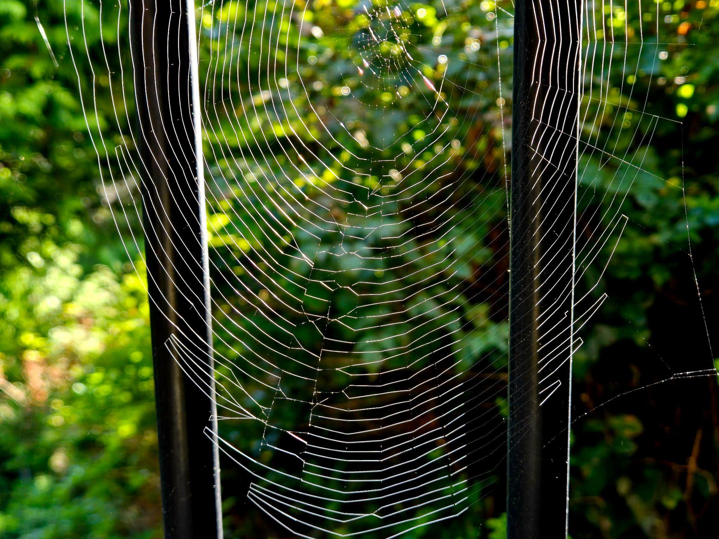
Audience Contributions
"Spider Web and Spindles" by Constance Blomgren is licensed under CC BY-SA 4.0

Slide 34
Professional Reading
Brown, Wendy. (2017). Undoing the Demos: Neoliberalism’s Stealth Revolution. Princeton University Press
Christian, B. (2020). The Alignment Problem: Machine Learning And Human Values. Norton & Company.
Czerniewicz, Laura and Cronin, Catherine, editors. (2023). Higher Education for Good: Teaching and Learning Futures. Open Book Publishers. CC BY-NC 4.0
Gebru, T., & Torres, É. P. (2024). The TESCREAL bundle: Eugenics and the promise of utopia through artificial general intelligence. First Monday.
Hao, K. (2025). Empire of AI: Dreams and Nightmares in Same Altman's OpenAI. Penguin Press, US.
Harari, Y. N. (2024). Nexus: A brief history of information networks from the stone age to AI. Signal.
Nohr, Rolf. (2023). Irina Kaldrack / Rolf F. Nohr: Preferable-Futures. 10.14619/0337 https://meson.press/books/preferable-futures/
Nørgård, R.T., Holflod, K. (No) Hope for the future? A design agenda for rewidening and rewilding higher education with utopian imagination. Int J Educ Technol High Educ 21, 30 (2024). https://doi.org/10.1186/s41239-024-00456-3
Scott, James C. (1987). Weapons of the Weak: Everyday Forms of Peasant Resistance, Yale University Press.

