Slide 1

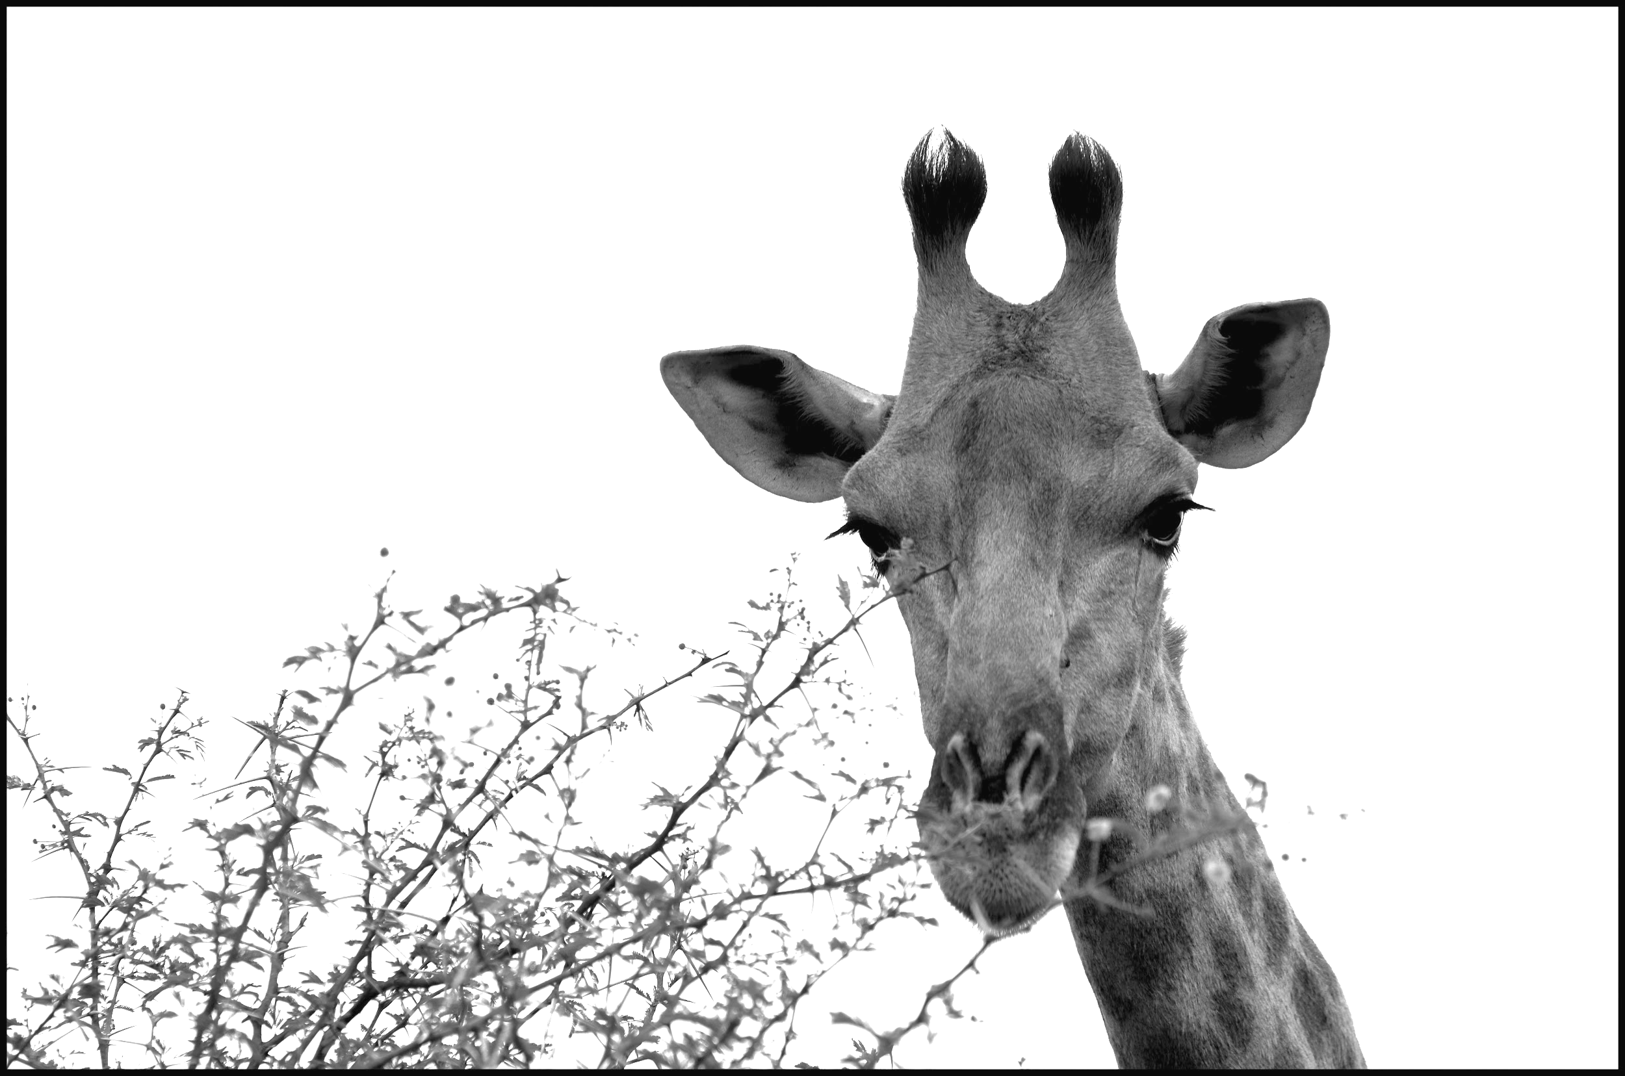
The CC Certificate
Jennryn Wetzler
Jonathan Poritz
Scann
Shanna Hollich
Paola Corti
Maran Wolston
Notes:
“Südafrika 10.12 (228)” by Armin Rodler, licensed CC BY NC 2.0

Slide 2

Created by Jennryn Wetzler, Jonathan Poritz, Maran Wolston, Scann, Shanna Hollich, and Paola Corti. Unless otherwise noted, this presentation is licensed under a Creative Commons Attribution 4.0 International License.
Notes:
Overview:
Round of introductions
Explain this session will be divided into two parts (come back in 20+ min if you’re not new to the Cert)
Part 1
Overview of the CC Certificate, (10 min)
Recent updates (15-20 min)
Questions interspersed in conversation
Part 2
New opportunities for involvement
Feedback from audience

Slide 3
What is the CC Certificate?
Notes:
What the CC Certificate is:
Online/ In person
Training in..
Edu/Lib (GLAM forthcoming)
5 units + final project, quizzes, assignments, access to experts
Nearly 800 graduates from 50 countries
Why people take the course
What we aim to do with the Certificate:
A) Share this resource & make it as useful to as many audiences as possible:
Good thing about open licensing materials is the invitation for remix & reuse!
Language translation
Remixes for different trainings
GLAM
We welcome you to explore the resources, and use them however they best serve your needs.
B) Iterate, learn and improve:
Best thing about open licensed works
Content updates every year
Feedback and evaluations

Slide 4
certificates.creativecommons.org

Slide 5
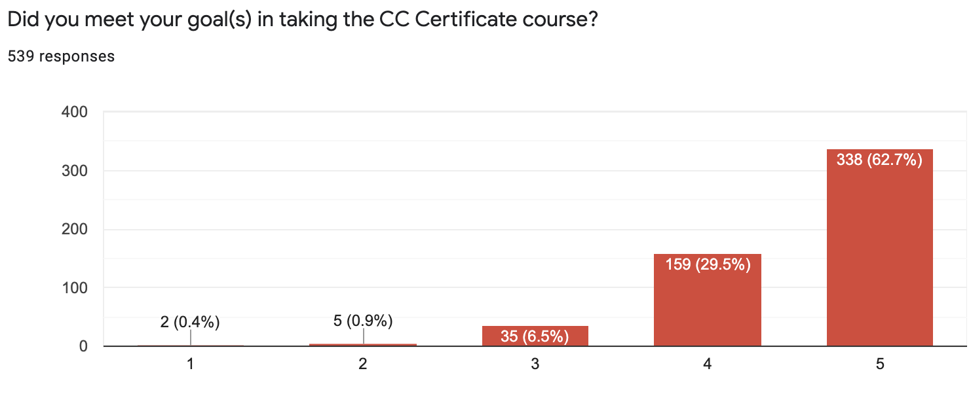
Impact
Notes:
Of the Certificate graduates surveyed, 96.5% report learning a significant amount during the course; over 92% reported the course met most or all of their goals.

Slide 6
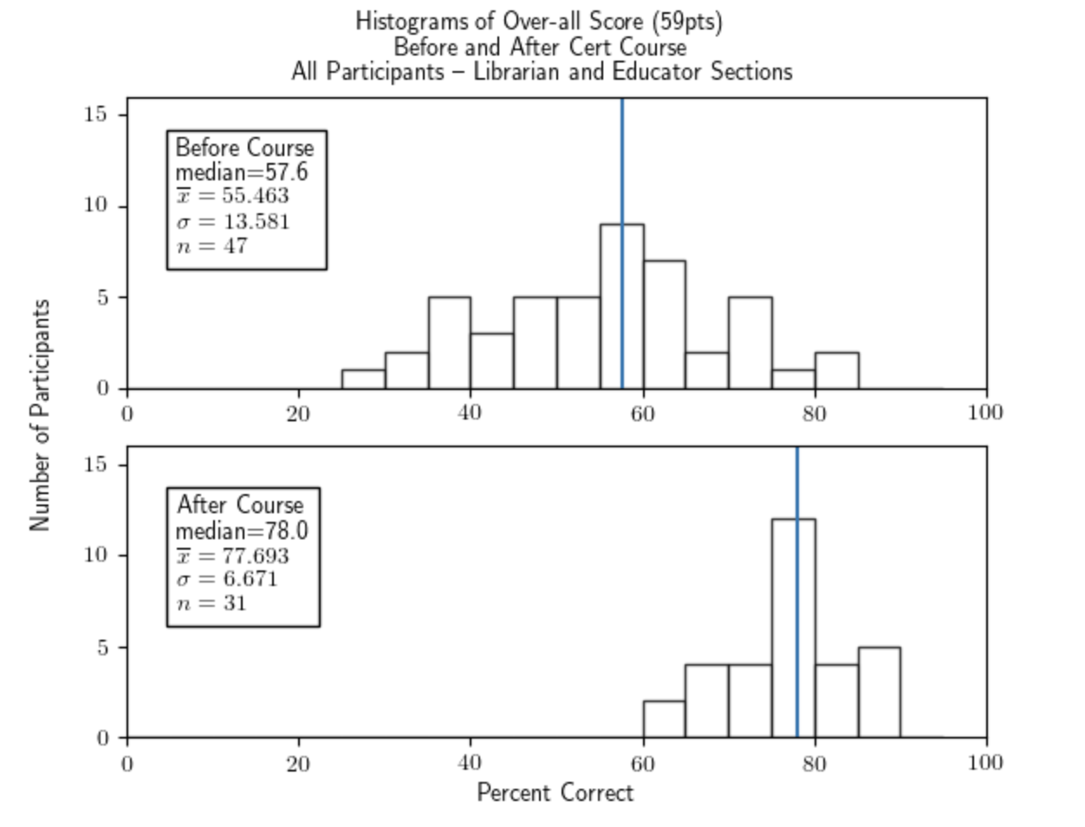
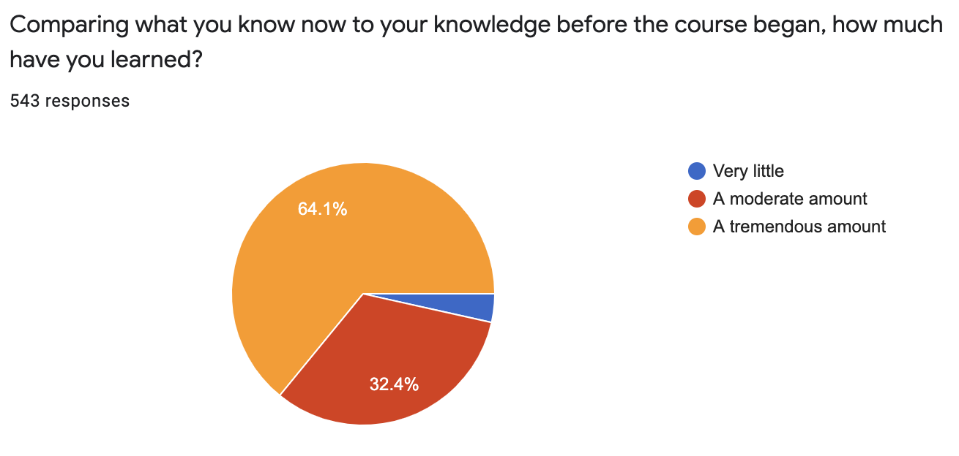
Impact
Notes:
https://poritz.net/j/cc/cert/assess/
The community has adapted Certificate content (CC BY) to produce new courses, workshops, online tutorials, audio files, and language translations, making content available to additional learning communities.
Ripple effect: Not only are CC Cert participants and alums doing incredible things with the knowledge they gain, for their own communities but we’re starting to see the ripple effect in other communities as well.

Slide 7
What’s new? What’s next?
Notes:
Continuous cycle of improvement (content, pedagogy etc) (Jennryn)
GLAM Cert (Scann)
Translations & Localized case studies (Paola)
The Open Education community has successfully translated the CC Certificate content into Arabic, Burmese, Italian, (and more languages forthcoming).
With these translations, over 515 million additional people around the world have access to the course content in their first language.
We may have guest appearances from other translators, including Beck Pitt (Burmese translation) and Adesina Ghani Ayeni (Yoruba translation)
Facilitator training + Open at the Margins (Jennryn/Maran & Shanna)
Audio files and Evaluation efforts (Jonathan)
Scholarships, website, etc (Jennryn)

Slide 8
CC GLAM “branch”
Draft outline: this is the “blueprint” of what we might be delivering in the GLAM Certificate
Content is currently being reviewed
Expected timeline:
        (tentative) January 18, 2021: alpha test
        (tentative) September 27, 2021: beta test
        2022: Certificate offering!

Slide 9

Questions?
Starlight 131219 by chiaralily is licensed CC BY NC 2.0
Notes:
Starlight 131219 by chiaralily is licensed CC BY NC 2.0

Slide 10
Ways to get involved
...and an opportunity for feedback
Notes:
Feedback:
Mentimeter (Jennryn to share screen)
Facilitators’ note: If there are a lot of alums & we need more structure for critique or conversation, we could try the +/delta exercise: https://docs.google.com/document/d/1Jl5U7D9XKzS3exsZ9BZ3vnah_oNZ2wXVrtDVn-F5t7w/edit?usp=sharing
Ways to get involved (Jennryn):
Spanish translation effort in 2021
GLAM Cert in 2021
Alumni interviews in 2021
Contact jennryn@creativecommons for volunteer opportunities.

Slide 11
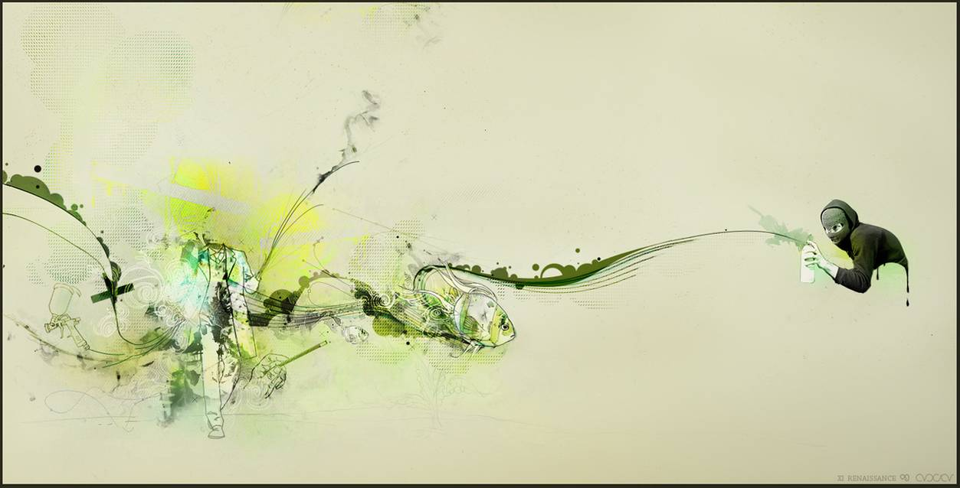
https://www.menti.com/hfcwnnatzt
Notes:
“Open Expression,” by zulu-eos is licensed under CC BY-NC-ND 3.0

Slide 12
Thank you!

