Slide 1
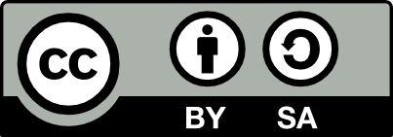
Slides on Creative Commons Licensing and Open Educational Resources for a Panel Discussion
What Campus Leaders Need to Know about
Copyright and Intellectual Property
from WCET on 23 July 2020
For more information about this event, see https://wcet.wiche.edu/events/webcasts/copyright-intellectual-property
These slides, by Jonathan A Poritz, are released under a Creative Commons Attribution-ShareAlike 4.0 International license. See https://poritz.net/j/share/inddex.html#CCnOER4WCET for remixable versions.

Slide 2


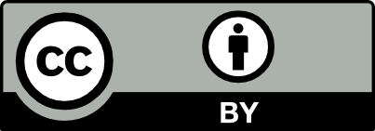
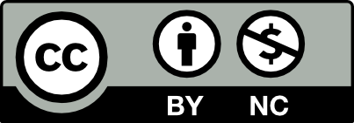
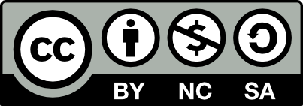
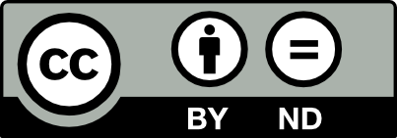
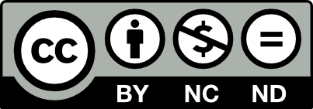
The Creative Commons Alternative to All-Rights-Reserved Copyright
Public domain dedication tool, CC0
  Puts work into worldwide public domain
Public domain mark, PDM
  Marks a work known to be in the public domain
Creative Commons Attribution, CC BY
  Give credit to the original creator
Creative Commons Attribution-ShareAlike, CC BY-SA
  Give credit and derivatives to be released under same license
Creative Commons Attribution-NonCommerical, CC BY-NC
  Give credit and don’t use to make a profit
Creative Commons Attribution-NonCommercial-ShareAlike, CC BY-NC-SA
  Credit, no profit, derivatives under same license
Creative Commons Attribution-NoDerivatives, CC BY-ND
  Credit, may not share derivative works publicly
Creative Commons Attribution-NonCommercial-NoDerivatives, CC BY-NC-ND
TOOLS
OER
LICENSES
NOT OER
ARR ©
CC licenses are built on top of copyright, so
You must control the rights on a work to put it under a CC license. [Also true of CC0.]
CC license terms do not apply when a work is used by fair use or other exception/limitation of ©.
CC licenses apply to expressions, not ideas. Copy/remix/distribute ideas as much as you want!
CC licenses are irrevocable, but a rightsholder can put out a work under different licenses at different times. Rightsholders are not bound, themselves, by the limits imposed on the public by a CC license.
Notes:
The Creative Commons (CC) organization was founded when Larry Lessig lost his case asserting that the Sonny Bono Copyright Term Extension Act of 1998 (also known as the Mickey Mouse Protection Act) was unconstitutional.
Aside from feelings of sour grapes about this loss, the idea of CC was to build a more flexible, new version of copyright more suitable for the Internet Age in which copying, sharing, and making derivative works (remixes) -- all things locked down by all-rights-reserved copyright [ARR ©] -- are easier than ever before, while copyright laws are as or more restrictive than before.
The way they did this was to use the powers of copyright to make CC licenses which intentionally open up some of the rights controlled by copyright (it’s a ‘hoist by your own petard’ situation); they can be called “some rights reserved” copyrights.
CC licenses live on the spectrum between the Public Domain, where works may be used by anyone, for any purpose, without any restrictions or conditions, and ARR ©, each giving specific rights to the public which may be exercised without any need for an individual contract between the rightsholder and prospective user.
The six CC licenses all include the BY clause, requiring re-users remixers to give attribution to the original work and creator -- that is, they enforce with copyright law what we teach as good scholarly practice: “cite your sources.”
Two of the licenses include the SA clause, requiring those who make derivative works to use the same license on their derivative works as was on the original, locking the work and all of its potential future descendent works into the open. This clause is sometimes described as making a “viral” license.
Three of the licenses include the NC clause, which forbids reuse, or use of derivative works, in profit-making situations. This is about the use, not the user, so a for-profit entity can use NC-licensed materials legally. It’s also about the profit, not the issue of whether money changes hands, so some college bookstores will sell hardcopies of NC-licensed materials to students “at cost,” and this is widely thought of as OK (even though there is no caselaw on this particular issue, so we don’t know 100% … and IAmNotALawyer, so I please do not construe this as legal advice).
Finally, two of the licenses have the ND clause, which means that the work may be used and shared, etc., but individuals who make derivative works of the original work may not publicly share their derivatives. There are a handful of use cases where this makes sense, but it is generally considered a very unwelcoming license clause, because it basically means the work cannot easily generate a future stream of new works useful to the world.
In addition to the six CC licenses, there is also a public domain dedication tool which enables a rightsholder to dedicate a work to the worldwide public domain, and a public domain mark, which can be used to indicate when a work is known to be in the public domain.
CC licenses work in all jurisdictions in the world (well, at least all 178 Berne Convention countries), and are now used by at least 1.6 billion works online.
CC has a helpful tool, the License Chooser at https://creativecommons.org/choose/ which makes it easy to choose a license and then to apply it to your work.
Many major content platforms allow (or even require: e.g., Wikipedia) posted works to be under a CC license. These include YouTube, Flickr, etc.
Search tools allow one to look for CC-licensed materials, e.g., images.google.com, ccsearch.creativecommons.org, youtube.com, etc.

Slide 3
Open Educational Resources [OER]: Potential
5Rs:
Wiley:
Retain
Reuse
Revise
Remix
Redistribute
Jhangiani:
Respect
Reciprocate
Risk
Reach
Resist
“OER are teaching, learning, and research resources that reside in the public domain or have been released under an intellectual property license that permits their free use and re-purposing by others. Open educational resources include full courses, course materials, modules, textbooks, streaming videos, tests, software, and any other tools, materials, or techniques used to support access to knowledge.” -- William and Flora Hewlett Foundation
“Free repurposing” and Wiley’s 5Rs amount to nothing more or less than pedagogical academic freedom.
In fact, it’s a little weird that faculty are so accepting of educational resources under ARR ©...
“Free use” amounts to getting off the gravy train (for publishers) which has seen textbook costs rise at many times the rate of inflation. It’s hard to justify textbooks that cost $200 or even $300 or $400 when: total student debt in the US is $1.74 trillion; 39% of students surveyed in 2019 were food insecure in the month prior to be surveyed, 46% were housing insecure in the prior year, and 17% were homeless.
Because of textbook cost, students take fewer classes, do more poorly, take longer to complete their studies, etc.; many students do not buy required texts or online access, but share books or skip those points.
Studies show when courses switch from commercial resources: student and instructor satisfaction goes up; academic performance goes up and DFW rate goes down -- and these effects are significantly larger for Pell-eligible and self-identified minority students, by as much as a factor of three.
Notes:
Student debt data from the Federal Reserve Bank and USPIRG.
Student basic needs from the #RealCollege survey by Sara Goldrick-Rab and the team at Temple University’s Hope Center for College, Community, and Justice.
Student responses to cost from Florida Virtual Campus survey.
“DFW rate” = fraction of students who get a D, fail, or who withdraw from a course.

Slide 4
OER: Reality
The Good:
OER have saved students at least $1 billion.
Millions of students use OER, at more than half of US colleges and universities.
The Open Textbook Library (open.umn.edu/opentextbooks) has 766 books, most reviewed by instructors.
OpenStax (openstax.org) has around 60 textbooks that look very much like commercial ones.
LibreTexts (libretexts.org) hosts nearly 400 resources and has a sophisticated remix tool.
OASIS (oasis.geneseo.edu) and OER Commons (oercommons.org/) are OER search engines.
Platforms like PressBooks (pressbooks.com), PreTeXt (pretextbook.org), and others make copying, adapting, and creating beautiful OER quite easy.
Organizations like The Open Textbook Network (open.umn.edu/otn) and The Rebus Community (rebus.community) support campuses with organization, platforms, training, etc.
All of these wonderful resources and tools circulate freely and without legal obstacles to the 5R permissions because they are under Creative Commons licenses.
The Bad and the Ugly:
OER may not have as many supplemental materials as commercial resources - but this is improving!
OER are thought not to be as accessible (i.e., ADA-compliant) as commercial resources - this is false.
Most problematic: there is a widespread belief that “you get what you pay for,” so OER must be worthless since they cost nothing. This is in fact the opposite of the truth, for the academic freedom reasons mentioned above among many other reasons -- e.g., open [or OER-enabled] pedagogy is the most interesting and powerful pedagogical innovation that has happened in decades!
Notes:
Total saving from SPARC article “$1 Billion in Savings Through Open Educational Resources at url https://sparcopen.org/news/2018/1-billion-in-savings-through-open-educational-resources/ .
“Millions of students…” see OpenStax announces top 10 schools that have adopted free college textbooks.
PressBooks is FLOSS (free/libre/open-source software) although pressbooks.com offers managed and hosted solutions for a fee.
The OTN is soon to change its name to “The Open Education Network.”
Note that OER which are software, such as PressBooks and the wonderful online homework system form mathematics WeBWorK (webwork.maa.org), to name just two, are not under CC licenses, but instead under one of several recognized open software licenses -- Creative Commons does not recommend to use its licenses for software.
Supplement materials are usually called ancilla in the OER world. There is a great variety in the ancilla available: OpenStax provides many for their books.
There is an argument that because of higher ed economics where a majority of student contact hours are with contingent faculty who are so underpaid that they must teach many sections to make a living wage and therefore cannot do hand-grading, automated homework systems are a necessity. These certainly exist in the commercial textbook world … but aside from the very problematic nature of this bit of economics, there is an increasing tendency for such systems (and LMSes, actually) to become instruments of surveillance capitalism and therefore questionable for that reason as well.
Much accessibility on many campuses revolves around either having a human who supports a student with a disability, or buying an electronic version of a textbook and feeding it through some screen reader or other assistive technology. Both approaches work in the same way -- without the “buying” step!
The “costing nothing so must be worth nothing” so flies in the face of everything we do as academics, it’s kind of insane. I write research papers, for which I get no financial remuneration -- I don’t think they’re worth nothing! I review papers for journals, for no pay -- I don’t think my expertise is worth nothing! And on and on. The fact that academics buy this canard is just a sign of how effective is the current global neoliberal hegemony (as the social scientists would say).

