Slide 1
Open Pedagogy in the Creative Commons Certificate Program
A Small Case Study and a Big Provocation
Licensed CC BY 4.0

Slide 2
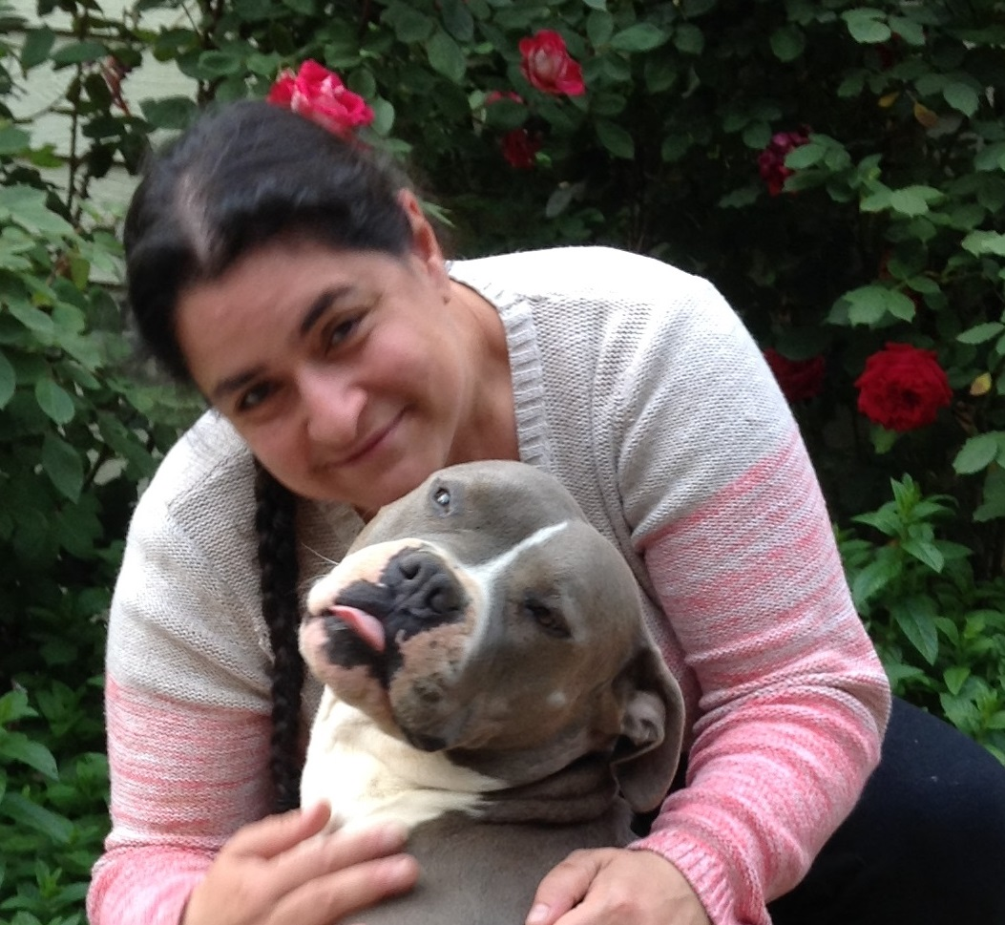
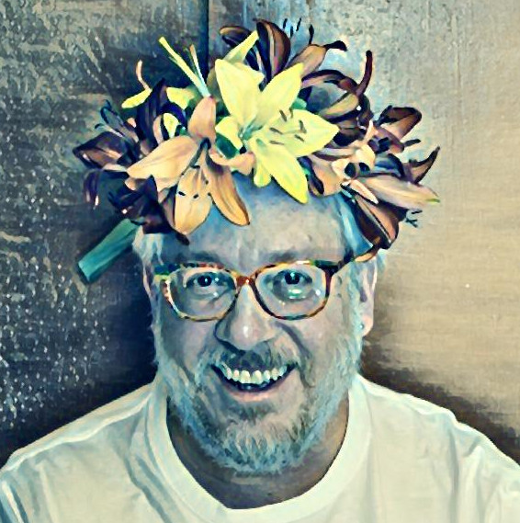
Presenters
Suzanne
Wakim
Jonathan
Poritz
ASCCC OER Initiative Project Facilitator since 2017; have helped over 30 faculty teams create new OER for a wide variety of disciplines. Author of biology textbooks and adoptable online courses. Helped design OER and Accessibility trainings for ASCCC OERI. Co-designed Equitable Grading Strategies class for @ONE. Faculty Trainer for courses including: OER,Online Course Design, Accessibility and Assessment. Took CC Certificate in 2018 and began facilitating in 2021.
Now: open ed consultant with several orgs; Formerly: assoc. prof. of math at Colorado State U. Pueblo, student/faculty at nearly a dozen other universities in six time zones, worked with CC, OEN, Rebus, PALNI, NEBHE, Colorado OER Council, etc.; author of 3 math OER textbooks; took CC Certificate in 2018, facilitator training in 2019, since facilitated around a dozen sections, both EDU and LIB, with around 300 participants from more than 30 US states and 20 other countries More info: https://poritz.net/jonathan

Slide 3
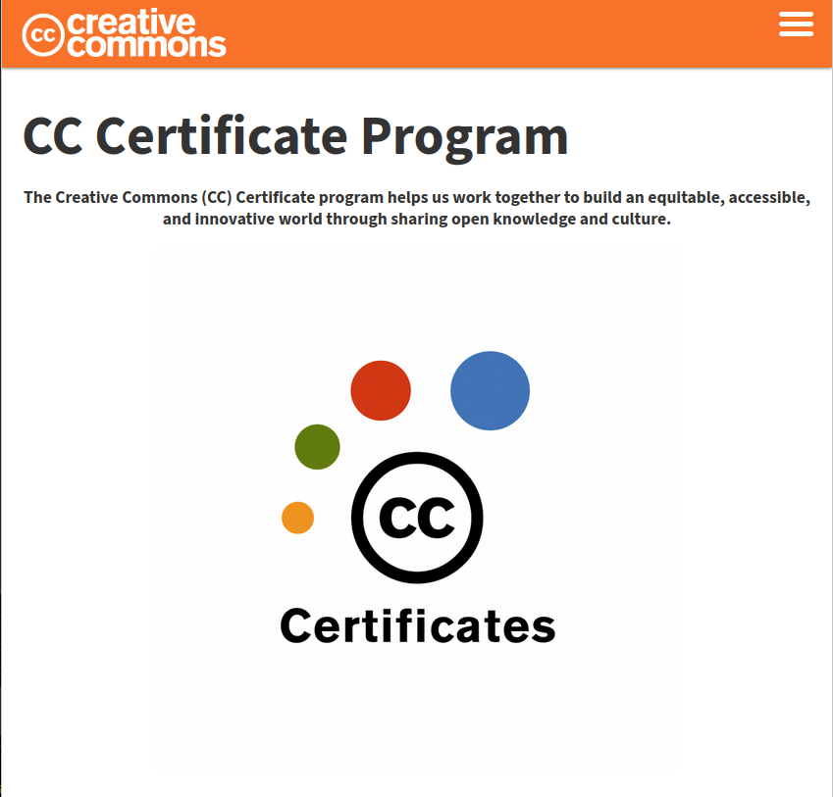
Creative Commons Certificate
From Creative Commons Certificate
“...The Certificate program offers in-depth courses about CC licenses, open practices and the ethos of the Commons. Courses are composed of readings, quizzes, discussions, and practical exercises to develop learners’ open skills. We provide personalized engagement with expert facilitators and copyright lawyers in the field, and offer a 1:25 (max) ratio of facilitators to course participants.’’

Slide 4
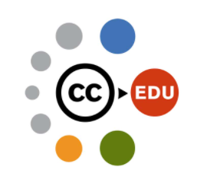
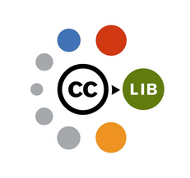
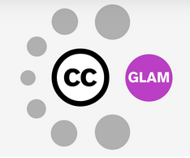
Creative Commons Certificate Courses
Why was that “... courses…”?
Educators
  ©, CC, OER, OEP, OA
Academic Librarians
  ©, CC, OA, OER, OEP
GLAM=“Galleries/Libraries/Archives/Museums”
  ©, CC, Rights Statements,
  Traditional Knowledge, Digitization Issues, OER, OEP, OA

Slide 5
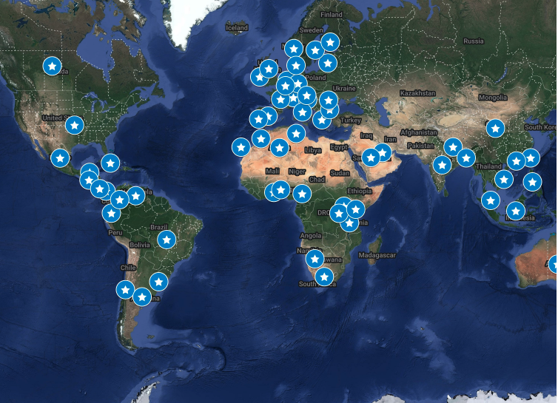
Global Reach of Creative Commons Certificate
Certificate Graduates
Total CC Certificate Graduates (to date): 1,459
Total CC Certificate Facilitator Training Graduates (to date): 17 and CC Staff
Total countries reached (as of September 2022): 65

Slide 6
Creative Commons Certificate: Topics
Two versions: 10-week, asynchronous online and 1 week, in-person bootcamp
Five Units:
What is Creative Commons
  Sono Bono, Mickey Mouse, Eric Eldred, John Ashcroft, Larry Lessing, ta-da: CC Licenses!
Copyright Law
  Why, what, how, where (internationally, too), exceptions and limitation, public domain
Anatomy of a CC License
  Layers (3), clauses (4; intricacies of NC and SA), full licenses (6), license enforceability, public domain tools (2)
Using CC Licenses and CC-Licensed Works
  Choosing a license, licensing statements, attributions, remixing considerations, collections,
CC for Educators/Academic Librarians/GLAM
  OER, OEP, OA, policies, strategies, rights statements, traditional knowledge

Slide 7
Creative Commons Certificate: Assessments
“Rigorous”: 6-10 hours of work per week, including fairly serious readings
Requirements – need 90% of the following points:
  Quizzes in Canvas, for self-monitoring (“required but not graded”)
  Discussions in Canvas, 8 required, 3pts each
    Respond to prompt, pose questions, chat among yourselves
  Assignments for each Unit, 5 required, 10pts each
    Essay, libguide, web page, video, podcast, infographic, interpretive dance…
  Final Project 26pts, options
    Choose two of several tasks: policy essay, renewable assignment, find five new resources, country case study, etc.
    Design your own: handouts for a workshop, Greek tragedy, interpretive dance, policy paper on CC and some new technology, collection and analysis of interviews with OER authors, outline an OER, draft of proposed OA policy, etc.

Slide 8
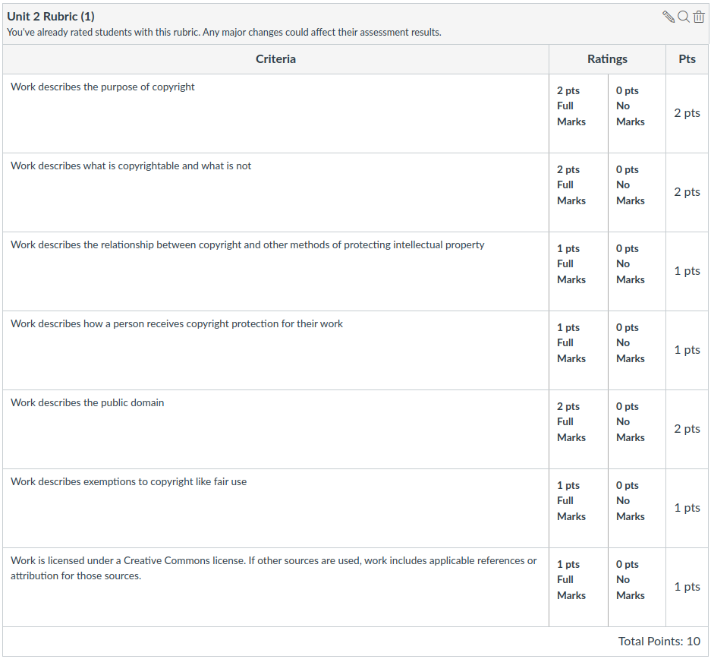
Creative Commons Certificate: Pedagogy 1
Traditional aspects:
Reading, formative MC
Quizzes … like usual online PD
Discussion fora: classic post once, reply twice … which we all hate?
Unit assignments have quite detailed rubrics – although it turns out that not everyone is familiar with rubrics!)

Slide 9
Creative Commons Certificate: Pedagogy 2
..But also open pedagogy aspects:
Some followed fora prompts by rote, most brought their own experiences, posed and answered questions, had references and links….
Assignments (and even more so the Final Project):
  Participants could choose the format of their work product with enormous freedom.
  Rubrics can be thought of as an outline, or a list of learning objectives, with points merely indicating relative importance of the different outcomes.
  All work (except essays on organizational internal issues) were openly licensed – give back to the community!
Ungrading [JP, with support of CC HQ]: promotes learner agency.

Slide 10
Creative Commons Certificate: Pedagogy 3
Experiment: Open Ped Track, Sept 2022, SW and JP facilitating
Replaced assignments with a document containing essentially all learning objectives, with an option for participants to build an artifact showing their master of each LO (often part of a large, full-session “final project”-like work product), or simply to explain their understanding there in the document.
Regular check-ins with facilitators; fora the same, albeit grade only with a ✔
Official ungrading
…Oddly, not all that successful! Relatively low pass rate and participants reported lower satisfaction than usual.
NB: structure very similar to in-person bootcamps, which are quite successful!

Slide 11
Provocation: Is open pedagogy the same thing as good pedagogy?
Part of the community seems to think so.
Our experiment doesn’t seem to support that … although randomness is a thing.
Also, our experiment was a very small – and in a particular context: maybe that matters, and open isn’t good in all contexts.
Maybe good also depends upon context – good for particular students, for particular purposes, or for particular educational institutions, or for other larger aggregates (e.g., good for society).
But thinking about the good is famously hard, let’s think about the open. A definition would be nice … but maybe it’s too much to expect, and might cause more trouble than it would be worth?

Slide 12
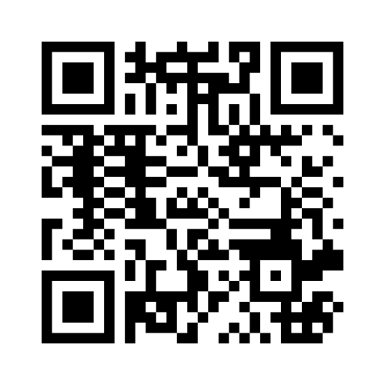
What comes to mind when you hear “Open Pedagogy”
https://www.menti.com/
Code : 6320 2313

Slide 13

OER-enabled Pedagogy
“A set of teaching and learning practices only possible or practical when you have permission to engage in the 5R activities.”
  Retain
  Revise
  Remix
  Reuse
  Redistribute
Disposable v. Living Assignments
Based on the work of David Wiley

Slide 14
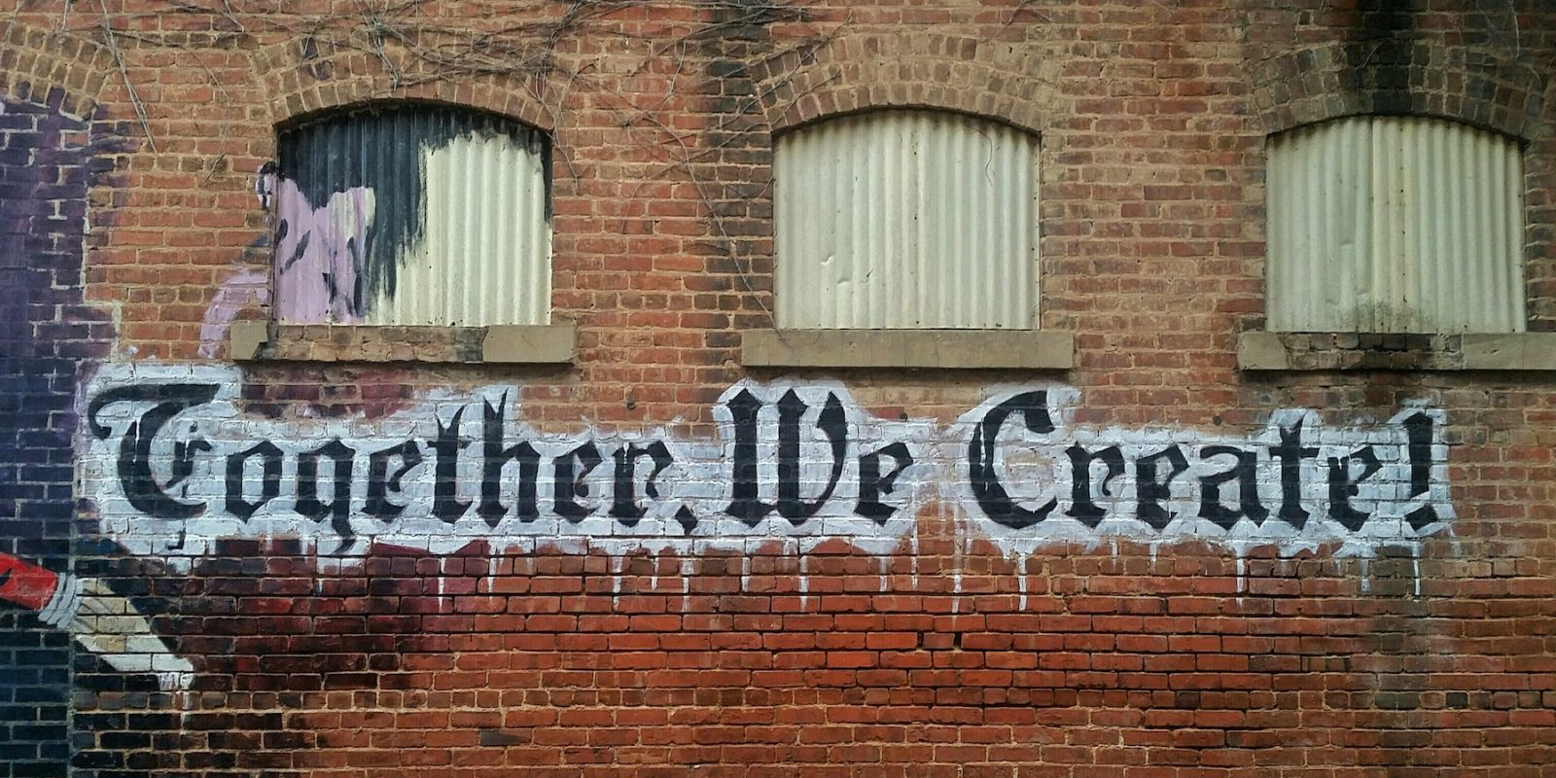
Open Pedagogy Notebook
“An access-oriented commitment to learner-driven education and a process of designing architectures and using tools for learning that enable learners to shape the public knowledge commons of which they are a part.”

Slide 15
Eight Attributes of
Open Pedagogy by
Bronwyn Hegarty
Open Pedagogy
Technology Web 2.0 mobile
Sharing ideas & resources
Reflective practices
People openness trust
Innovation & creativity
Connected community
Learner-generated
Peer review

Slide 16
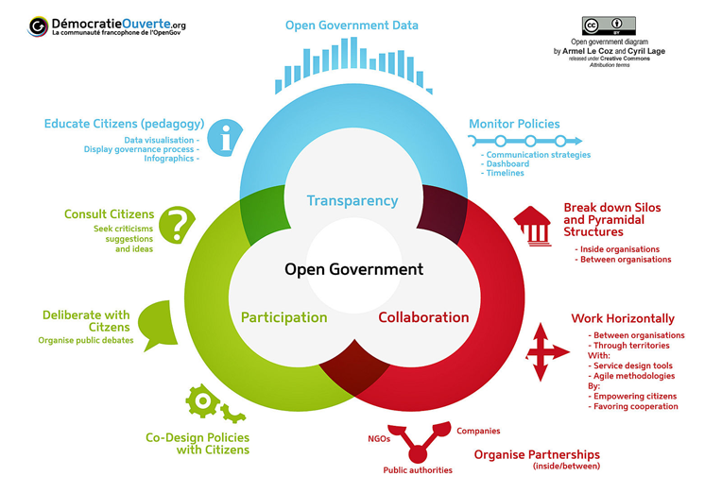
Open Government

Slide 17
Examples of Open Pedagogy
What are examples of Open Pedagogy that you have tried?
Share your examples and reflect on successes/challenges.

Slide 18
Why the word “open” at all?
“Open” is not to be taken literally (no door or box is open), but more in opposition to “closed,” and metaphorically: there are fewer or no restrictions on use.
A better word would have been FREE. Except that English confounds too much in that one word, requiring the clarification of the famous “‘Free’ as in speech, not ‘free’ as in beer.” Other languages are better! E.g.: IT: libero/gratis; FR: libre/gratuit; DE: frei/kostenlos; SP: libre/gratis; etc.
This battle was fought (and lost) for software decades ago, so we are left with open- source software – FLOSS=“Free/Libre/Open-Source Software” is better.
“Libero” and “libre” come from the same Latin root as the words “liberty” and “liberal” – a “liberal arts education” is an education which helps a person be a citizen of a free society, one where they expect to have freedom and agency. That’s what we’re after when we talk about “open education.”

Slide 19
Defining Open Pedagogy
How can open pedagogy be defined?
What are some essential characteristics for the definition?
Share your thoughts on this collaborative definition

Slide 20
Contact Information
CreativeCommonsCertificate
  https://certificates.creativecommons.org/
Jonathan Poritz
  jonathan.poritz@gmail.com
  https://poritz.net/jonathan
SuzanneWakim
  wakimsu@butte.edu

Slide 21
Attributions & References
All quotes and screenshots related the Creative Commons Certificate are from the certificates.creativecommons.org website, are by Creative Commons, and have been released under the Creative Commons Attribution 4.0 International license. They were all accessed on 31 July 2023.
Slides 13 – 15 (Defining OER-enabled Pedagogy, Open Pedagogy, and Open Educational practices) are based on the organization from Chapter 5.4 of the Creative Commons Certificate.
OER Enabled Pedagogy Slide references:
  Defining the "Open" in Open Content and Open Educational Resources by David Wiley
  Defining OER-Enabled Pedagogy by David Wiley and John Levi Hilton III
  What is Open Pedagogy by David Wiley
  Image attribution: Paper Projects by JerzyGorecki pixabay license
Open Pedagogy Notebook Slide references:
  Definition is quoted from Open Pedagogy Notebook
  Year of Open
  Open Pedagogy Notebook
  Image attribution: Together we Create; public domain
Open Educational Practices references:
  Cronin’s 2018 Open Edu Global presentation
  Adapted from CC Certificate; CC-BY 4.0
  Image attribution: Adapted from www globe and social media; pixabay license
Eight attributes of Open Pedagogy Bronwyn Hegarty
  Attributes of Open Pedagogy by Bronwyn Hegarty based on Conole (2013) licensed CC-BY 3.0 [recreated from image as MS SmartArt]
Open Government
  Democratie Ouverte by Armel Le Coz and Cyril Lage, licensed CC BY 3.0

