Slide 1

COLORADO’S
OER
INITIATIVE
Meg Brown-Sica, Spencer Ellis, Tina Parscal, & Jonathan Poritz
January 30, 2019

Slide 2
INTRODUCTIONS
Meg Brown-Sica, Assistant Dean for Collections and Scholarly Communication, CSU-Fort Collins
Spencer Ellis, Director of Educational Innovation, Colorado Department of Higher Education
Dr. Tina Parscal, Executive Director, Colorado Community Colleges Online
Dr. Jonathan Poritz, Associate Professor, Math and Director of Center for Teaching and Learning, CSU-Pueblo / OER Council Chair

Slide 3
AGENDA
Welcome & Introductions
What is OER and Why is it important?
Colorado’s OER initiative
Getting started with OER
OER in action (Institutional Examples)
How to get involved?
Questions & Answers

Slide 4



THE WHAT & WHY OF OER

Slide 5
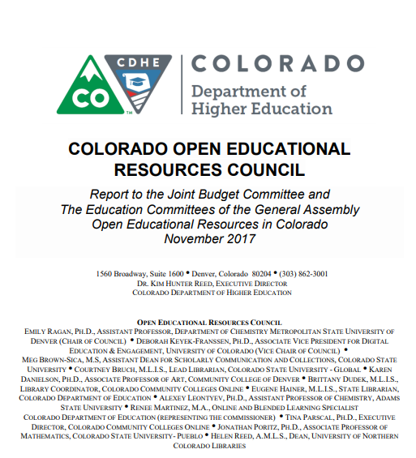

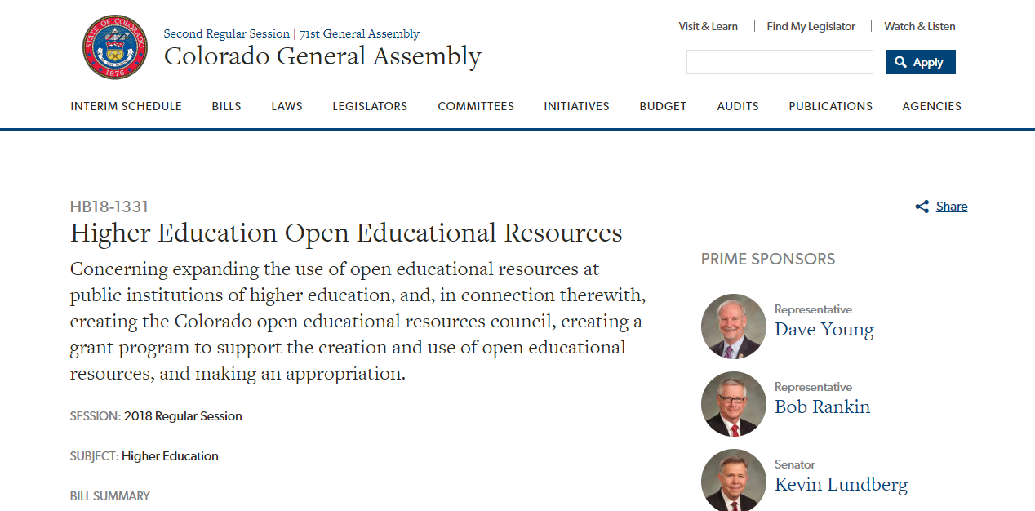
COLORADO’S OER INITIATIVE
OER Council, WCET & CDHE

Slide 6
90%
Highlights from 2017 Statewide Survey
Nearly 90 percent of respondents who took the Solicitation of Individual Input Survey reported that they agreed with the statement “Textbook costs have become a serious affordability barrier to students attending Colorado’s colleges and universities.”
Of the 27 public institutions that returned surveys, 26 indicated that reducing the cost students pay for higher education is a “major” or “moderate” concern to the institution’s board, president and senior administrators.
Comments from participants agree that lowering the cost of education is beneficial to both individual students and Colorado society as a whole.
“...agree textbook costs have become a serious affordability barrier to students…”

Slide 7
2018 LEGISLATION:
HB 18-1331

Slide 8
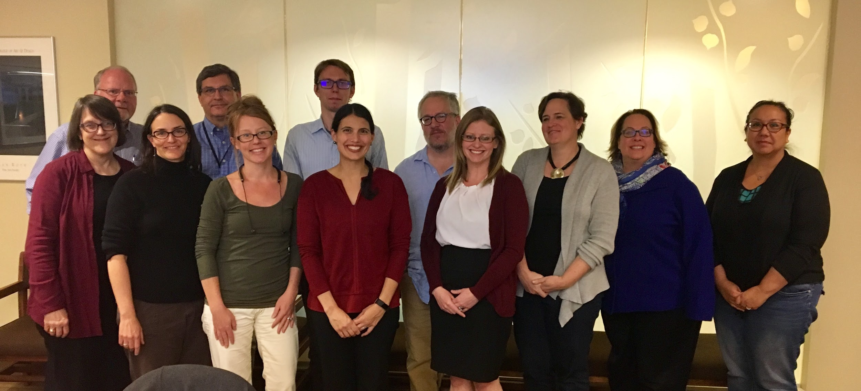
MEET THE 2018 OER COUNCIL
Working Groups
State Grant Administration & Sustainability
Policy & Reporting
Campus Outreach & Implementation
Communication & Website Curation
Not in photo: Dr. Ye Li (CSM), Dr. Mark Manzanares (ASU), Ragan Harper (CDE), Spencer Ellis (CDHE), Alana Mitchell (student rep)
Notes:
We have some nationally renowned professionals on the Council including:
-Jonathan Poritz (chair and faculty member at CSU-Pueblo)
-Brittany Dudek (nominated for WICHE’s Sally Johnstone Award which “recognizes a professional who has made an outsized contribution for their 'rank' to the technology-enhanced learning community”)
-Ye Li (Librarian at CSM, departing for libraries at MIT)
-Meg Brown-Sica (national leader in the OER movement, highly involved in Open Ed. community)
Too name a few..

Slide 9

COLORADO OER GRANT PROGRAM
Two types of proposals are solicited for an initial round of funding:
Those from public institutions of higher education to support and expand creation, adoption, adaptation and promotion of the use of OER across the institution and among multiple institutions
  Institutional Grants ranging from $10,000-$99,999
Those from faculty and/or staff of public institutions of higher education, individually or in small groups, to support the creation, adoption, adaptation and promotion of OER for specific courses, disciplines or programs.
  Individual or Small Group Grants ranging from $250-$4,999
Minimization of indirect costs encouraged
Partial funding and revisions to scope of work or project modification allowable
Vary slightly for individual and institutional grants; refer to RFP
Rubric directly reflects selection criteria & sections of proposal
Emphasis on accessibility and Creative Commons license

Slide 10
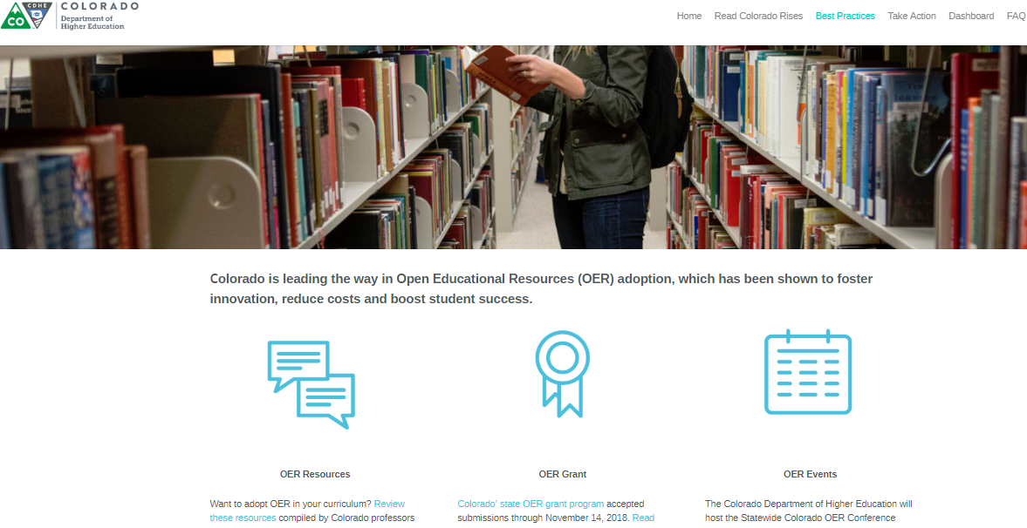
COLORADO OER WEBSITE
Currently updated with information on Council, OER in Colorado and resources
Resources include:
  Training and ‘How To’ Materials
  Licensing and accessibility guidelines
  References to existing repositories
  Guides for Creating Content

Slide 11
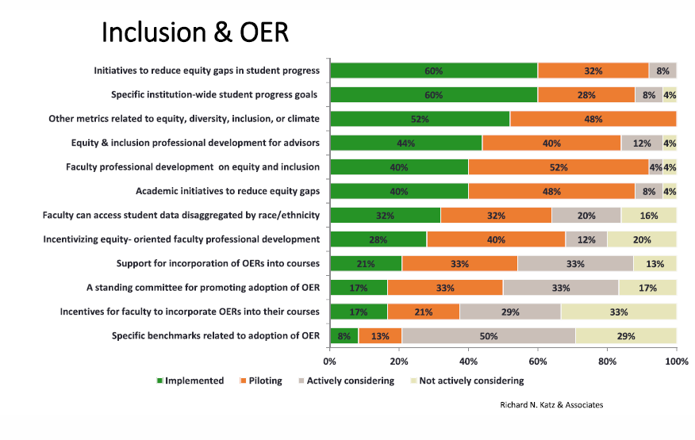
Where are we now?

Slide 12



Where are we going?
OER is just getting starting here in Colorado!

Slide 13

GETTING STARTED
WITH OER
https://mountainscholar.org/bitstream/handle/10217/23929/UHPC_901.jpg?sequence=1&isAllowed=y

Slide 14
Getting Started for Faculty
Find available materials in your subject area.
Talk to anyone who works with OER on your campus, librarians, instructional designers, other faculty.
Identify the courses in your department that have the highest enrollment, highest cost of course materials, and highest DFW rates.
Discuss the issue at a departmental meeting.
Invite a faculty member from your campus or another nearby campus who uses OER to discuss it with your department.
Join the SPARC mailing list/forum to connect with others who use OER in your discipline.

Slide 15
Getting Started for Administrators
Articulate that implementing OER where appropriate is a goal for the campus through strategic planning, student success initiatives, professional development for faculty, etc.
Make OER support part of the responsibilities of several key positions in the library, faculty support, and student success.
Make sure students can easily identify courses which utilize OER when registering.
Prioritize long term benefits vs. quick fixes.
Identify resources to support initiatives.

Slide 16
WHERE CAN WE FIND OER?
To reap the benefits of OER, institutions and faculty need either to create their own (under a CC license) or adapt or adopt an existing OER. They can be found
on a lot of random individuals’ web pages, e.g.,
http://www.introtoie.com/
or (thousands? of) others, in small disciplinary collections, e.g.,
https://aimath.org/textbooks/
in a few well-known OER repositories like
https://openstax.org/ and
https://open.umn.edu/opentextbooks/
or in a few well-known indices/search tools, e.g.,
https://www.oercommons.org/ or
https://www.merlot.org/merlot/index.htm
In short, OER are not hard to find [particularly if you ask for help from a librarian].

Slide 17
OER Organizations
SPARC: A global coalition committed to making Open the default for research and education.
  Focus/Benefits: Lists/Forums, Open Education, Open Access Publishing, Open Data, government policy/lobbying, leadership program.
  Membership: Institutions can become members to support their work but information is freely available.
OTN/Open Textbook Network/Center for Open Education: Support initiatives that advance open education.
  Focus/Benefits: List/Forum, hosts and maintains the Open Textbook Library, provides training, publishing support, a yearly summit and active community for member institutions.
  Membership: Institutions or groups of institutions can become members to support their work and benefit from community.

Slide 18
Others
Community College Consortium for Open Educational Resources
Rebus Community
Creative Commons
United Nations Educational, Scientific, and Cultural Organization (UNESCO)
ACRL/CJCLS OER Task Force

Slide 19



OER IN ACTION

Slide 20
OER IN ACTION
OER IN ACTION
CSU has a long history of developing and using freely available resources and OER.
Early use of free and open materials:
  Writing@CSU website (https://writing.colostate.edu)/WAC Clearinghouse (1996).
  GIS materials developed in collaboration with NASA and NSF by Dr. Melinda Laituri in the early 2000s
  The VCHILL system, developed by Dr. V. Chandrasekar in the late 1990s and early 2000s, which has been widely used at all levels of education to support understanding of radar systems and signal detection
  Web-based textbooks, developed by Dr. Richard Bowen, used in courses across the biomedical sciences in high school and college
  Early tutorials developed by Dr. David Fahrney and Dr. Jeffrey Hansen used at and beyond CSU in structural biochemistry courses
Current Use:
  CSU has had several key courses that have adopted existing Open Educational Resources for course materials:
    LIFE 205 (Fall 2017/Spring 2018 enrollment: 135 students)
    CHEM 111 (1,831 students)
    CHEM 113 (1,359 students)
    ECON 202 and 203 (Pilot this semester with potential to move to all sections with a total enrollment of 3,000 students per year.
Work on campus:
  Most recently, CSU has worked to increase awareness of OER among faculty, staff, and students by partnering with leading OER organizations, such as the Open Textbook Network and OpenStax, and offering workshops that support the adoption of OER. The OER working group and task force emerged from these efforts.

Slide 21
OER IN ACTION
OER IN ACTION

Slide 22
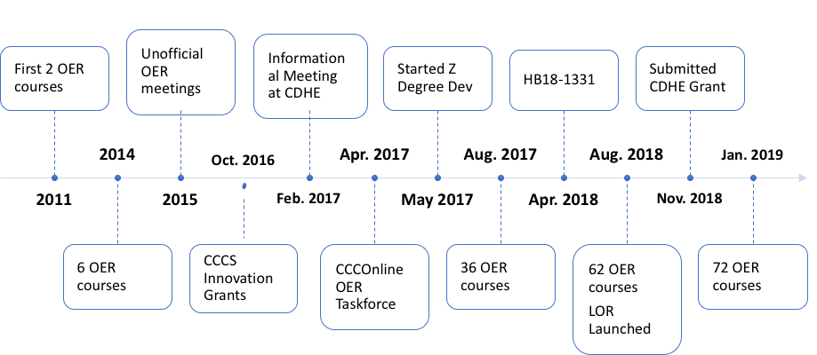
FUTURE OER PLANS
OER IN ACTION
Notes:
Background
Colorado Community Colleges Online is the consortium of the 13 colleges in the CCCS. We also serve Dawson CC in Glendive MT. For 20 years, CCCOnline has delivered online courses on behalf of the colleges.
There are a few things that enable CCCOnline to offer online courses at scale: 1. Single LMS and SIS and 2. CCNS. Centralize course development process using MCT. That is, individual faculty don't built own courses, we build master shell that mutiple instructors teach. We maintain 229 courses. 72 use OER.
In addition to an academic team and academic team, CCCO has a dedicated librarian and team of IDs that help develop OER courses. Leverage library materials and OER content. Therefore not true OER.
Timeline
Unofficial OER meetings - as we embarked on OER, discussions emerged around how it fits with our instructional design, course material adoption, digital integration, copyright, and other processes. Informal workgroup met to shift through these questions.
October 2016 -CCCS awarded to CCCOnline. WebWork (with RRCC and CCD). Transition 7 courses to OER. No sign difference in SLO, saved student $, good formative feedback from students in evaluation. During the grant period saved student $134k in course material costs.
April 2017 - formalized an OER taskforce.
The Learning Object Repository (LOR) went live August 1, 2018. 25 courses and over 1,500 learning objects have been migrated from Skills Commons into the LOR. All OER from previous grants in the system.

Slide 23
FUTURE OER PLANS
OER IN ACTION
Results
AY18 (FA17, SP18, SU18) OER Enrollment: 14,740 students
(30% of total enrollments)
AY18 (FA17, SP18, SU18) Student Savings: $777,203
Fall 18 OER Enrollments: 7,160
(37% of enrollments)
Fall 18 Student Savings: $372,315
Upcoming
Summer 2019: Launch Associates of Arts – History Zero-Textbook Cost Degree
Fall 2019: Launch Associates of Arts - Early Childhood Education Zero-Textbook Cost Degree

Slide 24
OER: 2019 & BEYOND
HOW TO GET INVOLVED!
Statewide conference on OER
Statewide trainings and outreach to faculty and staff
Grants

Slide 25


Slide 26

THANK YOU
Meg Brown-Sica | meg.brown-sica@coloradostate.edu, @brownsica
Spencer Ellis | spencer.ellis@dhe.state.co.us
Tina Parscal | tina.parscal@cccs.edu, @tjp303
Jonathan Poritz | jonathan.poritz@csupueblo.edu, https://poritz.net/jonathan, @poritzj
These slides released under a
Creative Commons Atritribution 4.0 license

