Slide 1

OPEN TEXTBOOKS for CSU-Pueblo
Access, Affordability, and Academic Success
On behalf of the PueblOER Committee: Rhonda Gonzales, Denise Henry, Margie Massey, Lona Oerther, Adam Pocius, Jonathan Poritz, and Leticia Steffen, with help from Isabel Soto-Luna and Alexis Wolstein
This work, licensed under a Creative Commons Attribution 4.0 International License (CC BY 4.0), is an adaptation by Jonathan Poritz of CO - Faculty Workshop Master by David Ernst, which is also licensed CC BY 4.0.

Slide 2

“…higher education shall be equally accessible to all”
Notes:
Not that many people know that United Nations’ Universal Declaration of Human Rights actually has language embedded within it concerning the importance of equal access to higher education (A26).
You might think of those people around the world. But no we are also talking about here in this country, where people who do not have equal access to higher ed.
And we are talking about an issue that is much broader than just textbooks.
I am very pleased to be here and to have a chance to speak with you about issues that I think concern us all. When I think about the value and goals of higher education, I see a vehicle to unleash human potential, to help our students become both knowledgeable & skillful, to become good global and good local citizens. I see a vehicle that has the potential to deliver us from social inequality. However, I also see that far too often higher education is structured in a way that only serves to reinforce social inequality.

Slide 3
From the CSU-Pueblo Vision 2028:
Our Values:
CSU-Pueblo is dedicated to interdisciplinary learning and entrepreneurship that elevates our people and our community, creates educational opportunities, fosters unique collaborations, and supports inclusion, access, and affordability as a gateway to the world.

Slide 4
The cost barrier kept
2.4 million
low and moderate-income college-qualified high school graduates from completing college in the previous decade.
The Advisory Committee on Student Financial Assistance http://files.eric.ed.gov/fulltext/ED529499.pdf
Notes:
This is from a study done for the US Department of Education. 2.4 million did not finish college because of cost in the first decade of this century.

Slide 5
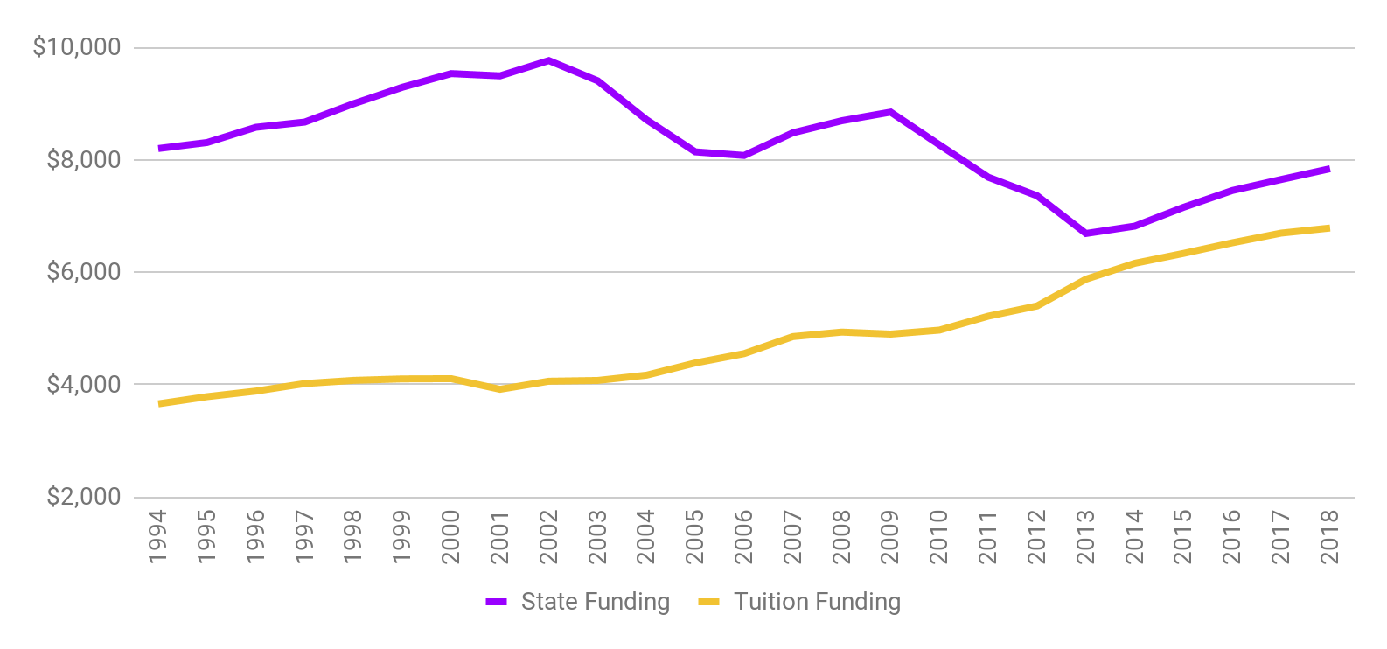
Higher Education Funding - US
http://www.sheeo.org
Notes:
Compare the proportion of cost that students must contribute in 1993 to today.

Slide 6
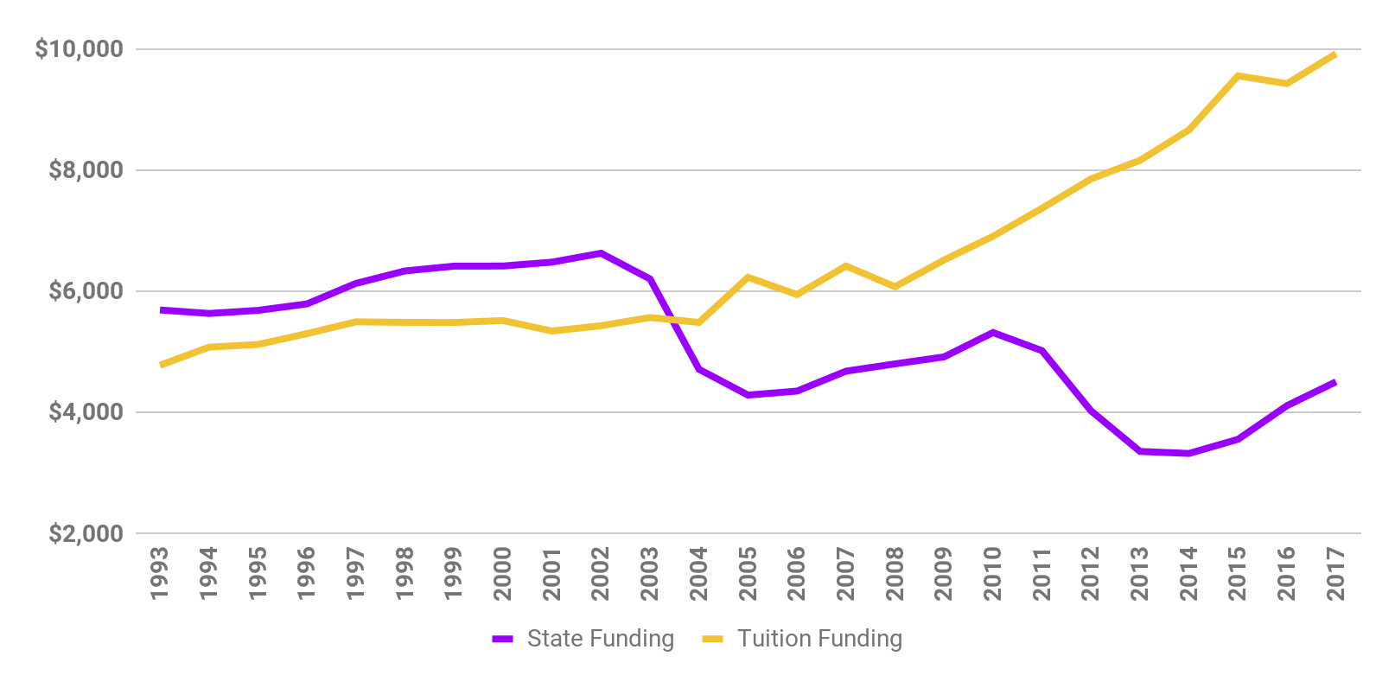
Higher Education Funding - Colorado
http://www.sheeo.org
Notes:
Compare the proportion of cost that students must contribute in 1993 to today.

Slide 7
The average debt of CSU-Pueblo graduates in 2015 was
$28,914
Compare: average debt of all graduates (bachelors degrees) in Colorado that year of $25,840.
CSU-Pueblo’s overall degree completion rate in 2015 was approximately 33%.
http://ticas.org/posd/map-state-data
Notes:
About 2/3 of students borrow to get through school. These borrows graduate with an average debt of …
National data:https://ticas.org/content/pub/student-debt-and-class-2017
Include state/institution’s data – can be found at https://ticas.org/posd/map-state-data#overlay=posd/state_data/2018/in

Slide 8
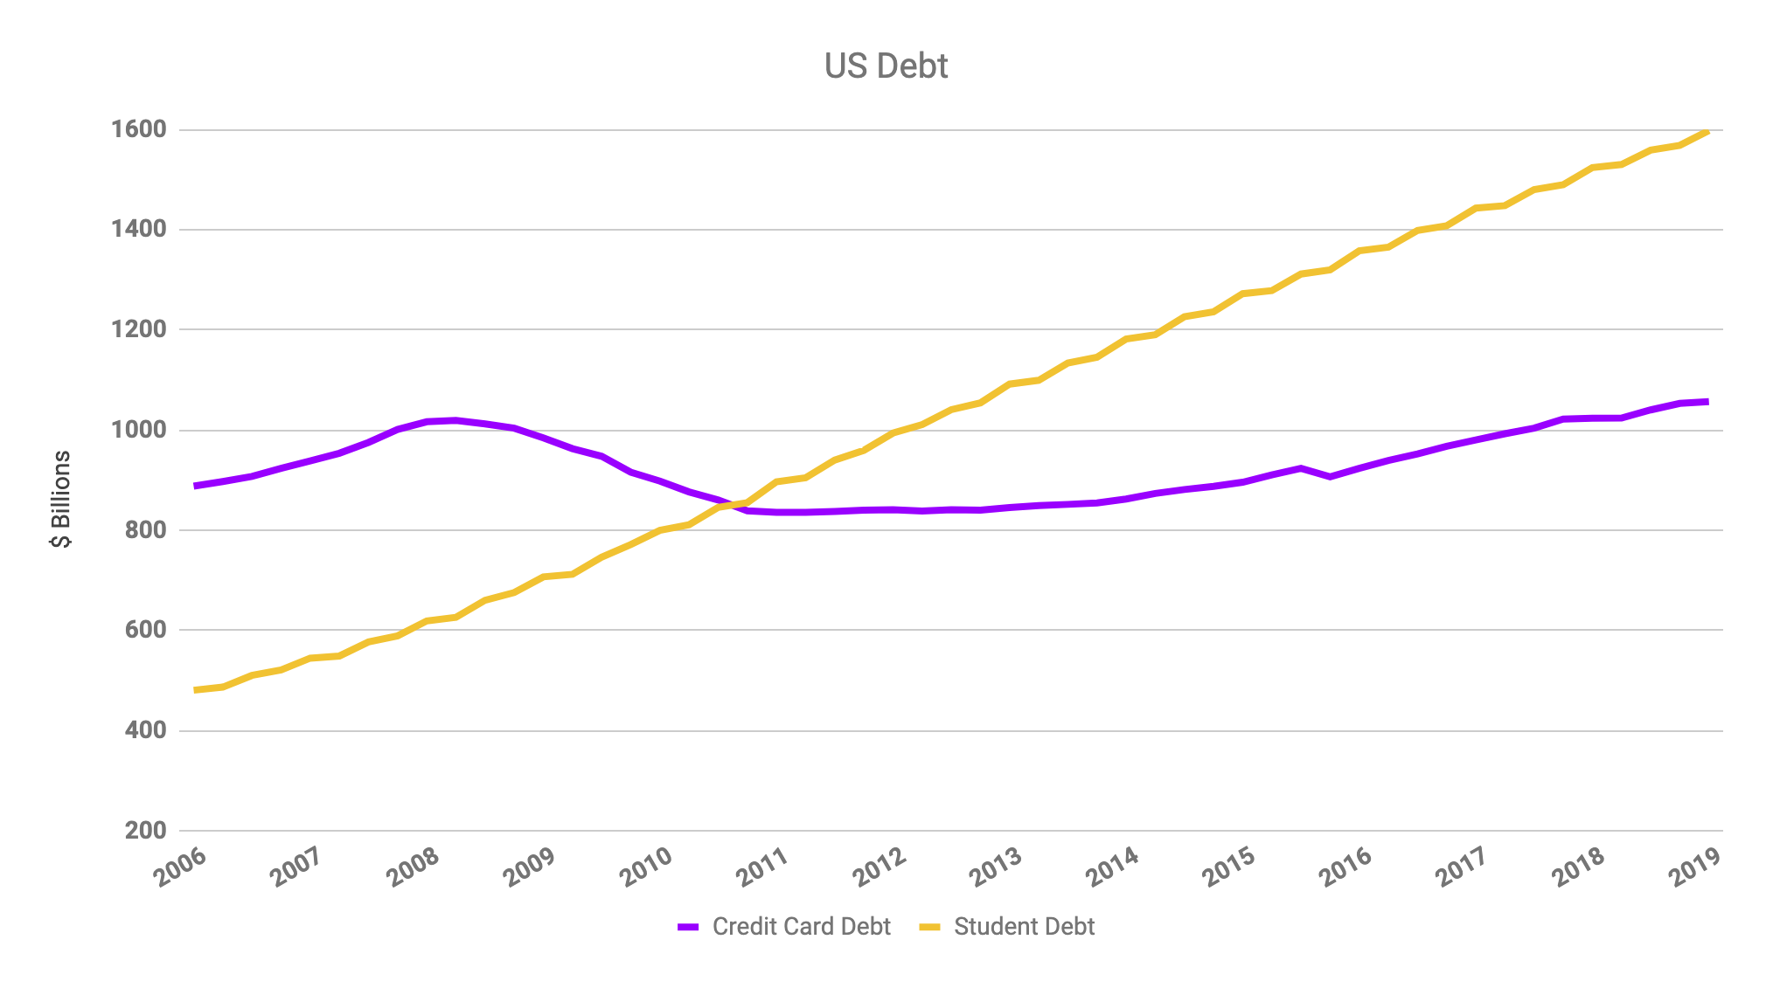
Federal Reserve http://www.federalreserve.gov/releases/g19/Current/
Notes:
Consumer Revolving Credit = Credit Card Debt
Tripled in just a decade, over 1.4 Trillion

Slide 9
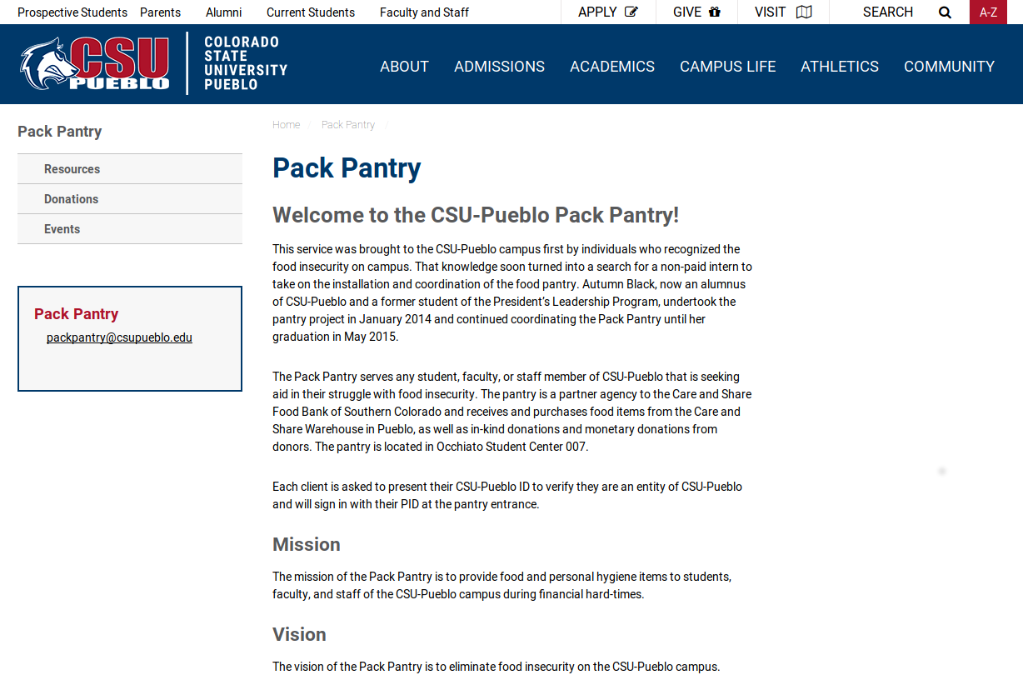

Slide 10
CSU-Pueblo was a participating campus for 2018 in Sara Goldrick-Rab’s national #RealCollege Survey, which found that, out of the approximately 600 CSU-Pueblo students polled:
45% were food insecure in the prior 30 days
53% were housing insecure in the previous year
17% were homeless in the previous year
Notes:
The College and University Foodbank Alliance started in 2012 with 13 members.
As of June, 2018, they had 641 members.

Slide 11
What can we do?
Tuition and Fees
Room and Board
Books and Supplies
Personal Expenses
Transportation
Notes:
Admit that it’s not the highest cost leading to these affordability issues – but it is:
the one cost that we as faculty can impact
it has a special impact on the academic success of students (as we’ll see later)

Slide 12
What can we do?
Tuition and Fees
Room and Board
Books and Supplies
Personal Expenses
Transportation
Notes:
Admit that it’s not the highest cost leading to these affordability issues – but it is:
the one cost that we as faculty can impact
it has a special impact on the academic success of students (as we’ll see later)

Slide 13
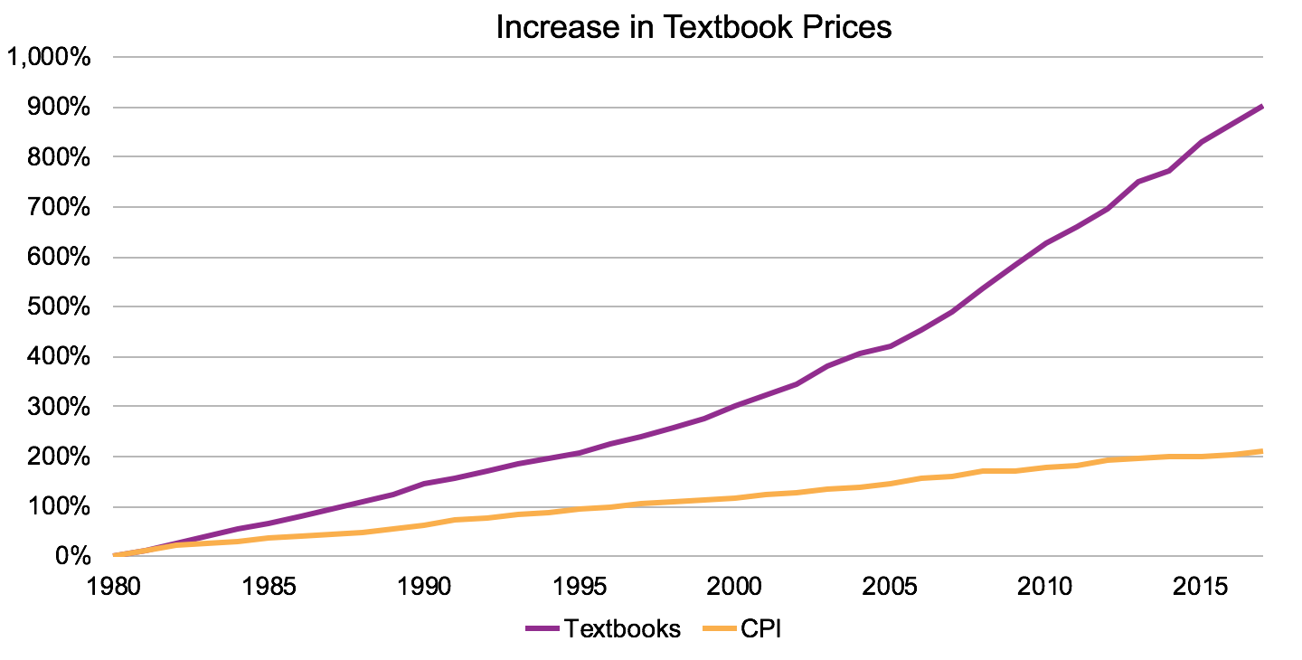
Bureau of Labor Statistics http://www.bls.gov/cpi/

Slide 14
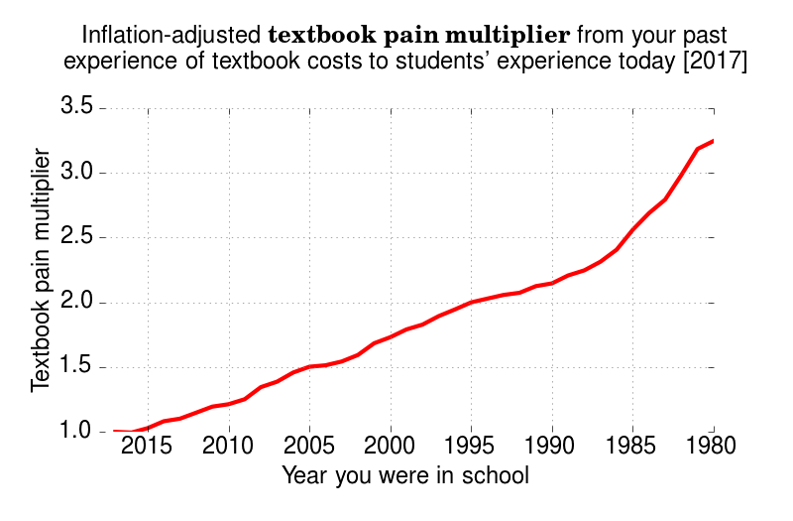

Slide 15
Students are told to budget between
$1240 - $1440 for books and supplies each year.
What they are actually spending is more like $415 per year.
Why the difference?
CSU-Pueblo’s Student Financial Services Office Recommends $1,800/year for books&supplies
https://www.csupueblo.edu/student-financial-services/cost-of-attendance.html
http://www.nacs.org/advocacynewsmedia/pressreleases/tabid/1579/ArticleID/867/Student-Spending-on-Course-Materials-Declines.aspx
Notes:
Note that the College Board data reflects what students are asked to budget for books and supplies each year. It’s not what they actually spend. Students are more likely to spend about $600 on books and supplies. It’s important to note this difference, and then ask the attendees why they think there’s a difference between what they are told to budget and what they actually spend.
While what students are spending on course materials appears to be declining, it’s not clear why. It could be because of the increase of inclusive access (which they probably are unaware of), it could be because they are purchasing fewer and fewer books, or it could be that course materials are decreasing in cost.
Consider localizing left-hand side of slide and actually find out cost of materials at individual schools by Googling Cost of Attendance and name of school. Then insert animation to show general and then specific cost.

Slide 16
Coping with the Cost
Purchase an older edition of the textbook
Delay purchasing the textbook
Never purchase the textbook
Share the textbook with other students
Download textbooks from the internet
Notes:
This section explores the ways students cope with the high costs and the academic risk, and the academic impact that those actions have.

Slide 17
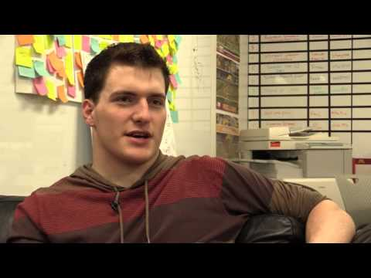
https://www.youtube.com/watch?v=-4IswNs0WWE

Slide 18
In your academic career, has the cost of required textbooks caused you to:
64.2% | Not purchase the required textbook
42.8% | Take fewer courses
40.5% | Not register for a specific course
35.6% | Earn a poor grade
22.9% | Drop a course
18.1% | Withdraw from a course
17.2% | Fail a course
Notes:
This slide is the key slide in making the point that cost is having an academic impact.
https://dlss.flvc.org/documents/210036/1314923/2018+Student+Textbook+and+Course+Materials+Survey+Report+--+FINAL+VERSION+--+20190308.pdf/07478d85-89c2-3742-209a-9cc5df8cd7ea

Slide 19
Notes:
Ask them if they’re depressed yet. ☺ This is the end of defining the problem.
I typically ask what would solve this problem – what would make all the percentages on slide 22 go to 0%? Eventually, someone will say “free textbooks”. Ask the question “but how could a textbook be free? They typically cost hundreds of thousands of dollars to create.” Let’s look at a simplified explanation of the business model…

Slide 20
In your academic career, has the cost of required textbooks caused you to:
64.2% | Not purchase the required textbook
42.8% | Take fewer courses
40.5% | Not register for a specific course
35.6% | Earn a poor grade
22.9% | Drop a course
18.1% | Withdraw from a course
17.2% | Fail a course
Notes:
This slide is the key slide in making the point that cost is having an academic impact.
https://dlss.flvc.org/documents/210036/1314923/2018+Student+Textbook+and+Course+Materials+Survey+Report+--+FINAL+VERSION+--+20190308.pdf/07478d85-89c2-3742-209a-9cc5df8cd7ea

Slide 21




College / University
Foundations
Government
Consortia
Publisher
Author
Author
$
$
$
$
Students
Students
Textbook
Textbook

Slide 22
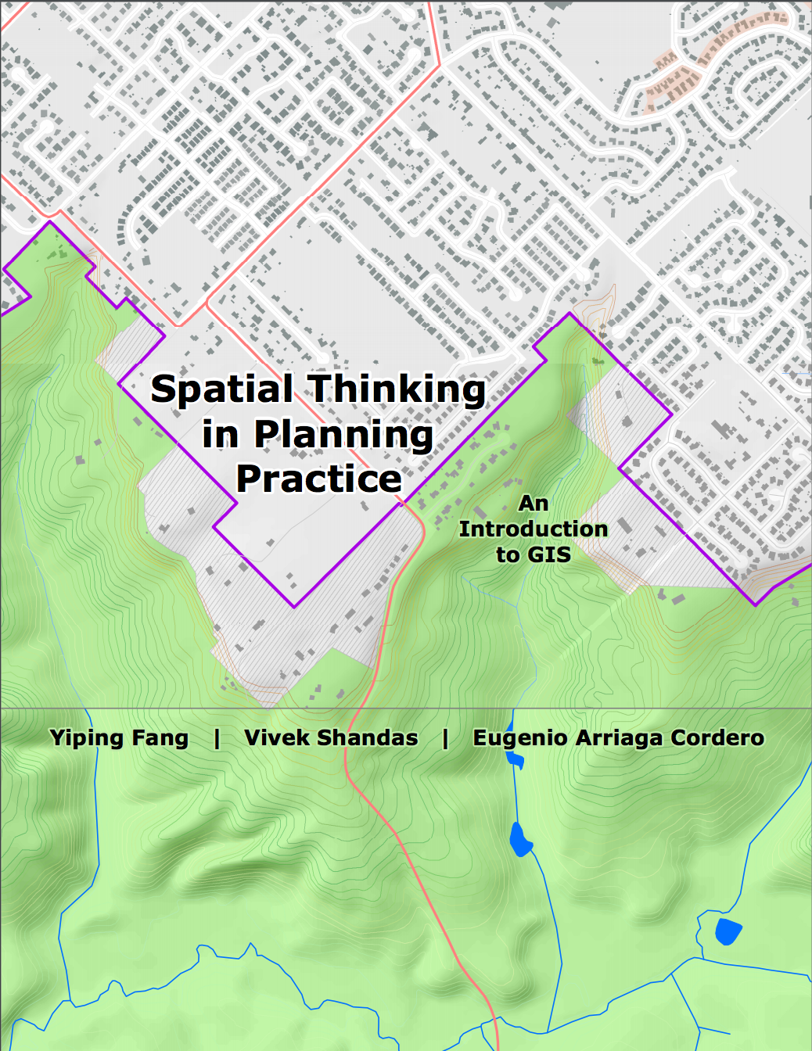
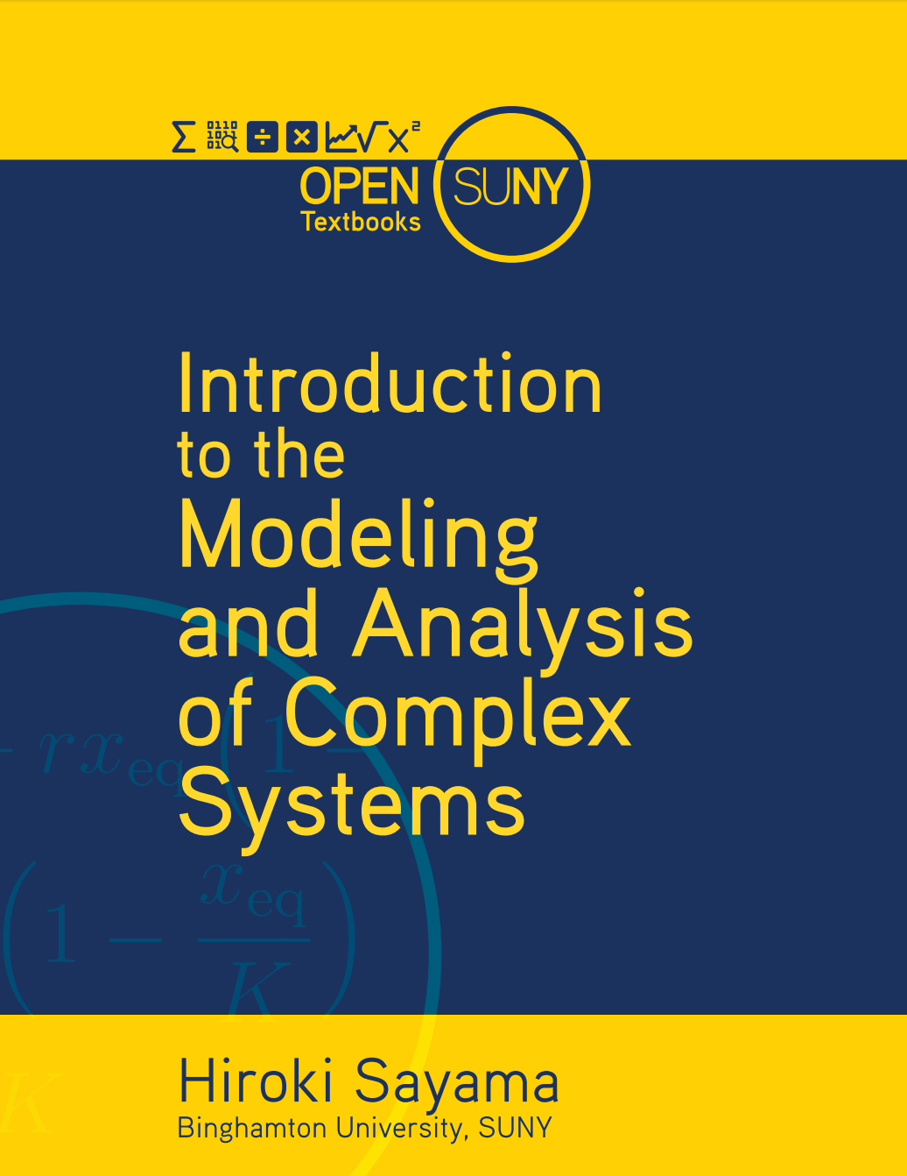
Notes:
Some example books from (1) Portland State University, and (2) SUNY – funded by the institutions

Slide 23
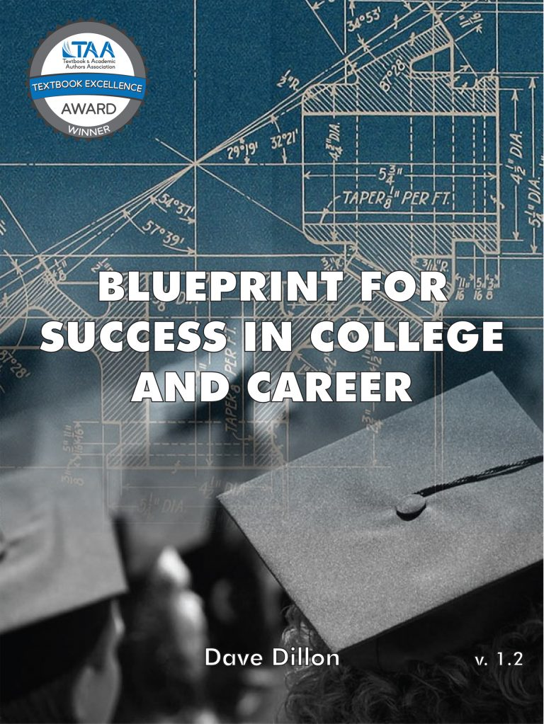
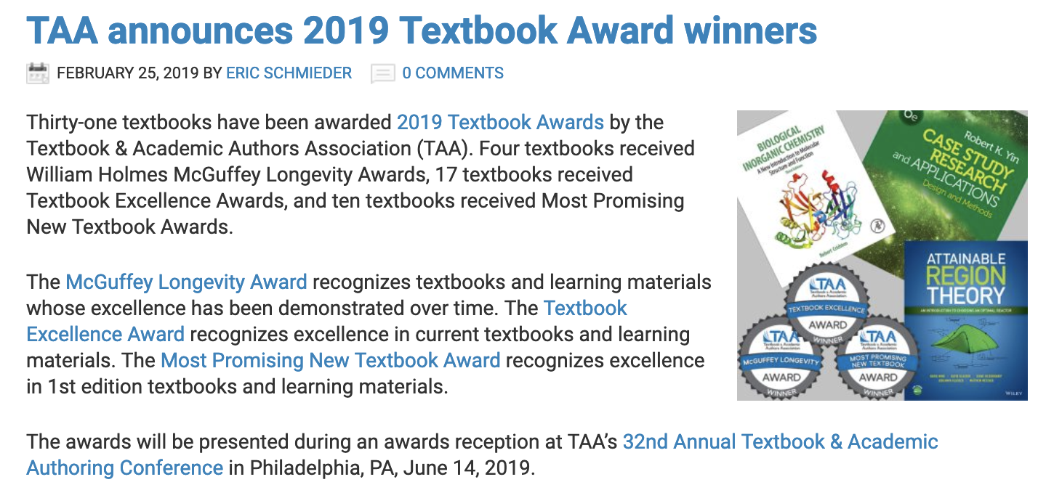

Slide 24
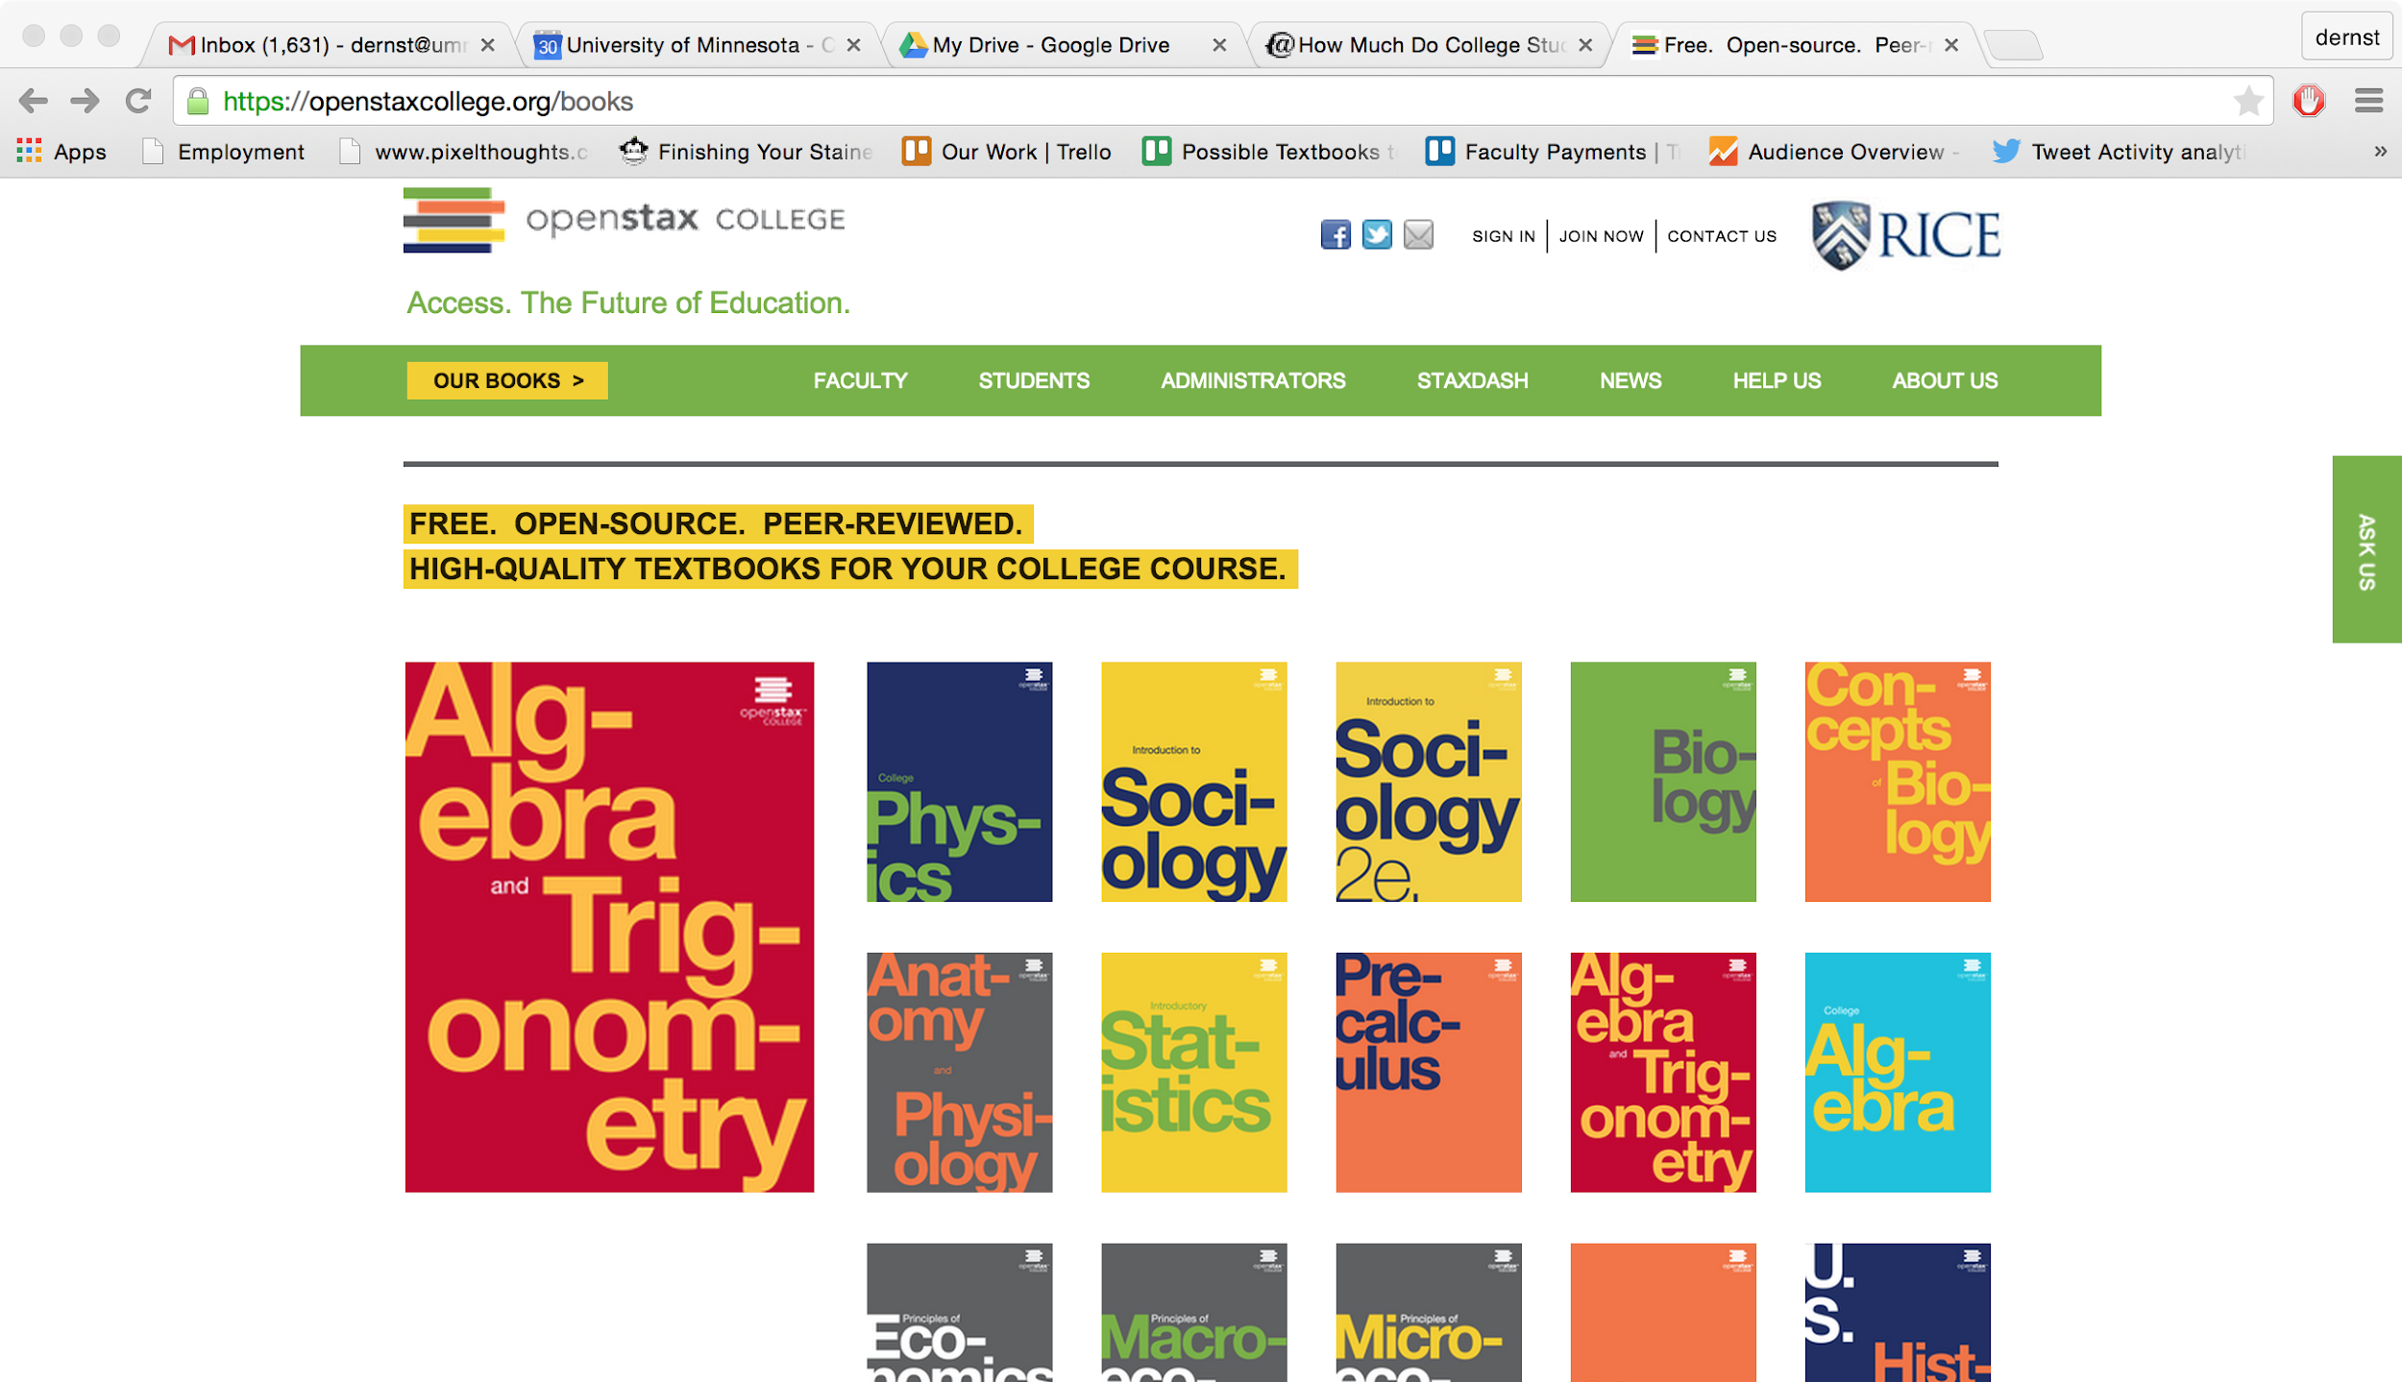
Notes:
OpenStax (Rice University) – funded by foundations

Slide 25
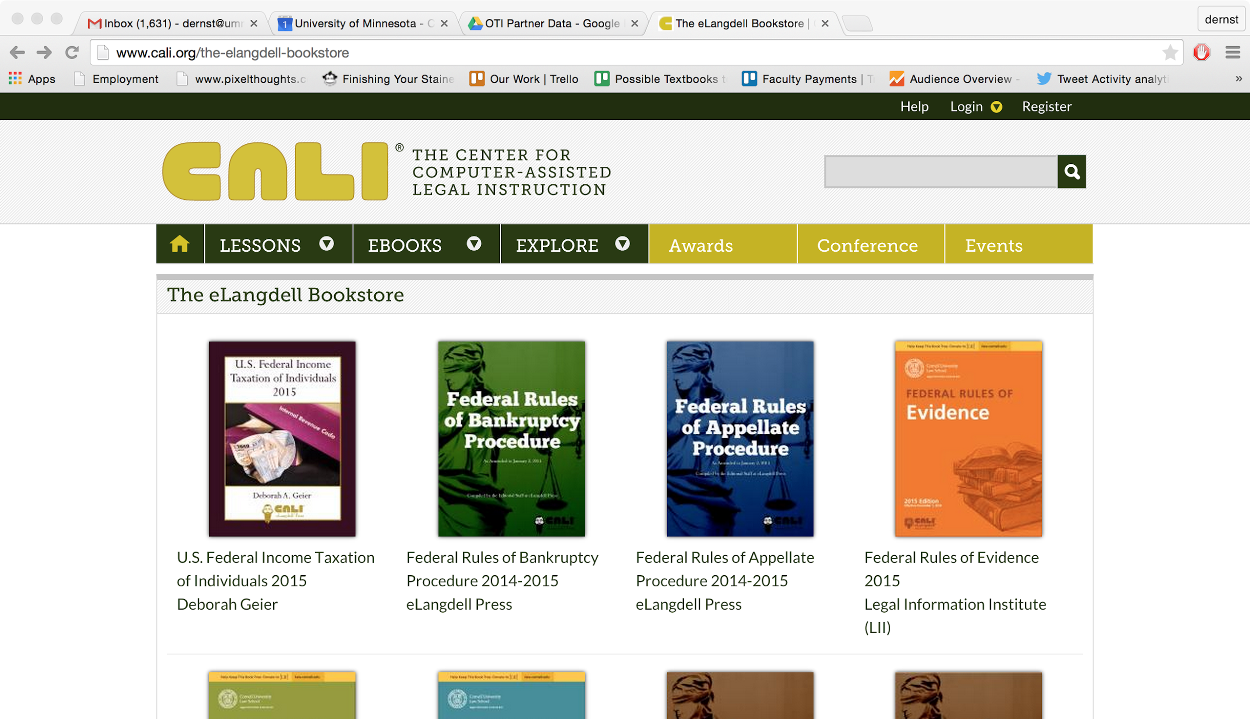
Notes:
CALI is funded by “just about every law school in the country” and they update these books annually. – funded by members.

Slide 26

College / University
Publisher
Author
Author
$
$
$
Students
Students
Textbook
Textbook

Slide 27
Notes:
Acknowledge that copyright law is extremely important. Then note that it wasn’t intended to help people who want to share. So it isn’t sufficient in this case. We need …

Slide 28

Notes:
… the Creative Commons. The CC is a nonprofit that created licenses to help people who want to share intellectual proerty.

Slide 29

All Rights
Reserved
Some Rights
Reserved

Slide 31
With Creative Commons licenses, you are free to…
Copy | Mix
Share | Keep
Edit | Use
Notes:
The licenses allow for these things…

Slide 32
College / University
Author
$
Students
Textbook

Slide 33

Notes:
…give a brief overview of the four license components.

Slide 34
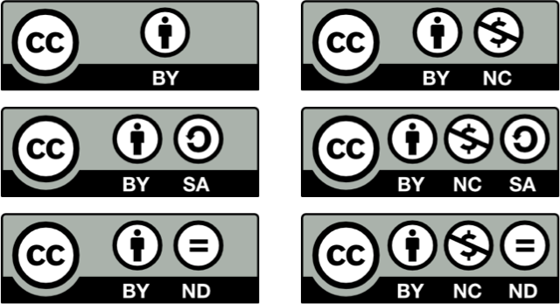
Notes:
These are the 6 CC licenses. Maybe even quiz them on one or two...
Note that these licenses are used in many places, but we often don’t notice...

Slide 35
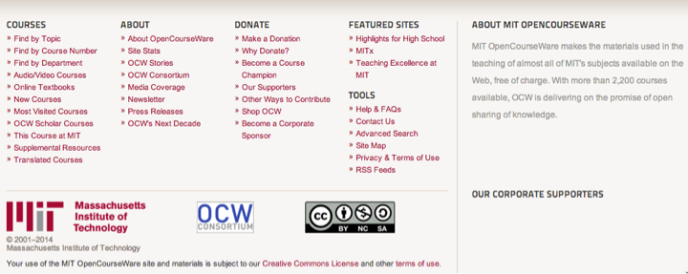
Notes:
MIT Open Courseware
This is a screenshot from an OCW page – there was a video above. Note the license.
MIT wants you to use it, and here are their terms: (BY NC SA). Ask what that means.

Slide 36
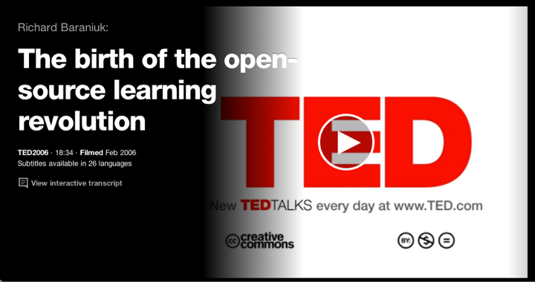
Notes:
TED Talks: BY NC ND
Ask what that means.

Slide 37
Notes:
So, that’s what a CC license is for…
Don’t get too bogged down in scenarios of CC remixing, etc. Tell them that this is just an overview.

Slide 38

Introductory, algebra-based, two-semester college physics
1272 pages
Available in
PDF
ePub
Print
Web
Bookshare (accessible)
Instructor solution manual
Powerpoint slides
Notes:
So, an open textbook (possibly the first time the term “open textbook” is used) is a textbook with a CC license – it’s free and you can do all the things on slide 43.
Here’s an example. Note the ancillary materials. Note that they shouldn’t assume that an open textbook doesn’t have them – some do and some don’t (just like commercial textbooks)

Slide 39
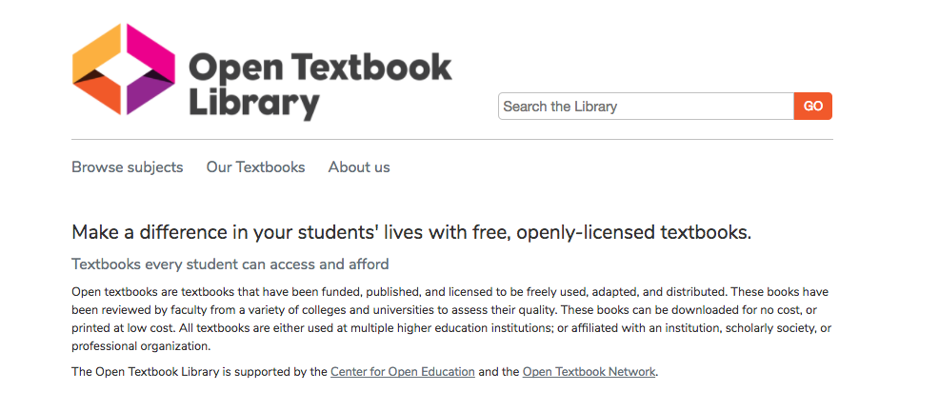
open.umn.edu
Notes:
This section is about credibility. The OTL is a collection of open textbooks to make it easy to find them, but we also are asking faculty to write reviews…

Slide 40
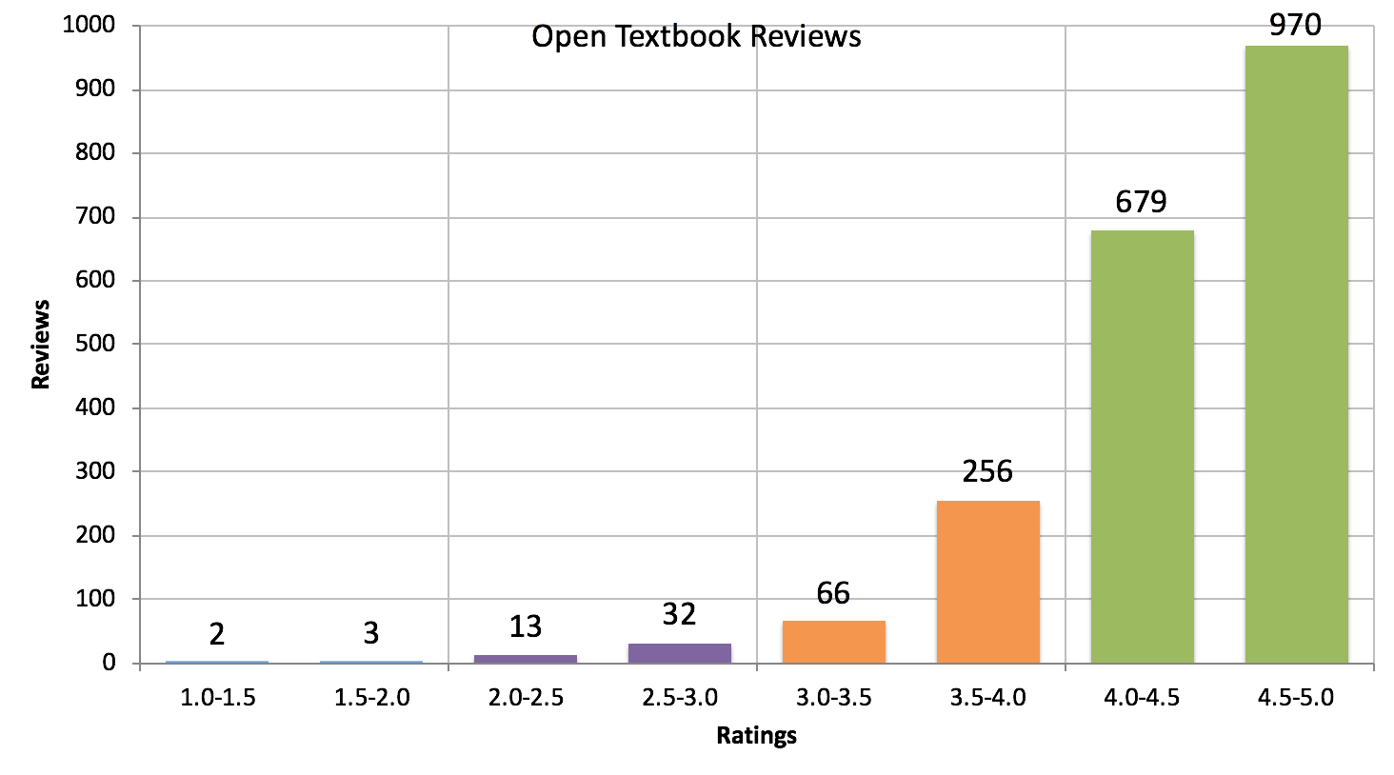
Notes:
Remember, OTN focuses on HONEST reviews, not seeking “good” reviews. Even if a text doesn’t live up to expectations, and honest review will tell faculty where things can be improved… or possibly… remixed or authored.

Slide 41
University of Georgia
Change from non-OER to OER
Δ Grade
Δ DFW
Non-Pell eligible students
+7.4%
-2.05%
Pell eligible students
+12.3%
-4.43%
All Students
+8.6%
-2.68%
The Impact of Open Educational Resources on Various Student Success Metrics
Notes:
Colvard, N., Watson, C., Park, H. (2018, July) The Impact of Open Educational Resources on Various Student Success Metrics. Retrieved from http://www.isetl.org/ijtlhe/pdf/IJTLHE3386.pdf
This article reports the results of a large-scale study (21,822 students) regarding the impact of course-level faculty adoption of Open Educational Resources (OER).

Slide 42
“…higher education shall be equally accessible to all”
Notes:
Not that many people know that United Nations’ Universal Declaration of Human Rights actually has language embedded within it concerning the importance of equal access to higher education (A26).
You might think of those people around the world. But no we are also talking about here in this country, where people who do not have equal access to higher ed.
And we are talking about an issue that is much broader than just textbooks.
I am very pleased to be here and to have a chance to speak with you about issues that I think concern us all. When I think about the value and goals of higher education, I see a vehicle to unleash human potential, to help our students become both knowledgeable & skillful, to become good global and good local citizens. I see a vehicle that has the potential to deliver us from social inequality. However, I also see that far too often higher education is structured in a way that only serves to reinforce social inequality.

Slide 43
How else can open textbooks improve student success?

Slide 44
Content Customization
Localization
OER Enabled Pedagogy

Slide 45
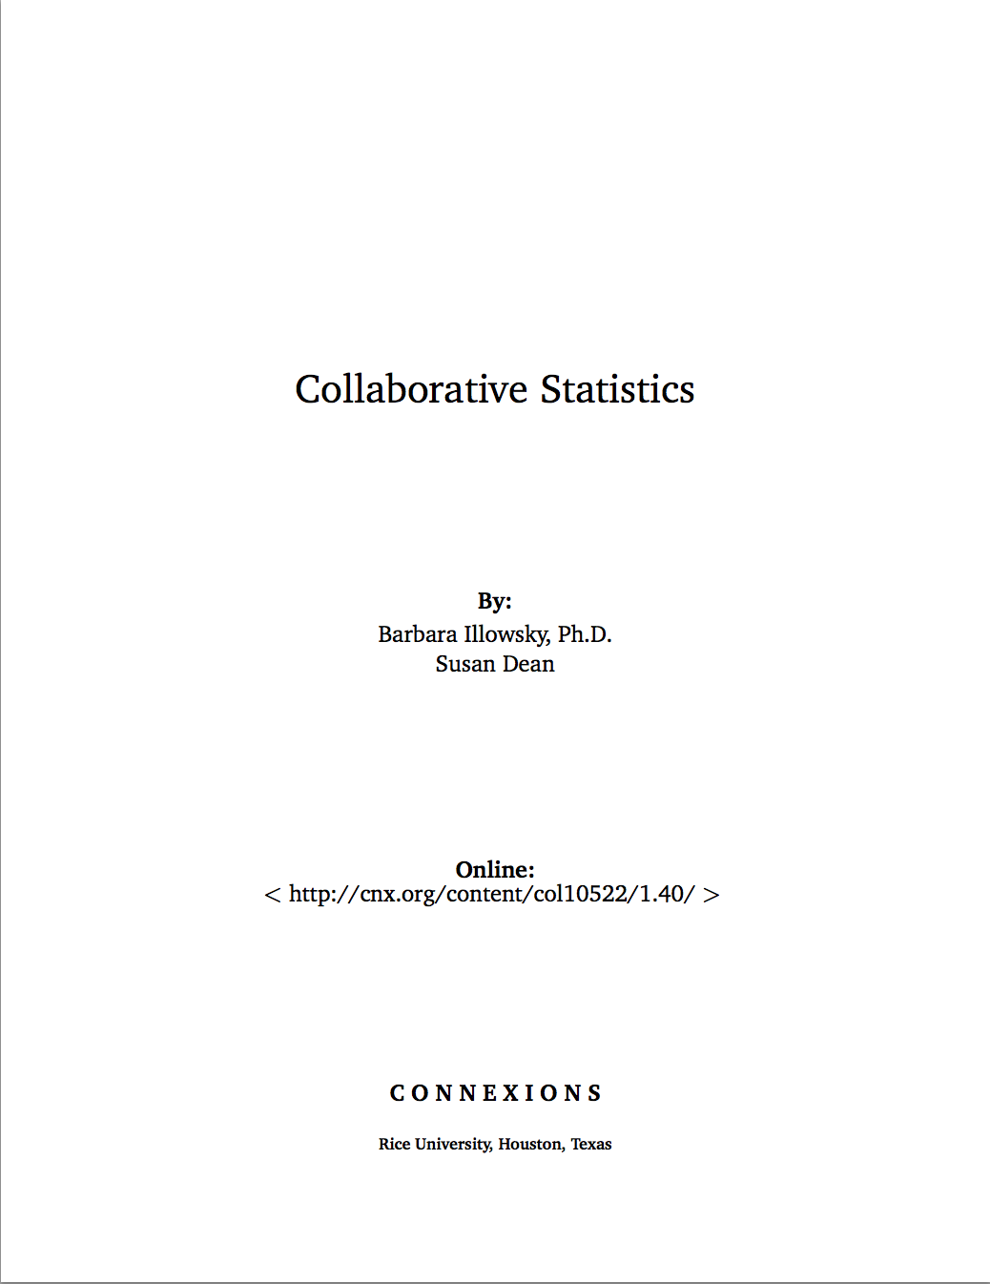
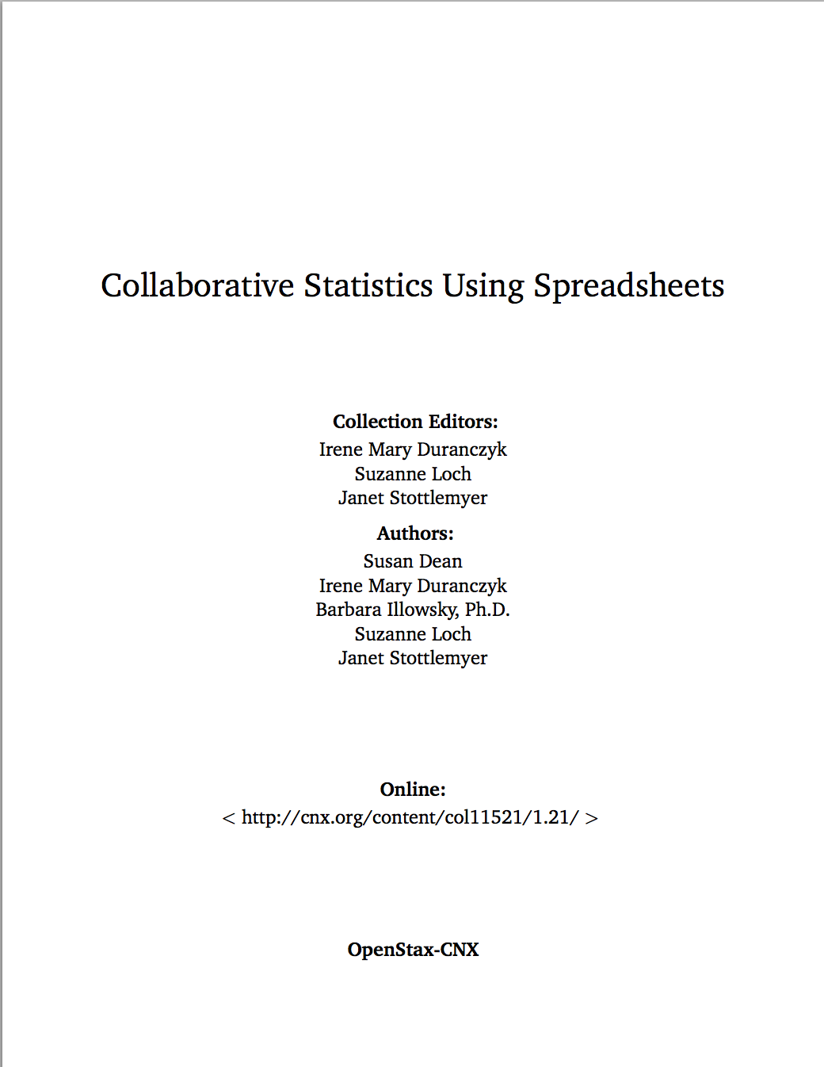
Content Customization

Slide 46
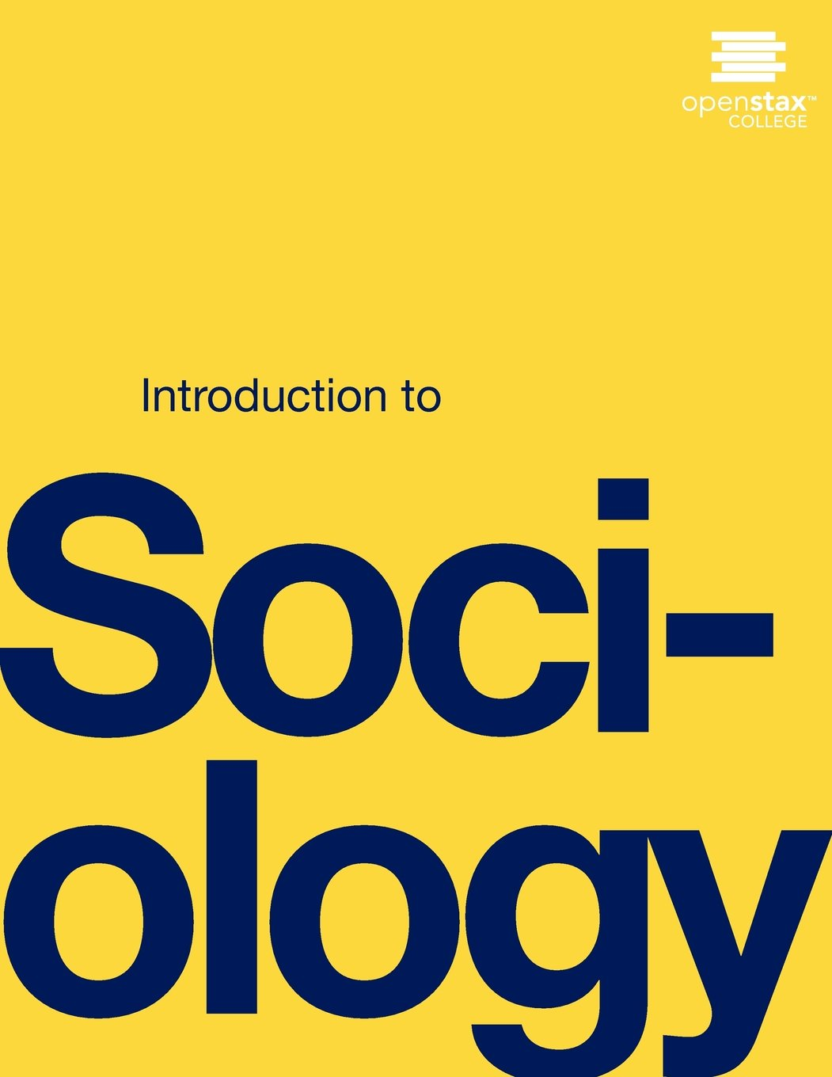
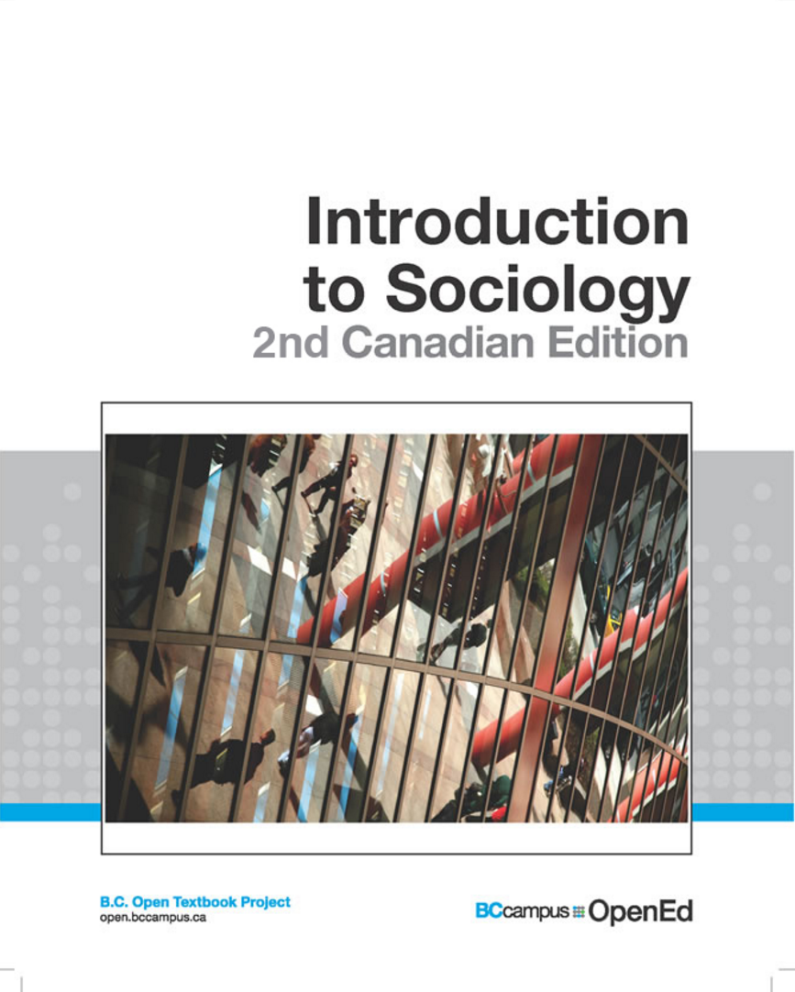
Localization

Slide 47

Localization

Slide 48

OER Enabled Pedagogy
https://pm4id.org/

Slide 49
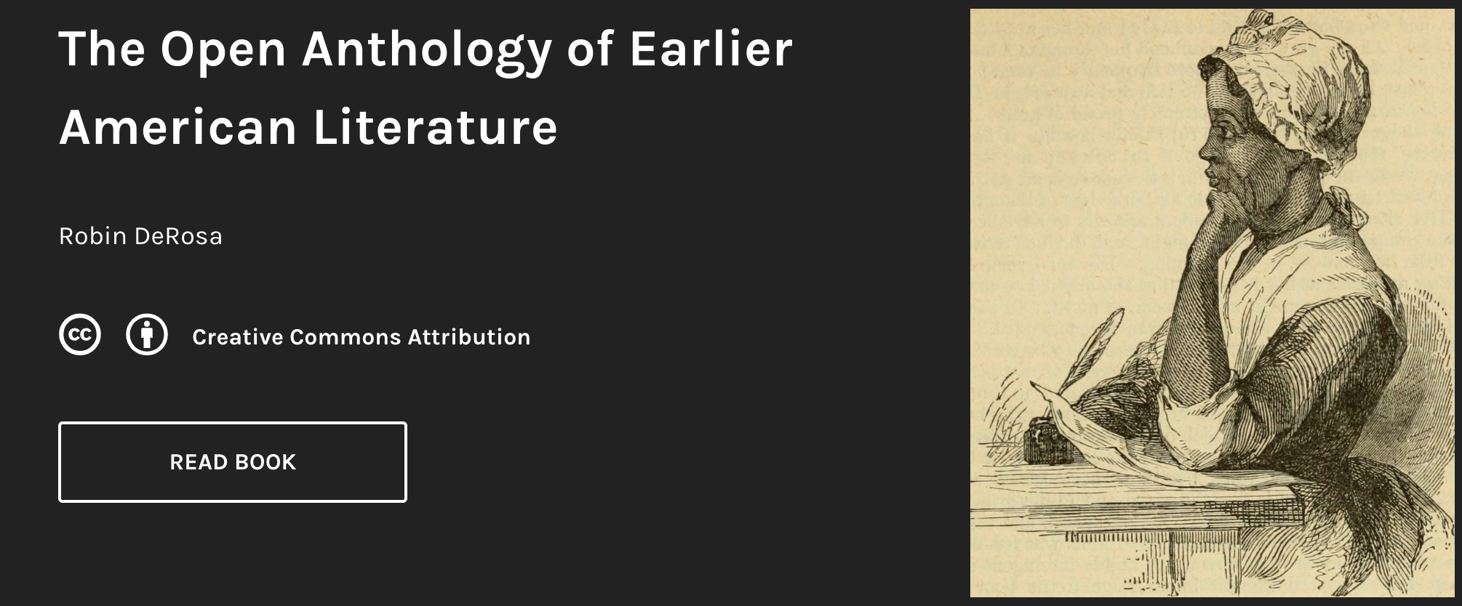
OER Enabled Pedagogy
https://openamlit.pressbooks.com/

Slide 50
What can we do?
Notes:
This is what they can do…

Slide 51
What can we do?
Take a look!
Write a review!
Adopt if a book meets the needs of you and your students
Raise awareness - talk with colleagues in your program and department
Notes:
This is what they can do…

Slide 52
Writing a Review
Is there is a textbook in the Open Textbook Library that fits your class and/or expertise?
Incentive will be paid for:
attending this workshop, and
reviewing a textbook in the Open Textbook Library
Notes:
To make it clear that they are eligible for the stipend only if they do both of these things. They can put a check next to #1…

Slide 53
Writing a Review
You will receive an email with a link to the online review form.
Complete a concise review by December 1, 2019.
The review [not anonymous!] will be posted on the Open Textbook Library under an open license.
Incentive will be paid.
Notes:
Here’s the review process. The due date – typically about 6 weeks after the workshop - should be discussed with your hosts before the workshop. Ask the faculty if the due date works for them.
Note that the review will have it’s own open license so we can share their wisdom with other open textbook projects. Note that if you over-emphasize this, some people could get cold feet. Tell them that it’s not a big deal. ☺

Slide 54
Open Textbook Library: open.umn.edu
These slides: http://poritz.net/j/share/OTNwsOct19
PueblOER Committee
Rhonda Gonzales, rhonda.gonzales@csupueblo.edu
Denise Henry, denise.henry@csupueblo.edu
Margie Massey, margie.massey@csupueblo.edu
Lona Oerther 👽, lona.oerther@csupueblo.edu
Adam Pocius, adam.pocius@csupueblo.edu
Jonathan Poritz 👽, jonathan.poritz@csuepueblo.edu, https://poritz.net/j, @poritzj
Leticia Steffen, leticia.steffen@csupueblo.edu
With friends
Isabel Soto-Luna 👽, isabel.sotoluna@csupueblo.edu
Alexis Wolstein 👽, alexis.wolstein@csupueblo.edu
[👽 means CDHE Open Ambassador, trained to give OTN-style workshops.]
This work, licensed under a Creative Commons Attribution 4.0 International License (CC BY 4.0), is an adaptation by Jonathan Poritz of CO - Faculty Workshop Master by David Ernst, which is also licensed CC BY 4.0.

