Slide 1

Two Faculty Journeys with
Open Educational Resources
Emily Ragan (Metropolitan State University of Denver)
Jonathan Poritz (Colorado State University-Pueblo)
This work is licensed under a Creative Commons Attribution-ShareAlike 4.0 International License.
Shareable versions can be found at poritz.net/j/share/index.html#WCU2FJwOER

Slide 2
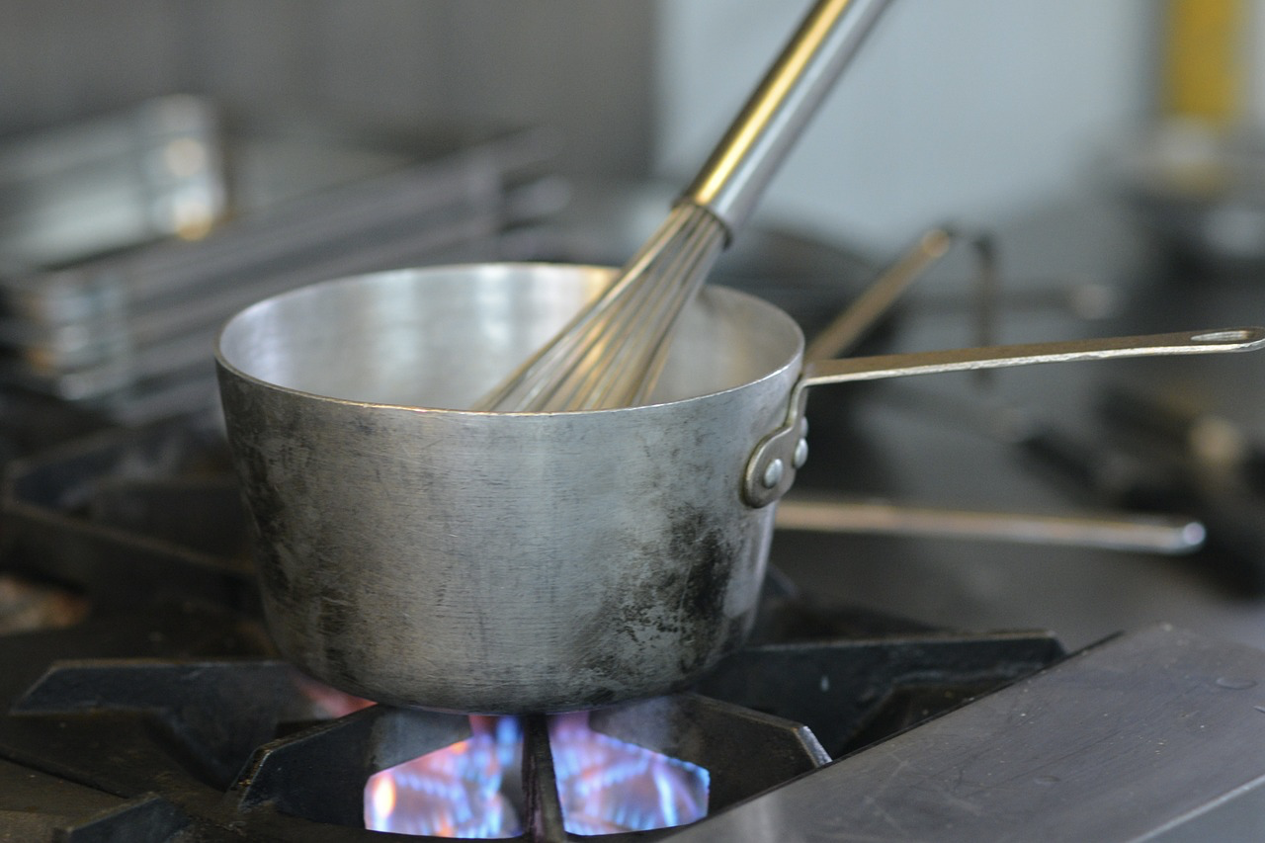
Emily’s path to OER use and advocacy
Notes:
Image by JaiMagazine from Pixabay

Slide 3
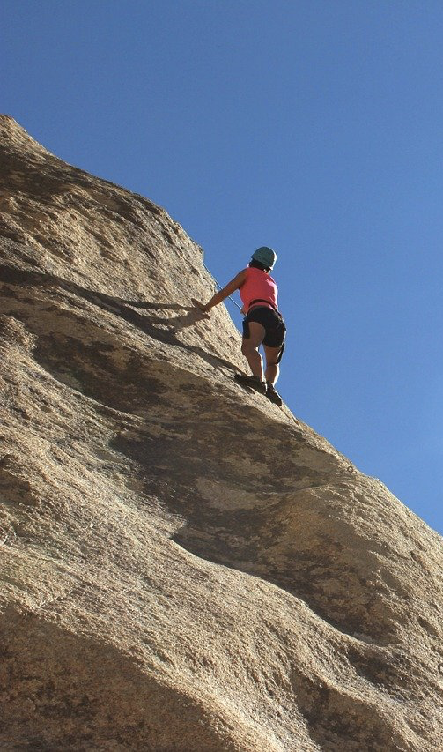
Challenges many instructors face
Need to cover a lot of content…rigorously!
Want students to
  Learn concepts
  Solve a wide spectrum of problems, not just memorize a set of steps
  Retain knowledge from earlier courses and be able to use it in future courses: learn it well
  Stop being scared and actually enjoy our field ☺
Notes:
https://pixabay.com/photos/climber-rock-wall-vertical-984380/

Slide 4
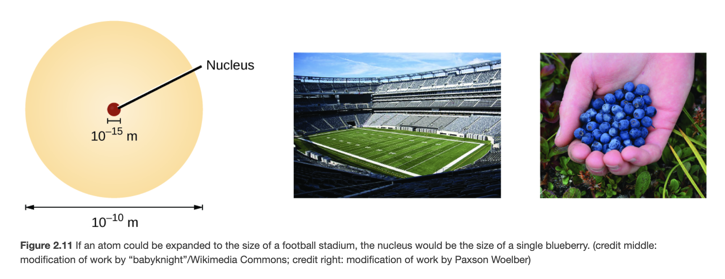
How do our resources help us with this?
Provide opportunities for students to engage with content
  Make connections to prior knowledge

Slide 5
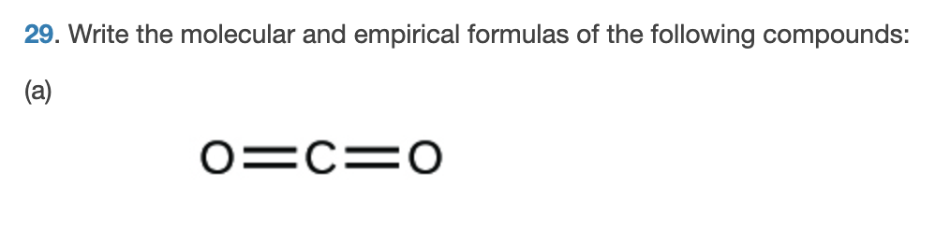
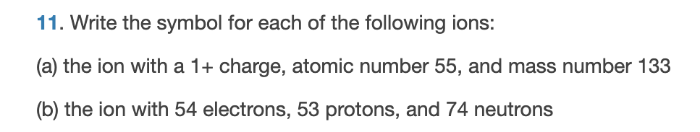
How do our resources help us with this?
Practice working problems

Slide 6
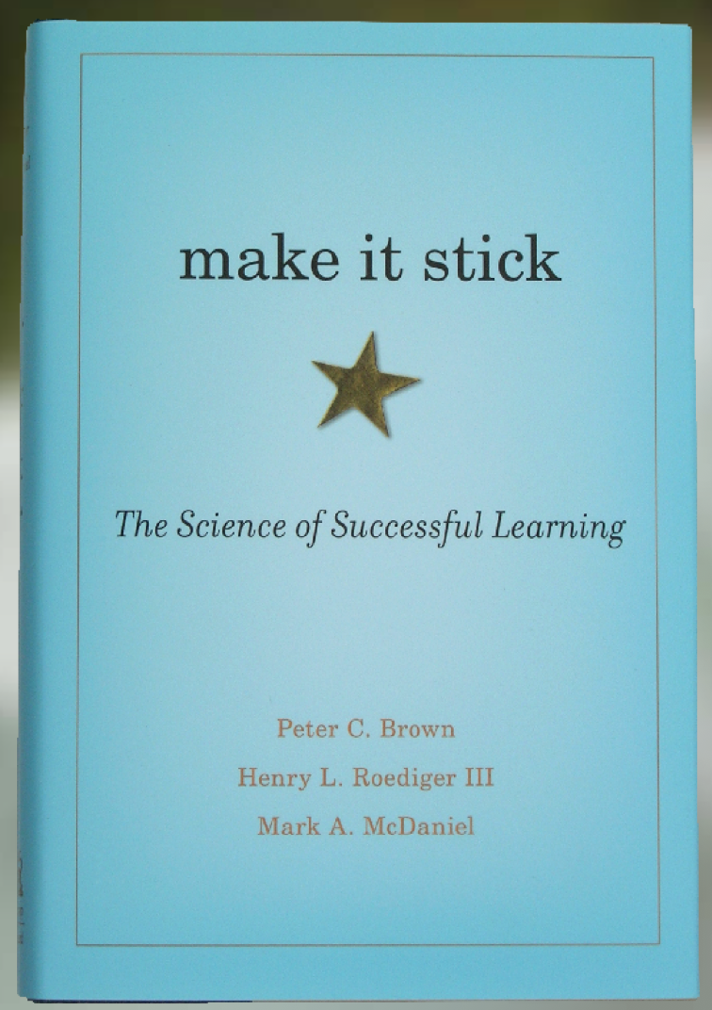
Important learning strategies that may or may not come with our resources
Practice retrieval (quizzing)
Reflection (what has been learned? What is working well for me?)
Generation (attempting to solve problems without being given answers at first)
Spaced repetition

Slide 7
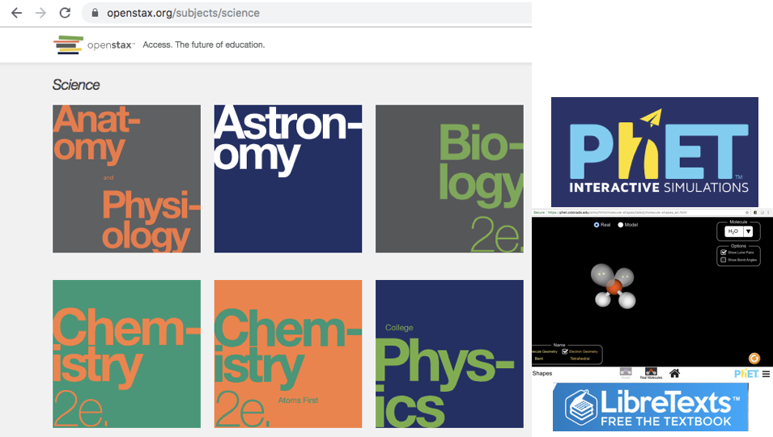

The importance of focusing on
learning objectives first,
resources second
Notes:
Image on left Image by Gerd Altmann from Pixabay
Image on right includes logos from the phet simulations

Slide 8
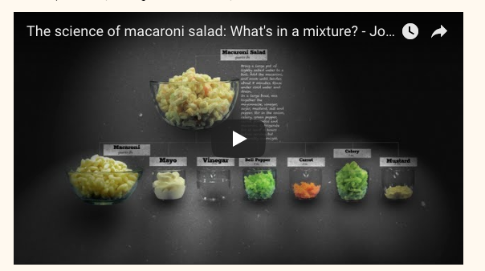
My chronological approach to developing this course:
Wrote learning objectives (so MANY objectives…) and decided on organization
Found fun images (ex. pixabay) or videos (ex. TedED videos) to capture student attention
Entered content and questions aligned with objectives in LMS

Slide 9
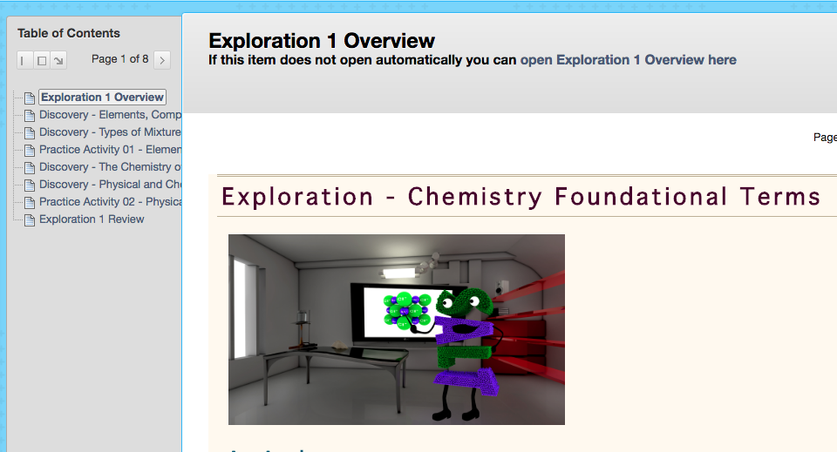
Online Gen Chem I Course structure
11 Areas of Inquiry
  Each Area has 2-4 “Explorations”
  The 34 Exploration sections have content sections and “practice activities” (low-stakes assessments, unlimited attempts, 3 points/ea.)

Slide 10

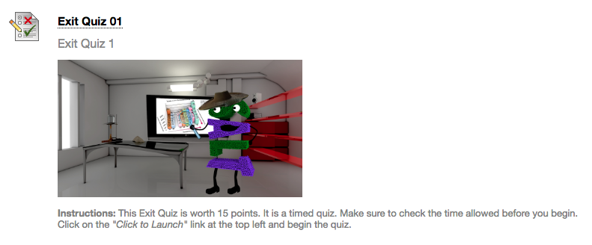
Content followed by questions
Each Exploration ends with a 15 point exit quiz (34 total)
Two midterms and a final (100 points each)
Group discussion posts weekly (10 points each)

Slide 11
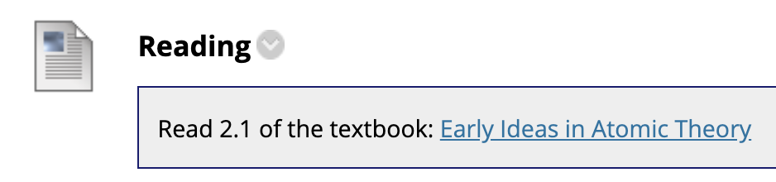
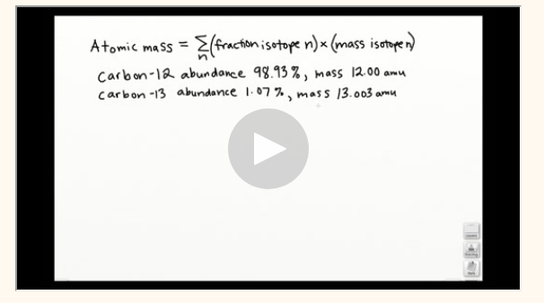
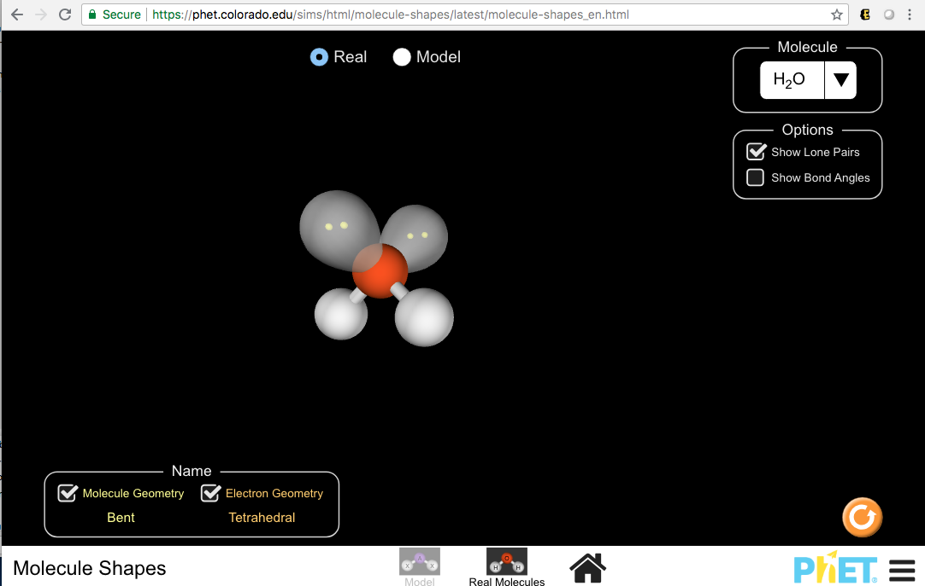
My chronological approach to developing this course:
Integrated OpenStax Chemistry
Recorded videos
Added PhET simulations and reflection questions for discussion posts

Slide 12

What do students think about the course and its resources?
Student responses to an optional survey administered through our LMS (Blackboard)

Slide 13
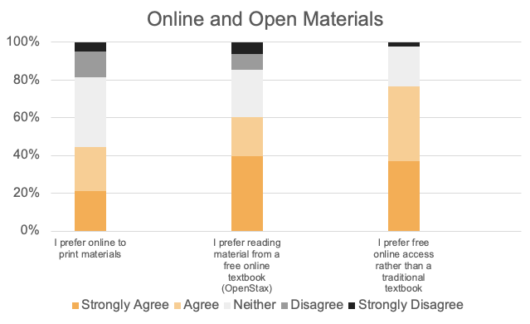
Notes:
While only 45% of students preferred online materials, 75% preferred free access over a traditional textbook
In SRI comments one student mentioned how much they appreciated being able to get a print copy of the book

Slide 14
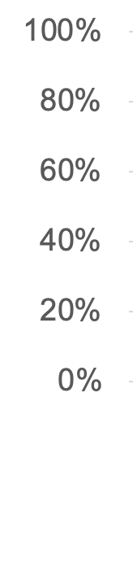
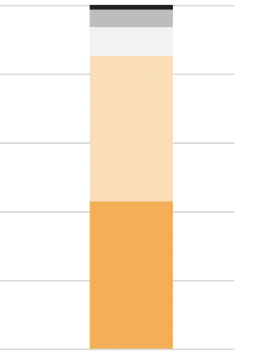
Student responses about course design and materials
“The videos for the math problems always helped.”
“The plethora of exercises, videos, simulations, and discussions really got me engaged in learning.”
The course materials help me achieve the learning objectives
Notes:
85% of students agreed that the course materials helped them achieve the course learning objectives

Slide 15

DIY Online Homework System
Created my own online homework/quiz/exam system in our LMS (Blackboard)
Advantages:
  Gave me a lot of control over content and alignment of questions with my learning objectives
  No additional cost to students
  No additional system to navigate
Disadvantages:
  Took a lot of time
  Requires troubleshooting
  Giving adequate feedback is hard

Slide 16
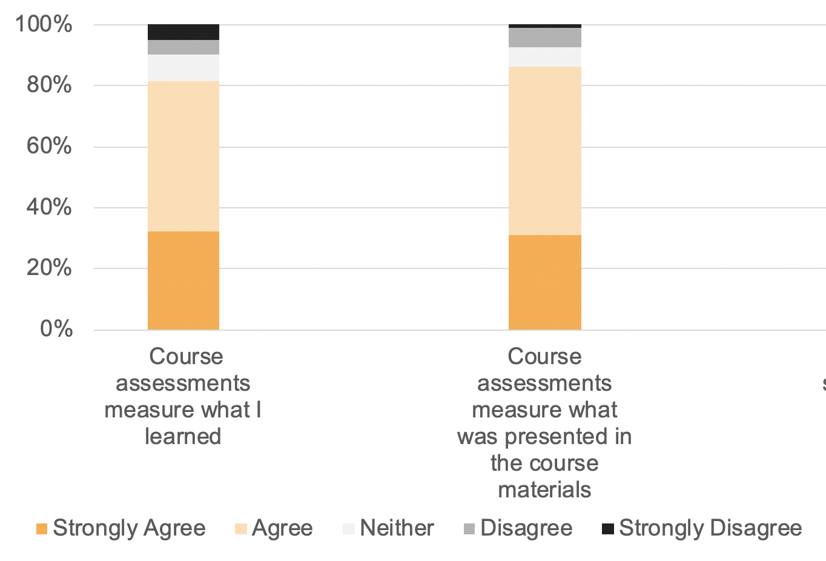

Student responses about course design and materials
“I like the practice activities within each exploration. The questions are similar to the exit quizzes and help me to understand what you want me to take away from the activity.”
“Practices should show the correct answer. ”
“Quizzes seem to throw twists on the exercises. You either know it or you don't. I have had some don'ts.”

Slide 17
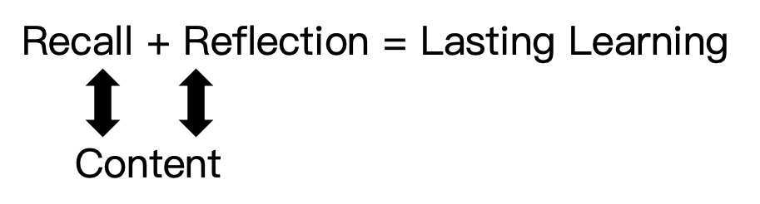
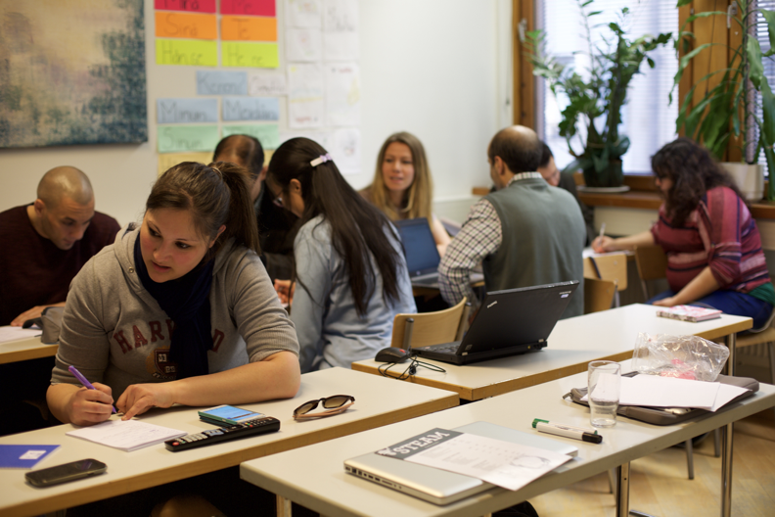
Notes:
Image by Tania Rodriguez from Pixabay

Slide 18
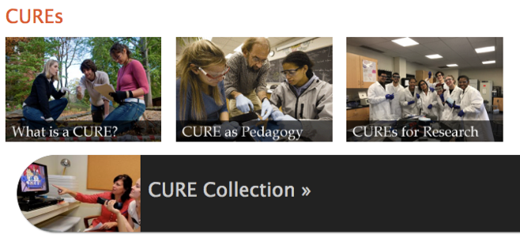
Creating and sharing an innovative module in Biochemistry II
•https://serc.carleton.edu/curenet/index.html

Slide 19
Course-based Undergraduate Research Experiences (CUREs)
Students engage in research during a course so that more students have exposure to research experiences
The work must be on a real scientific problem with the potential to make discoveries that are of interest to the scientific community
Progress is iterative, involving repetition and trouble-shooting
The results are communicated back to stakeholders

Slide 20
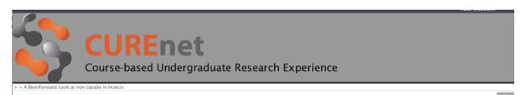

https://serc.carleton.edu/curenet/institutes/boulder/examples/207018.html
This item is offered under a Creative Commons Attribution-NonCommercial-ShareAlike license http://creativecommons.org/licenses/by-nc-sa/3.0/ You may reuse this item for non-commercial purposes as long as you provide attribution and offer any derivative works under a similar license.

Slide 21
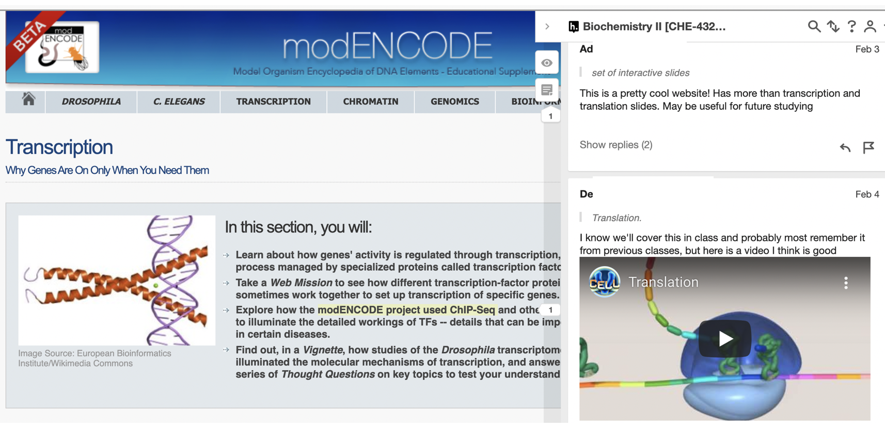
Using hypothes.is in class

Slide 22
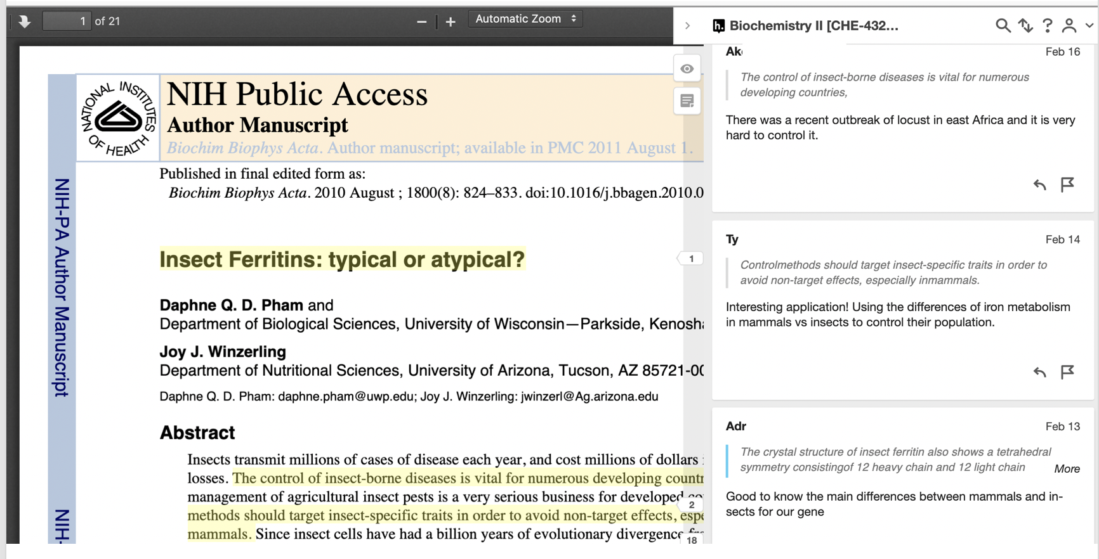
Using hypothes.is in class

Slide 23

Agency
Notes:
Image by John Hain from https://pixabay.com/illustrations/fist-liberate-change-freedom-681848/

Slide 24
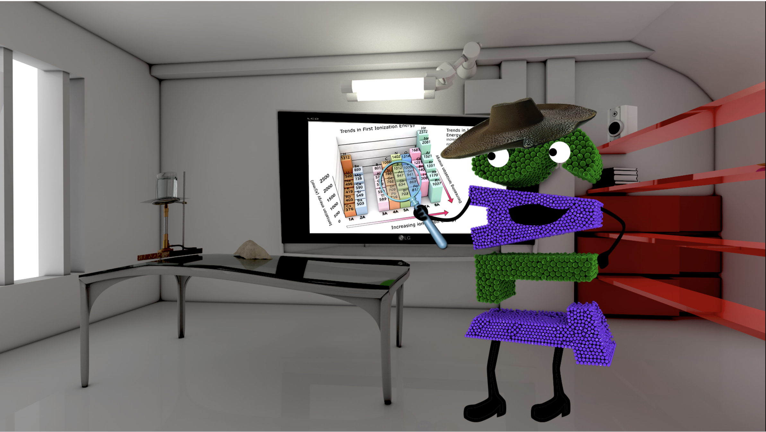
Creativity

Slide 25
Jonathan’s path to OER use and advocacy
CSU-Pueblo Math 419, Number Theory, spring 2012: Student-written textbook, using MediaWiki & MathJax, because of poor departmental scheduling.
CSU-Pueblo Math 242, MATLAB Computation, spring 2014: Students use Linux, Octave, other FLOSS tools, because they’re just better; early JITERs.
CSU-Pueblo Math 319, Number Theory, spring 2014: OER creation [“YAINTT”], usually a week ahead of the class, because how hard could it be?
CSU-Pueblo Math 319, Number Theory, spring 2015: OER creation [“YAINTT, v2.0”], because this should just be polishing by now, right?
CSU-Pueblo Math 411, Introduction to Topology, summer 2015: use and some creation of OER, because this is in my blood, I’m not giving up control to a textbook.
CSU-Pueblo Math 156, Introduction to Statistics, Fall 2016 (one online, one in-person): use of existing OER with my supplements, because of the cost of the commercial book.
Reykjavík U. T-[7,8]50-CYCR, Cryptocurrencies, Winter 2016: full-on JITER creation.
CSU-Pueblo Math 156, Introduction to Statistics, Spring 2017 (two sections): OER creation [“LDLoS”], because this must just be polishing, this time, right?

Slide 26
CSUP Math 419, Number Theory, Spring 2012
I was assigned to this quite advanced class [but required of teacher-ed math majors!] at the last minute. The bookstore had already ordered, and some (but not all) students had purchased A Friendly Introduction to Number Theory, by Joseph H. Silverman -- a perfectly nice book. But it cost around $180, the first two chapters are available on the author’s website, and I didn’t want to cover much in later chapters.
So I spun up a MediaWiki instance on my website -- poritz.net/jonathan; it helps to own your own name on the Internet -- and assigned the students in rotating, carefully chosen pairs, to take notes each week and to write them up on that wiki.

Slide 27
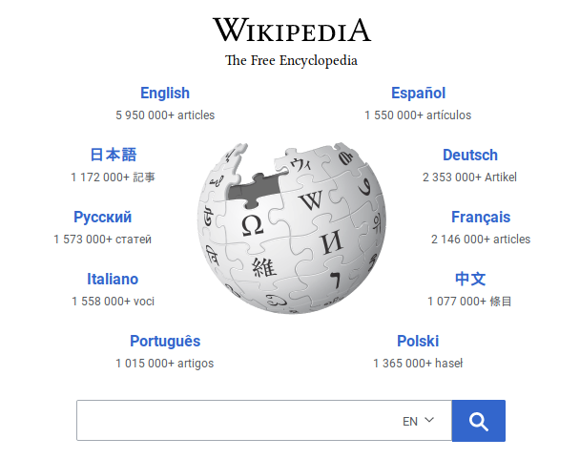
What is MediaWiki?
It’s the FLOSS[=”Free/libre/ open-source software”] behind the 8th most popular website on the planet.
Administering it was of moderate difficulty in 2012, but today [e.g., on the site reclaimhosting.com] is mostly just point-and-click.

Slide 28
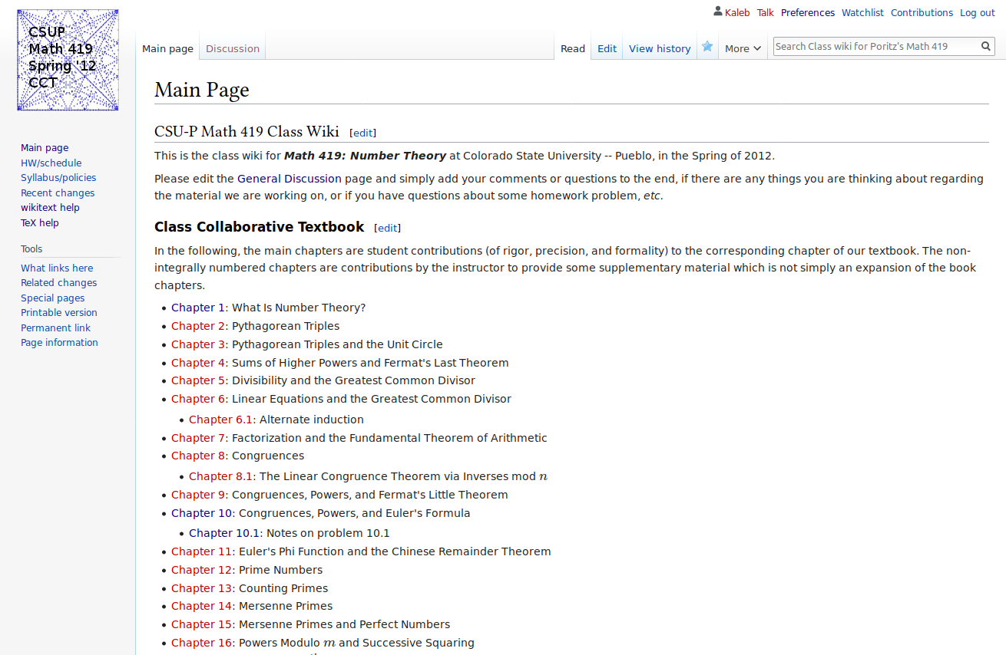
Front page of
Math 419
Class
Collaborative Textbook

Slide 29
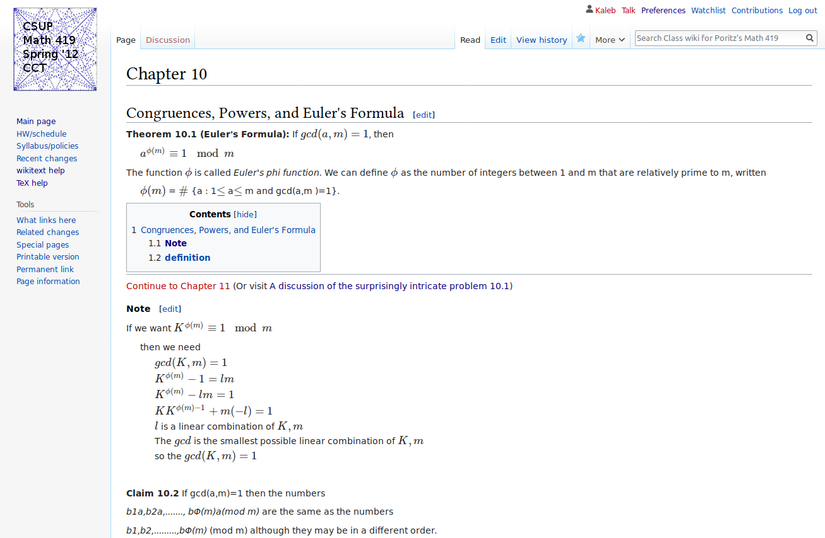
Chapter 10 [by students]
of
Math 419
Class
Collaborative Textbook

Slide 30
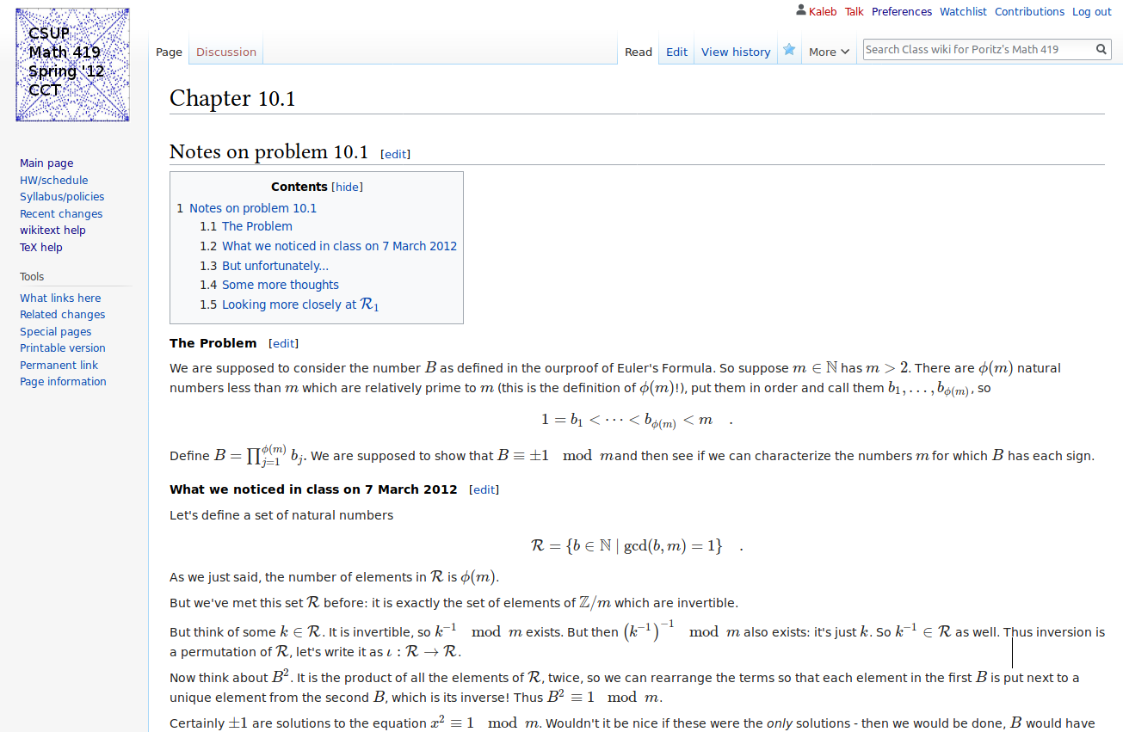
Chapter 10.1 [by JP] of
Math 419
Class
Collaborative Textbook

Slide 31
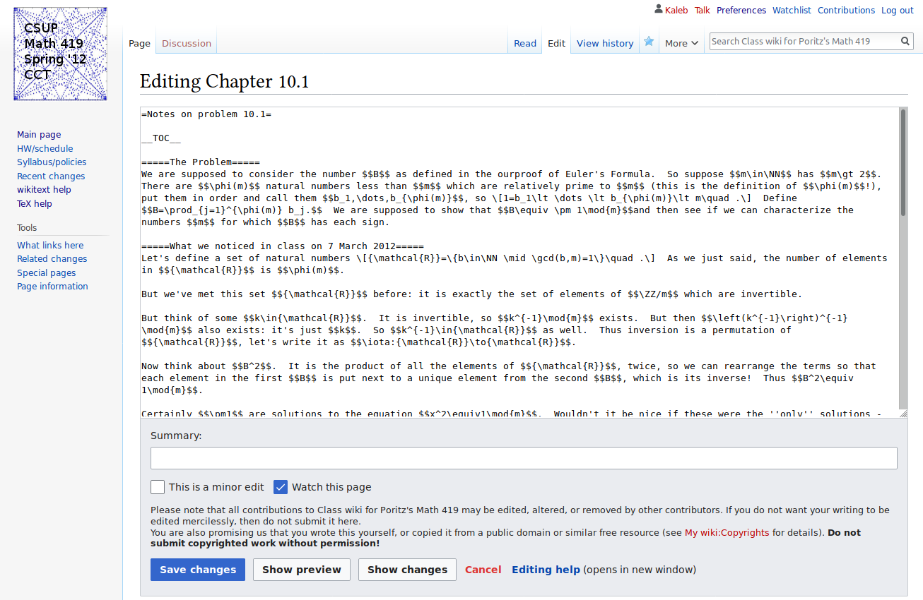
Chapter 10.1, editing, of
Math 419
Class
Collaborative Textbook
Looks just like editing Wikipedia, obviously.

Slide 32
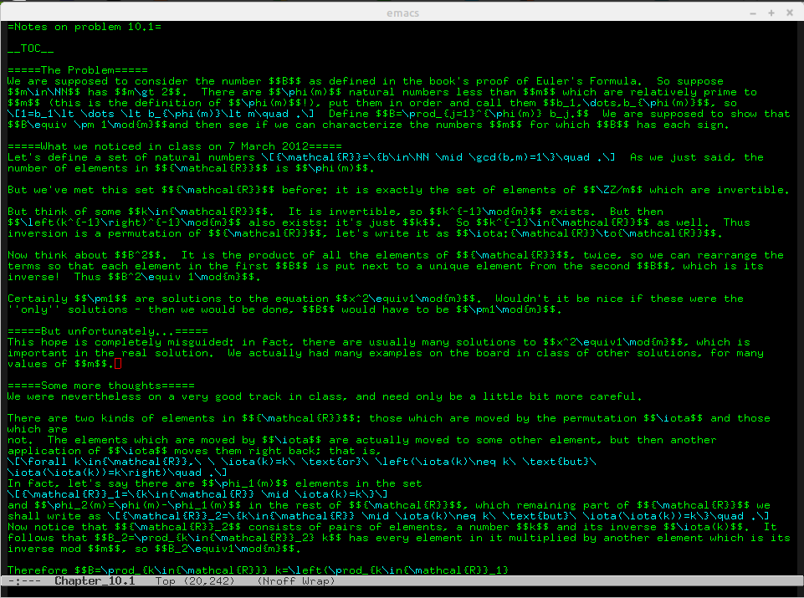
Chapter 10.1, editing, hacker’s view, of
Math 419
Class
Collaborative Textbook
Maybe not exactly like Wikipedia editing... because of LaTeX

Slide 33
MediaWiki with MathJax uses both wikitext and LaTeX, two markup languages.
wikitext: to put something in italics, do ‘’something’’; links are [URL text], etc.
There’s not much to it (most common markup fits on a one-page cheat sheet), and wiki editing is a valuable life skill, why not learn it here and now?
LaTeX: for equations, enclose bits of text in $’s, e.g.: $e^{i\pi}=-1$ makes e^{i𝞹} = -1
All mathematicians, computer scientists, and physicists use LaTeX, why not learn it here and now?
HTML is also a markup language (HTML=”Hypertext Markup Language”, in fact), so learning wikitext and LaTeX will help build towards web literacy…
My colleagues said the students would never be able to do it, but there was literally not a single complaint from the students about the technology.

Slide 34
CSUP Math 242, MATLAB Computation, Spring 2014
Two aspects of this course, the software environment and the text[s], etc., were OER -- remember OER is not all text!
Software: Rather than use the commercial (expensive) MATLAB running on lab Windoze PCs, students booted Linux, a FLOSS operating system, from thumb drives and Octave, a FLOSS alternative [superset] of MATLAB.
A majority of (silicon) CPUs on the planet use Linux and FLOSS, why not learn about them here and now? ..Also, FLOSS is to commercial software exactly as OER are commercial texts, so why wouldn’t we use FLOSS alternatives?
Text[s]: all OER, of a form I am calling JITERs [for Just-In-Time-Educational- Resources] … the subject of a talk I gave at OpenEd19….

Slide 35
CSUP Math 319, Number Theory, Spring 2014
Note the course was demoted in the intervening two years (400→300).
The material was easier, I was used to writing myself detailed class notes, I’m very comfortable in LaTeX, why not put the notes together into chapters? I tried to stay a week ahead of where the students were and usually (mostly?) succeeded.
This turns out to be a lot of work.
But the students appreciated it, and the book Yet Another Introductory Number Theory Textbook [YAINTT] had all those famous advantages of OER. Mostly, it covered exactly what I wanted it to cover, how I wanted that covered....

Slide 36
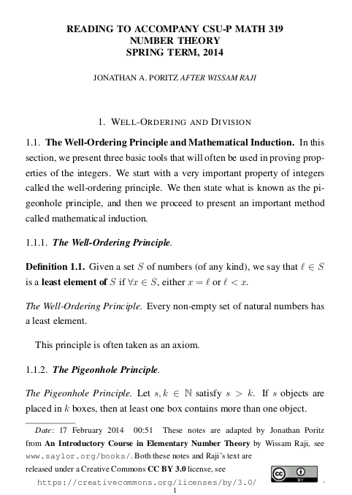
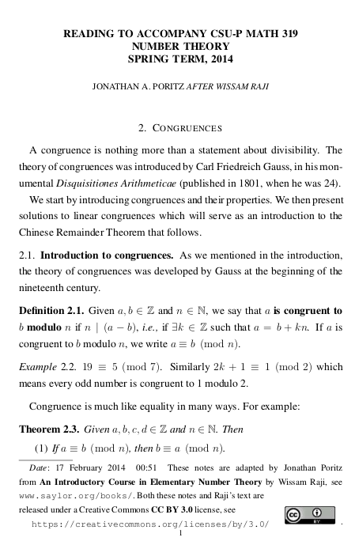
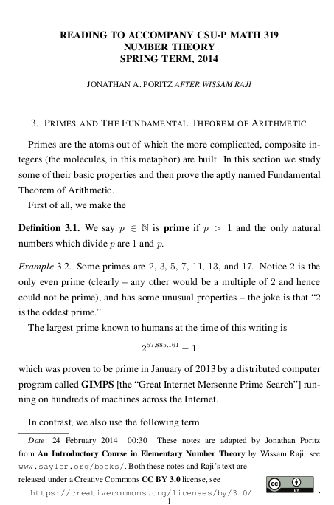

Slide 37
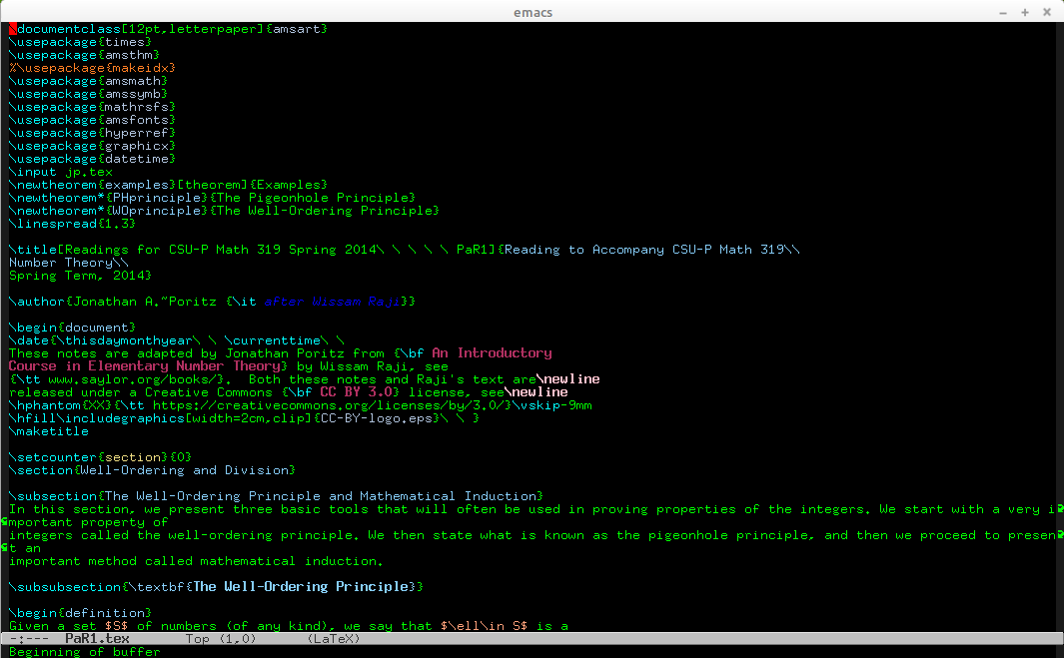

Slide 38

CSUP Math 319, Number Theory, Spring 2015
I had done this before, I had much of the material, surely I could make a good- looking book, rather than a bunch of disjointed chapters (“readings”).
While I was at it, I could include a lot of new material: the applications of number theory to cryptology that I really wanted to teach.
The goal was Yet Another Introductary Number Theory Textbook, v2.0: Cryptology Emphasis Version.
It still turned out to be a lot of work.

Slide 39
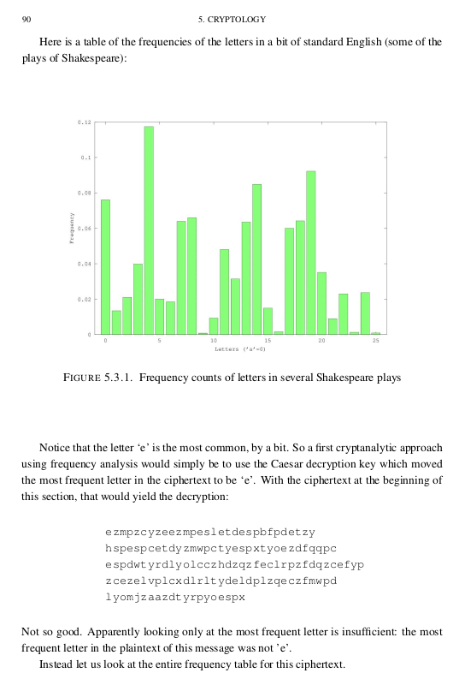
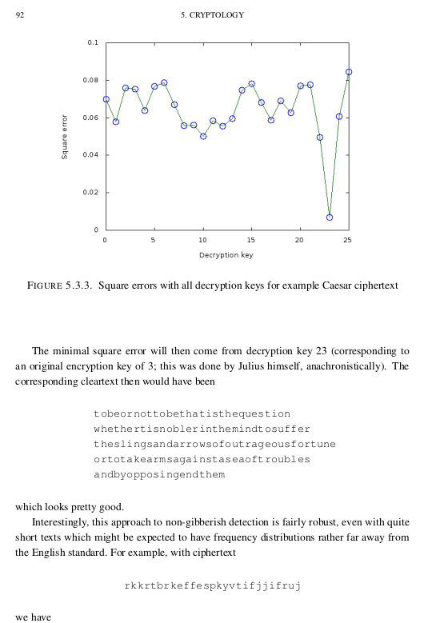
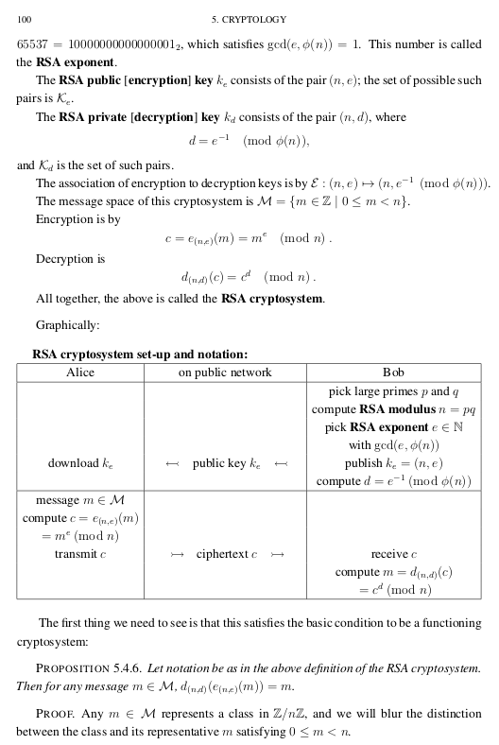

Slide 40
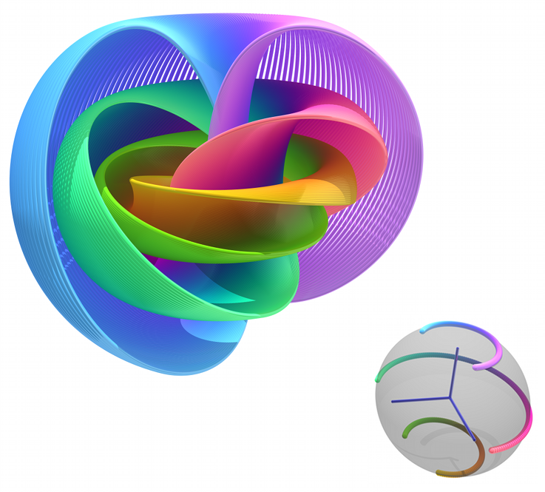
CSUP Math 411, Intro. to Topology, Summer 2015
Topology was always my first love, it’s why I became a mathematician, it’s part of me.
Surely I could teach it entirely without a book … maybe creating notes when it would help the students and finding resources on the Internet.
To use someone else’s book would be an insult to my topologist’s heart.
The educational resources I used were all JITERs.
Hopf Fibration, by Niles Johnson, from Wikimedia Commons, was released under a Creative Commons Attribution-Share Alike 3.0 Unported license.

Slide 41
CSUP Math 156, Intro. to Statistics, Fall 2016
This time, for the first time, I was in large part motivated by the cost of the commercial textbook I had always unquestioningly used.
I mostly assigned students to read bits out of a book from the Saylor Academy I found on the Open Textbook Library, plus lots of additional material - simplifications, alternate explanations, etc. - I wrote, mostly in the form of LaTeX on my website.
It was only a tiny amount more effort to use this resource plus my web pages of explanation, than it had been to use the commercial textbook.
There was a surprisingly low success rate in the online section, which might have partly been because the students had not spent the money on an expensive textbook and so had less to lose by failing…?

Slide 42
Reykjavik U. T-[7,8]50-CYCR, Crypto., Winter 2016
Very intense experience of all JITERs and FLOSS.
Didn’t see the sun in four weeks. The rain was often horizontal.
Never tried the fermented shark, which a student of mine told me was not made with urine as an ingredient -- it’s just that the flesh of those sharks has naturally occurring urea, so it does smell like piss.
Don’t get me wrong, I’d go back in a minute!
Computer science is so much fun to teach: it’s all exploration, curiosity, collaboration, students going to the web for bits of code and libraries - stackoverflow.com, etc. It’s a shame math can’t be taught this way… maybe?

Slide 43
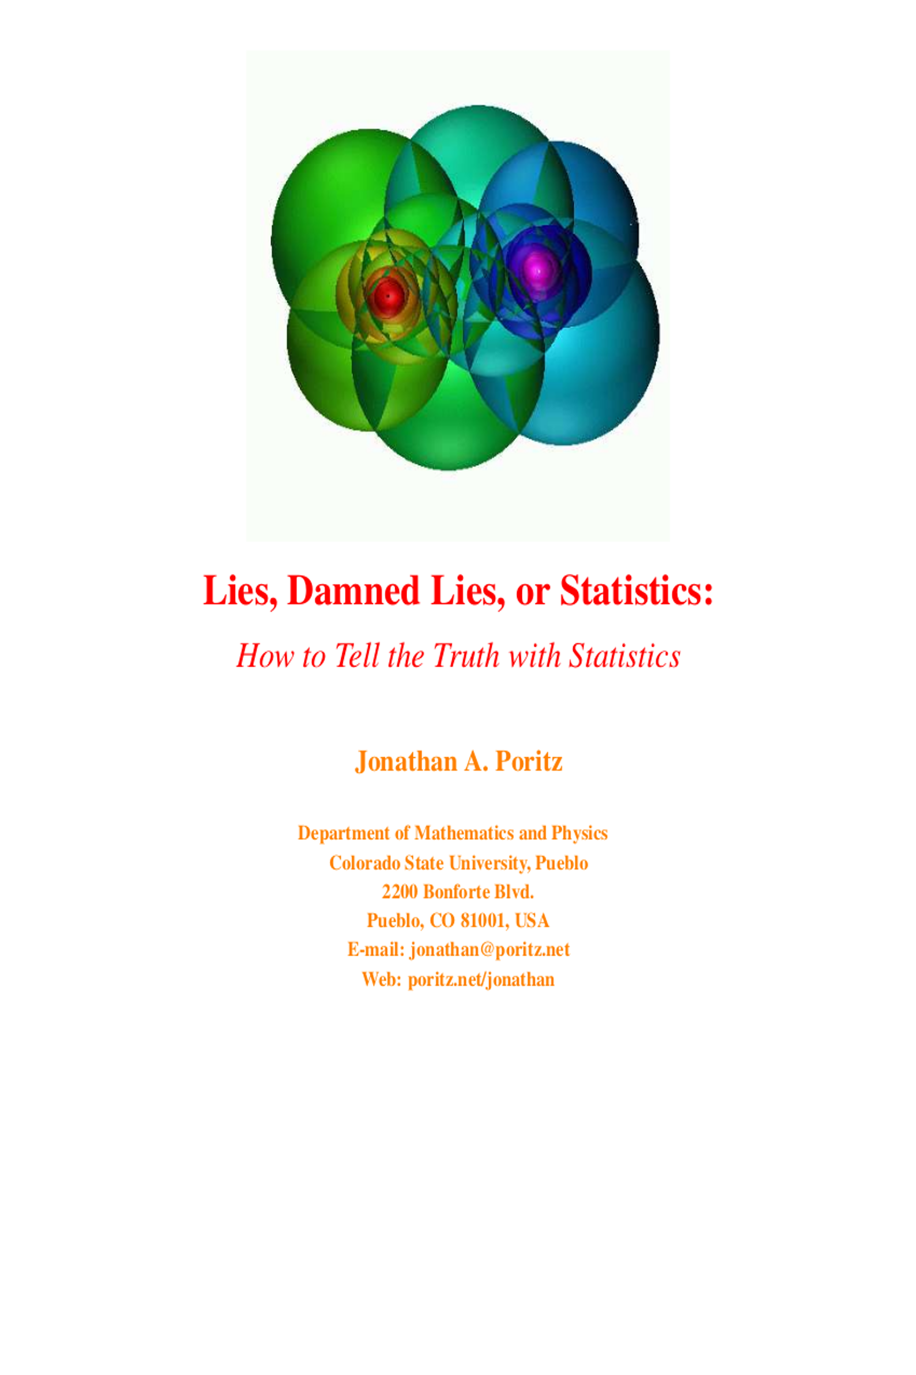
CSUP Math 156, Intro. to Statistics, Spring 2017
Much like my second go ‘round with number theory, I felt that I had done this before and surely could make a good-looking book that covered what I wanted, from the perspective I wanted.
The result was Lies, Damned Lies, or Statistics: How to Tell the Truth with Statistics.
It still turned out to be a lot of work.

Slide 44
I’ve (mostly) ported LDLoS to PressBooks recently, where it will be easier to modify.
An easy thing to do with an OER statistics textbook, as I did once with LDLoS and could do again in the future, is to make new, topical problems every time it is used. This would prevent student cheating (e.g., with chegg.com), and promote student engagement.
I don’t know that I will ever do that, because I want, the next time I teach statistics, to do a more personalized, exploratory [IBL] version, which needs either extensive JITER support, or else a very concise textbook with terse summaries of definitions, theorems, algorithms, etc., plus scaffolding for student projects and exploration.
◼

Slide 45

Benefits of a state-wide initiative

Slide 46
Lessons/Generalizations… Emily
Serving on the State OER council helped me realize:
Impact cost of materials has on student achievement
The importance of building relationships and teams
A little interest and support from the state can enhance the interest of the University administration

Slide 47
Lessons/Generalizations … Jonathan
It seems like two overarching themes characterize my involvement in OER:
Technology issues: comfort with things like running server software, preferring markup languages to WYSIWYG interfaces, the command-line interface to point-and-click, etc. (i.e., general geekiness)
A certain monomania on the topic of autonomy, agency, and academic freedom for myself and my students. Hence FLOSS and OER.
The AAUP’s 1940 Statement of Principles on Academic Freedom and Tenure, where academic freedom is explained and justified, says
“Institutions of higher education are conducted for the common good and not to further the interest of either the individual teacher or the institution as a whole. The common good depends upon the free search for truth and its free exposition.”
Notes:
Mention how Polis challenged institutions of higher ed in Colorado to switch to FLOSS, as he was encouraging us to use OER, at our 31 May 2019 conference.

Slide 48
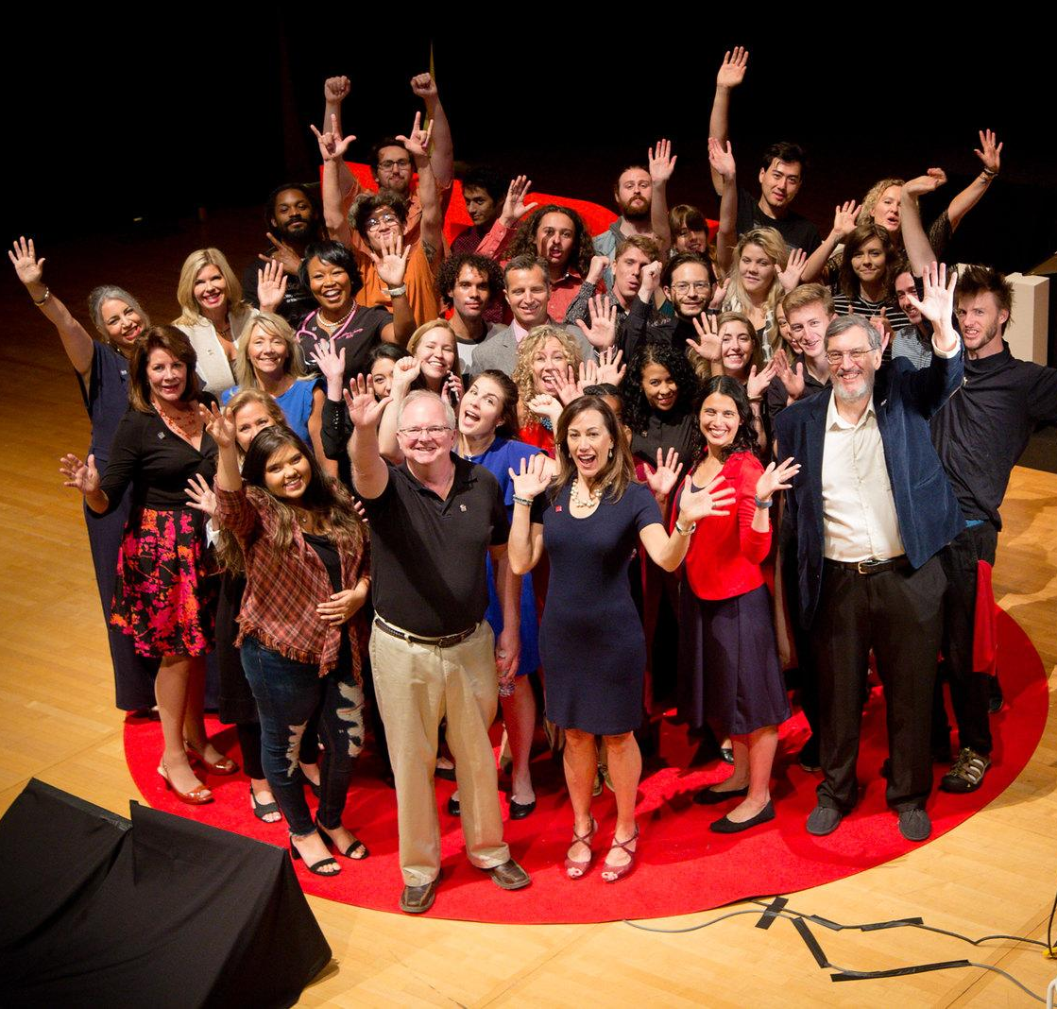
Call to action...Emily
Find your intrinsic motivation
Engage students
Enjoy teaching
Look for opportunities to share stories
https://www.ted.com/talks/emily_ragan_lasting_learning_in_an_age_of_abundant_information

Slide 49
Call to action...Jonathan
Faculty can self-educate about the tools -- we needn’t accept the suppression of autonomy and agency of nonfree software (LMSes, commercial OSes and environments, online walled gardens), we can take the time to learn how to use free software, it gives us and our students autonomy and agency.
A certain obstinacy about academic freedom, along with a bit of humane arrogance about who has the expertise, can drive us away from nonfree tools, platforms, and non-open educational resources, to a better future.

Slide 50
Questions/Comments/Contact Info:
Emily Ragan:
Email: eragan@msudenver.edu
Twitter: @eragan7
Jonathan Poritz:
Web: https://poritz.net/jonathan
Email: jonathan@poritz.net
Twitter: @poritzj

